Slide 1
VM Selection for Financial Exchanges in the Cloud
Master Thesis Final Presentation
Student: Daniel Duclos-Cavalcanti
Supervisors: Muhammad Haseeb (NYU), Navidreza Asadi (TUM)
Notes:
10 Min. Presentation

Slide 2

Background: Financial Exchanges and the Cloud
What is a Financial Exchange?
Migration: on-premise => public cloud
Cloud Medium: i) High Variance ii) Mechanisms for fair delivery
Stock/Currency/Futures Exchange
Buyers
Sellers
Market Data
Exchange Infrastructure
Fairness!
Notes:
What Are Financial Exchanges?
Place that connects Buyers and Sellers to exchange goods
Allows for what is called price discovery, an iterative process to find an asset’s true price.
Status Quo:
Exchanges run on highly-engineered infrastructures composed of on-premise data centers
A fundamental requirement for this service is what is called “Fairness”.
MPs receive market data or updates on the market simultaneously to ensure a balanced and fair playing field.
Migration to cloud:
There is an incentive from the industry to move the current on-prem infrastructure to the public cloud as it:
Promises: Scalability, Cost-Efficiency, More Robust Infrastructure, Rapid Increase in MPs
CLOUD SHIFT ISSUES:
has varying network latencies: market unfairness
network conditions that change daily
limited control over underlying infrastructure
no mechanisms for fair delivery

Slide 3
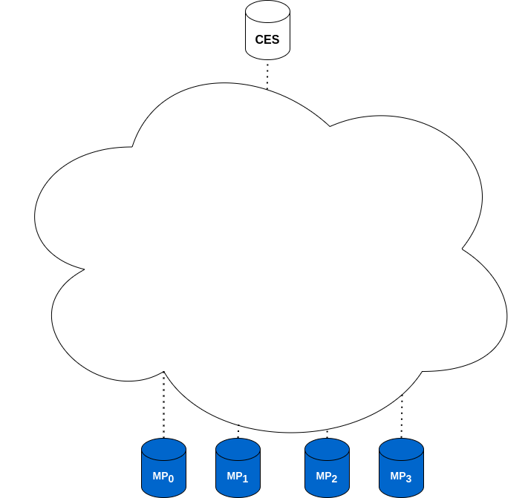
State-of-the-Art: Jasper¹: Scalable Exchange in the Cloud
Scalable, Fair, and Performant Multicast
Market Data Dissemination
¹Jasper: https://arxiv.org/abs/2402.09527
¹Jasper: https://arxiv.org/abs/2402.09527, https://sigcomm24posterdemo.hotcrp.com/paper/
²Hyugens: https://www.usenix.org/system/files/conference/nsdi18/nsdi18-geng.pdf
Notes:
Jasper:
is the latest effort to address the obstacles in this cloud migration, work from PhD Muhammad Haseeb
offers a scalable, fair and performant multicast solution for the dissemination of data in the context of a cloud-based exchange.
to achieve this, a group of different techniques are applied.
Techniques:
Overlay Multicast Tree to overcome serial DU across recipients
Clock-Synchronization:
compensates for noisy conditions in the cloud
common clock across cluster allows precise global timestamps
Hyugens 10s/100s ns, Jasper is working at 100us
Hedging
Decreases latency variance (spatially)
Hold And Release
Deadline mechanism based on global timestamps
Receivers takes the 95th percentile their OWD records at regular intervals and sends the results back to the sender using an all-reduce mechanism.
The sender calculates the maximum of these OWDs called Global OWD for messages using the gathered statistics: OWDG = maxi(OWDi) where OWDi is the OWD estimate reported by the 𝑖-th multicast receiver.
Opportunity:
Nodes are running on top of VMs on the cloud.
“Stragglers” or under-performing VMs.
instances of identical configurations, that however underperform compared to their counterparts.
Virtualization Overhead: Context Switching among VMs, memory overhead, I/O Virtualization
Network Congestion
Noisy Neighbors
Straggler VMs can potentially affect Jasper’s performance (children)
Straggler VMs affect deadline calculations

Slide 4
State-of-the-Art: Jasper¹: Scalable Exchange in the Cloud
Scalable, Fair, and Performant Multicast
Market Data Dissemination
Techniques:
¹Jasper: https://arxiv.org/abs/2402.09527
¹Jasper: https://arxiv.org/abs/2402.09527, https://sigcomm24posterdemo.hotcrp.com/paper/
²Hyugens: https://www.usenix.org/system/files/conference/nsdi18/nsdi18-geng.pdf
Notes:
Jasper:
is the latest effort to address the obstacles in this cloud migration
offers a scalable, fair and performant multicast solution for the dissemination of data in the context of a cloud-based exchange.
to achieve this, a group of different techniques are applied.
Techniques:
Overlay Multicast Tree to overcome serial DU across recipients
Clock-Synchronization:
compensates for noisy conditions in the cloud
common clock across cluster allows precise global timestamps
Hyugens 10s/100s ns, Jasper is working at 100us
Hedging
Decreases latency variance (spatially)
Hold And Release
Deadline mechanism based on global timestamps
Receivers takes the 95th percentile their OWD records at regular intervals and sends the results back to the sender using an all-reduce mechanism.
The sender calculates the maximum of these OWDs called Global OWD for messages using the gathered statistics: OWDG = maxi(OWDi) where OWDi is the OWD estimate reported by the 𝑖-th multicast receiver.
Opportunity:
Nodes are running on top of VMs on the cloud.
“Stragglers” or under-performing VMs.
instances of identical configurations, that however underperform compared to their counterparts.
Virtualization Overhead: Context Switching among VMs, memory overhead, I/O Virtualization
Network Congestion
Noisy Neighbors
Straggler VMs can potentially affect Jasper’s performance (children)
Straggler VMs affect deadline calculations

Slide 5
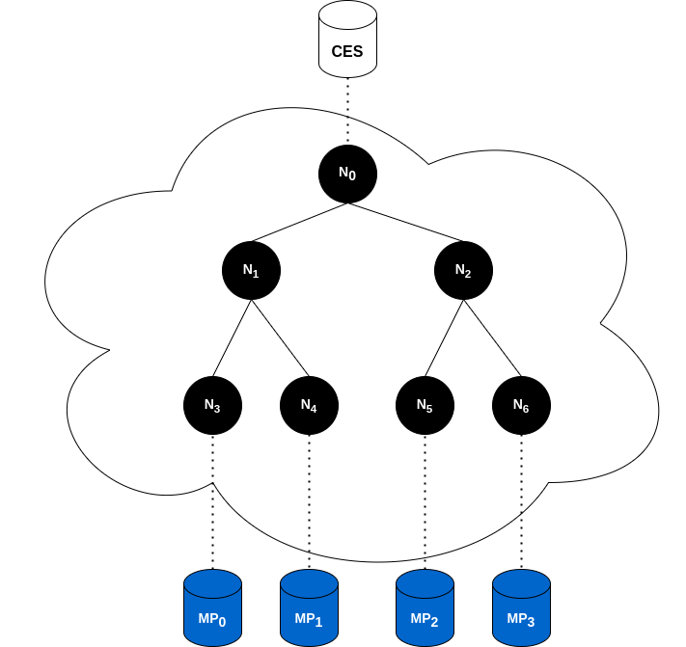
State-of-the-Art: Jasper¹: Scalable Exchange in the Cloud
Scalable, Fair, and Performant Multicast
Market Data Dissemination
Techniques:
Overlay Multicast Tree
¹Jasper: https://arxiv.org/abs/2402.09527
¹Jasper: https://arxiv.org/abs/2402.09527, https://sigcomm24posterdemo.hotcrp.com/paper/
²Hyugens: https://www.usenix.org/system/files/conference/nsdi18/nsdi18-geng.pdf
Notes:
Jasper:
is the latest effort to address the obstacles in this cloud migration
offers a scalable, fair and performant multicast solution for the dissemination of data in the context of a cloud-based exchange.
to achieve this, a group of different techniques are applied.
Techniques:
Overlay Multicast Tree to overcome serial DU across recipients
Clock-Synchronization:
compensates for noisy conditions in the cloud
common clock across cluster allows precise global timestamps
Hyugens 10s/100s ns, Jasper is working at 100us
Hedging
Decreases latency variance (spatially)
Hold And Release
Deadline mechanism based on global timestamps
Receivers takes the 95th percentile their OWD records at regular intervals and sends the results back to the sender using an all-reduce mechanism.
The sender calculates the maximum of these OWDs called Global OWD for messages using the gathered statistics: OWDG = maxi(OWDi) where OWDi is the OWD estimate reported by the 𝑖-th multicast receiver.
Opportunity:
Nodes are running on top of VMs on the cloud.
“Stragglers” or under-performing VMs.
instances of identical configurations, that however underperform compared to their counterparts.
Virtualization Overhead: Context Switching among VMs, memory overhead, I/O Virtualization
Network Congestion
Noisy Neighbors
Straggler VMs can potentially affect Jasper’s performance (children)
Straggler VMs affect deadline calculations

Slide 6
State-of-the-Art: Jasper¹: Scalable Exchange in the Cloud
Scalable, Fair, and Performant Multicast
Market Data Dissemination
Techniques:
Overlay Multicast Tree
Clock-Synchronization²
¹Jasper: https://arxiv.org/abs/2402.09527
¹Jasper: https://arxiv.org/abs/2402.09527, https://sigcomm24posterdemo.hotcrp.com/paper/
²Hyugens: https://www.usenix.org/system/files/conference/nsdi18/nsdi18-geng.pdf
Notes:
Jasper:
is the latest effort to address the obstacles in this cloud migration
offers a scalable, fair and performant multicast solution for the dissemination of data in the context of a cloud-based exchange.
to achieve this, a group of different techniques are applied.
Techniques:
Overlay Multicast Tree to overcome serial DU across recipients
Clock-Synchronization:
compensates for noisy conditions in the cloud
common clock across cluster allows precise global timestamps
Hyugens 10s/100s ns, Jasper is working at 100us
Hedging
Decreases latency variance (spatially)
Hold And Release
Deadline mechanism based on global timestamps
Receivers takes the 95th percentile their OWD records at regular intervals and sends the results back to the sender using an all-reduce mechanism.
The sender calculates the maximum of these OWDs called Global OWD for messages using the gathered statistics: OWDG = maxi(OWDi) where OWDi is the OWD estimate reported by the 𝑖-th multicast receiver.
Opportunity:
Nodes are running on top of VMs on the cloud.
“Stragglers” or under-performing VMs.
instances of identical configurations, that however underperform compared to their counterparts.
Virtualization Overhead: Context Switching among VMs, memory overhead, I/O Virtualization
Network Congestion
Noisy Neighbors
Straggler VMs can potentially affect Jasper’s performance (children)
Straggler VMs affect deadline calculations

Slide 7
State-of-the-Art: Jasper¹: Scalable Exchange in the Cloud
Scalable, Fair, and Performant Multicast
Market Data Dissemination
Techniques:
Overlay Multicast Tree
Clock-Synchronization²
Hold-and-Release
¹Jasper: https://arxiv.org/abs/2402.09527
¹Jasper: https://arxiv.org/abs/2402.09527, https://sigcomm24posterdemo.hotcrp.com/paper/
²Hyugens: https://www.usenix.org/system/files/conference/nsdi18/nsdi18-geng.pdf
Notes:
Jasper:
is the latest effort to address the obstacles in this cloud migration
offers a scalable, fair and performant multicast solution for the dissemination of data in the context of a cloud-based exchange.
to achieve this, a group of different techniques are applied.
Techniques:
Overlay Multicast Tree to overcome serial DU across recipients
Clock-Synchronization:
compensates for noisy conditions in the cloud
common clock across cluster allows precise global timestamps
Hyugens 10s/100s ns, Jasper is working at 100us
Hedging
Decreases latency variance (spatially)
Hold And Release
Deadline mechanism based on global timestamps
Receivers takes the 95th percentile their OWD records at regular intervals and sends the results back to the sender using an all-reduce mechanism.
The sender calculates the maximum of these OWDs called Global OWD for messages using the gathered statistics: OWDG = maxi(OWDi) where OWDi is the OWD estimate reported by the 𝑖-th multicast receiver.
Opportunity:
Nodes are running on top of VMs on the cloud.
“Stragglers” or under-performing VMs.
instances of identical configurations, that however underperform compared to their counterparts.
Virtualization Overhead: Context Switching among VMs, memory overhead, I/O Virtualization
Network Congestion
Noisy Neighbors
Straggler VMs can potentially affect Jasper’s performance (children)
Straggler VMs affect deadline calculations

Slide 8
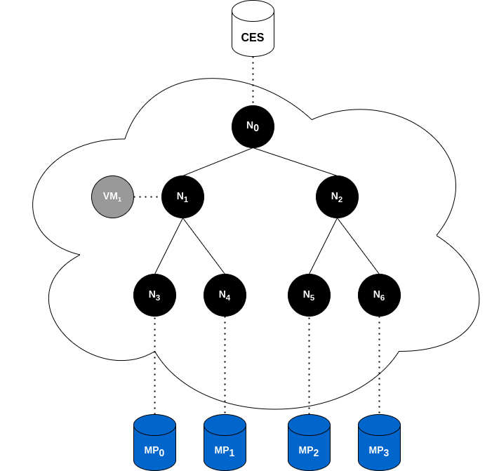
State-of-the-Art: Jasper¹: Scalable Exchange in the Cloud
Scalable, Fair, and Performant Multicast
Market Data Dissemination
Techniques:
Overlay Multicast Tree
Clock-Synchronization²
Hold-and-Release
Opportunity:
“Stragglers”
Underperforming VMs
Stragglers affect deadlines!
¹Jasper: https://arxiv.org/abs/2402.09527
¹Jasper: https://arxiv.org/abs/2402.09527, https://sigcomm24posterdemo.hotcrp.com/paper/
²Hyugens: https://www.usenix.org/system/files/conference/nsdi18/nsdi18-geng.pdf
Notes:
Jasper:
is the latest effort to address the obstacles in this cloud migration
offers a scalable, fair and performant multicast solution for the dissemination of data in the context of a cloud-based exchange.
to achieve this, a group of different techniques are applied.
Techniques:
Overlay Multicast Tree to overcome serial DU across recipients
Clock-Synchronization:
compensates for noisy conditions in the cloud
common clock across cluster allows precise global timestamps
Hyugens 10s/100s ns, Jasper is working at 100us
Hedging
Decreases latency variance (spatially)
Hold And Release
Deadline mechanism based on global timestamps
Receivers takes the 95th percentile their OWD records at regular intervals and sends the results back to the sender using an all-reduce mechanism.
The sender calculates the maximum of these OWDs called Global OWD for messages using the gathered statistics: OWDG = maxi(OWDi) where OWDi is the OWD estimate reported by the 𝑖-th multicast receiver.
Opportunity:
Nodes are running on top of VMs on the cloud.
“Stragglers” or under-performing VMs.
instances of identical configurations, that however underperform compared to their counterparts.
Virtualization Overhead: Context Switching among VMs, memory overhead, I/O Virtualization
Network Congestion
Noisy Neighbors
Straggler VMs can potentially affect Jasper’s performance (children)
Straggler VMs affect deadline calculations
The system's overall multicast latency is directly influenced by the slowest VM. A slower VM results in less stringent deadlines for future messages, which, while easing the timing constraints, ultimately increases the system's total latency.

Slide 9
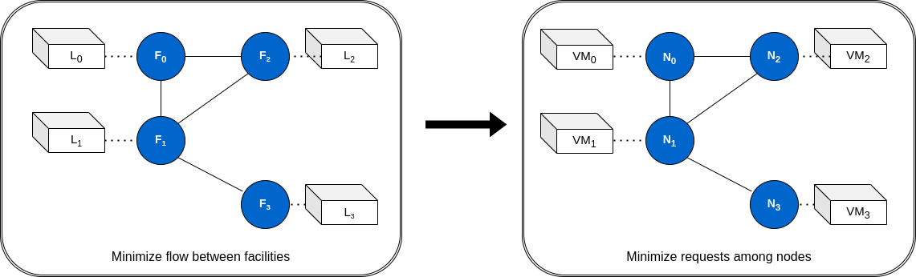
State-of-the-Art: LemonDrop¹
Method of Selecting/Scheduling VMs on a cluster
Framed QAP => NP-Hard => Scalability issues
Disproportionally Robust for Jasper’s use-case
¹LemonDrop: https://searchworks.stanford.edu/view/14423035
Notes:
One recent work that addresses stragglers is LemonDrop.
LemonDrop: a Method for selecting VMs within a given cloud cluster optimized for an application’s latency needs.
LemonDrop:
Frames the selection and scheduling of nodes onto VMs as a natural Quadratic Assignment Problem(QAP):
There, we assign facilities to locations such that traffic flow between facilities is minimized
Nodes are facilities and locations are VMs
NP-Hard
Scalability Issues
Via this method, Lemondrop demonstrates that:
Virtual Machines (VMs) are not equally strong: “Lemons” or “Stragglers”
Virtual Machines (VMs) are not interchangeable
Algorithm:
Clock-Synchronization: Allows for accurate OWD delay latency across pairs of VMs within the entire cluster
Quadratic Assignment Problem Solver
Assign facilities to locations such that traffic flow between facilities is minimized
Nodes are facilities
VMs themselves are locations
QAP is NP-Hard
Approximate method to obtain locally optimal solution to a relaxed version of the problem is used:
FAQ:
O(n^3)
Relaxes the constraint set P to the set of doubly stochastic matrices denoted as D
non-negative, rows and columns add to 1.
continuous optimization routine
final solution is projected to the closest point in P
Step-by-Step
scipy and scipy.optimize
Initialize Permutation matrix: P = np.ones((self.N, self.N)) / self.N
While Loop:
Gradient with respect to current solution
Q Direction that minimizes the gradient, and alpha step size to minimize gradient => steepest descent of objective
both done with `linear_sum_assignment` and `minimize_scalar`
Update Solution
If Current Solution has changed (Frobenius norm) beyond a threshold `epsilon`, stop
Frobenius norm is a way to establish the magnitude of the change between two matrices
if a change is smaller than a given threshold, we have likely found a local optimum
If max iterations ran, stop
Input:
Accurate OWD Measurements Matrix:
NxN
packets timestamped when sent
Median Delay
44Byte UDP Packets
Communication/Load Pattern/Matrix (Application Traffic Pattern)
LxL
captures the normalized number of requests made by node k to node l per unit of time.
padded with zeros to be NxN
Goal:
D = ∑^{L}_{i,j=1}λ_{ij}d_{ij}
HADAMARD PRODUCT OF OWD x LOAD
captures total distance traversed by the requests of the application per unit of time
Mathematical Representation of the total time or more precisely “in-network” time it takes for requests to flow through the distributed application.
Minimize: D(P) = trace(𝚲PΔ^{T}P^{T})
P is the set of all possible permutation matrices
trace: the sum of diagonal elements
trace of hadamard product with permutation set:
represents “in-network time” of requests for this assignment of service nodes to VMs
summing up only elements where i=j, representing the product of load and delay for requests that start and end at the same VM.
aims to find the VM assignment that minimizes the total “in-network” time for self-communicating requests?
the diagonal is important because LemonDrop is primarily concerned with optimizing delays experienced by requests that start and stay within same VM?
these are requests that are directly affected by VM performance.
𝚲xP:
multiplies the LOAD matrix by permutation matrix
rearranges the rows of the LOAD matrix according to the assignment of service nodes to VMs
resulting matrix represents the LOAD between VMs after the assignment
(𝚲xP) x Δ^{T}
Multiplies the result by the transpose of the OWD matrix
calculating the product of load and delay for each pair of VMs
( (𝚲xP) x Δ^{T} ) x P^{T}
Multiplies again by the transpose of the permutation matrix
rearranging columns of the resulting matrix
aligning the results with the original service node ordering
trace()
sums up diagonal elements, representing the in-network time for requests that start and end at the same VM
Disproportionally robust for Jasper’s use case
Scalability Issues:
All-to-All Probe Mesh (2 min): N increases => Stress placed on VMs, Data Collection, Storing, Analyzing
Expensive
Not Scalable
Optimization Method
FAQ is O(n³)

Slide 10
Objectives
Develop lightweight VM selection heuristic
Minimize “Straggler” Effect
Lightweight and Scalable
Notes:
Motivation:
Lightweight, Cheap and Scalable
Incremental: Applied to the system as a whole or to layers individually

Slide 11
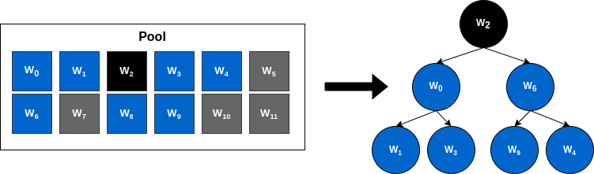
TreeBuilder¹: Testbench and Design
Goal: VM Selection Method to minimize “stragglers”
Testbench:
Pool Size: P
Tree Size: N < P
¹TreeBuilder: https://github.com/duclos-cavalcanti/TreeBuilder
Notes:
The developed work we now present is named TreeBuilder
We have already established its goal of selecting VMs within a POOL to filter against stragglers and form an optimized multicast tree, as such used in the context of Jasper’s cloud-based exchange.
BEYOND the actual selection method, TreeBuilder includes a testbench to evaluate results and differently applied selection techniques.
The Testbench deployment can be described as such:
We first launch a cluster of P VMs
These are described within TreeBuilder as WORKERS
We also deploy an additional node named MANAGER, which serves as the supervising entity within this distributed application
Manager and Worker nodes can exchange messages, issuing commands, probing for results, inspecting on state and much more.
GIVEN THIS MANAGER X WORKER FRAMEWORK, we apply different selection techniques onto the available pool.
our own proposed method, which will be outlined later
a faithful implementation of the previously mentioned LemonDrop technique adapted to a multicast tree’s topology
and a vanilla method, which essentially means no intelligent node selection whatsoever and serves as the base benchmark for when a user directly utilizes the given pool of VMs without an optimization technique.
WE FINALLY evaluate the trees performances, comparing and constrasting their results.
However, this leaves us with some crucial questions, which will be answered in the following slides:
HOW are nodes in the pool examined and selected?
HOW are trees evaluated?

Slide 12
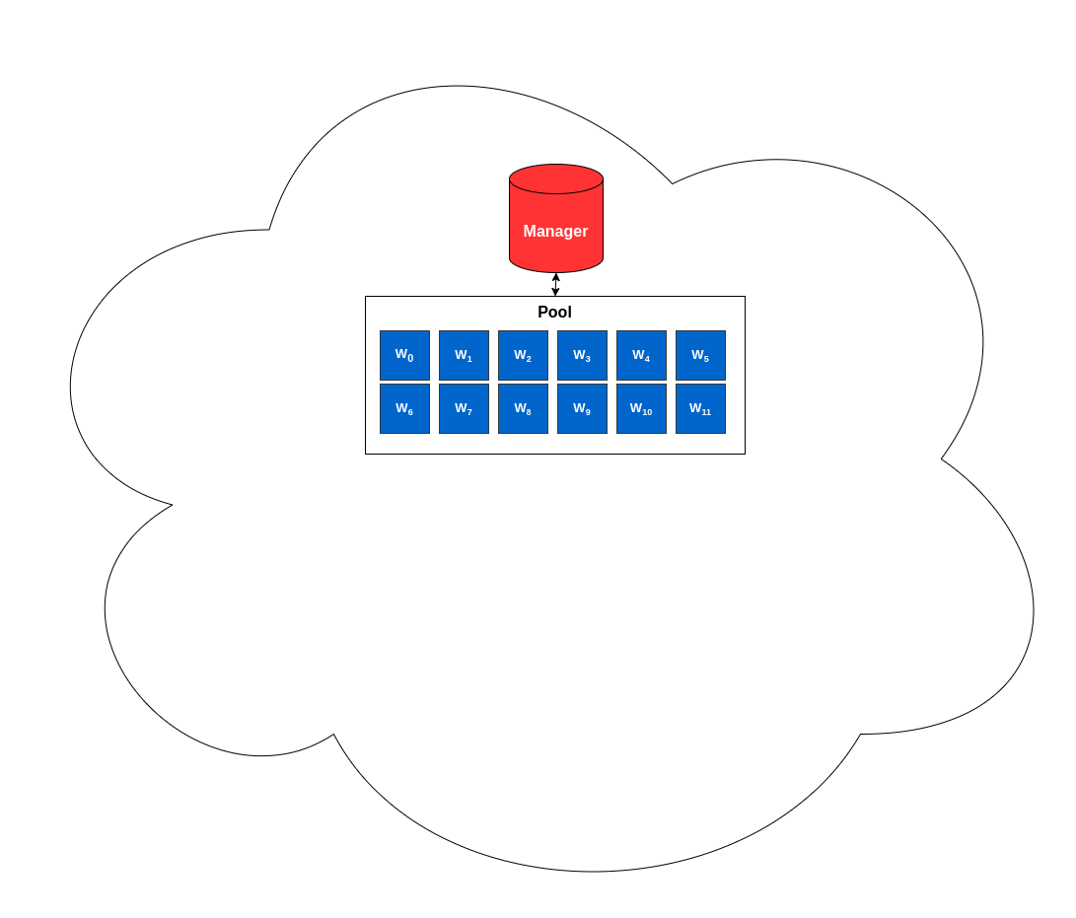
TreeBuilder¹: Testbench and Design
Goal: VM Selection Method to minimize “stragglers”
Testbench:
Launch a cluster of P VMs
Workers => Pool
Manager => Supervisor
Manager x Workers
¹TreeBuilder: https://github.com/duclos-cavalcanti/TreeBuilder
Notes:
The developed work we now present is named TreeBuilder
We have already established its goal of selecting VMs within a POOL to filter against stragglers and form an optimized multicast tree, as such used in the context of Jasper’s cloud-based exchange.
BEYOND the actual selection method, TreeBuilder includes a testbench to evaluate results and differently applied selection techniques.
The Testbench deployment can be described as such:
We first launch a cluster of P VMs
These are described within TreeBuilder as WORKERS
We also deploy an additional node named MANAGER, which serves as the supervising entity within this distributed application
Manager and Worker nodes can exchange messages, issuing commands, probing for results, inspecting on state and much more.
GIVEN THIS MANAGER X WORKER FRAMEWORK, we apply different selection techniques onto the available pool.
our own proposed method, which will be outlined later
a faithful implementation of the previously mentioned LemonDrop technique adapted to a multicast tree’s topology
and a vanilla method, which essentially means no intelligent node selection whatsoever and serves as the base benchmark for when a user directly utilizes the given pool of VMs without an optimization technique.
WE FINALLY evaluate the trees performances, comparing and constrasting their results.
However, this leaves us with some crucial questions, which will be answered in the following slides:
HOW are nodes in the pool examined and selected?
HOW are trees evaluated?

Slide 13
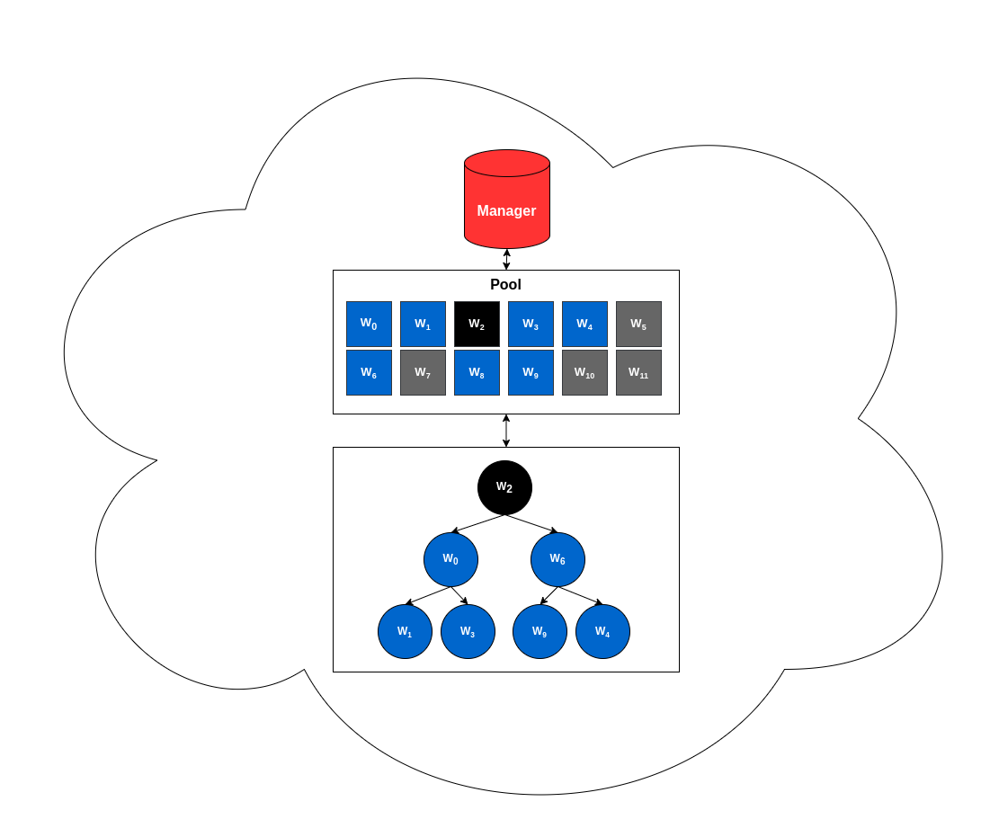
TreeBuilder¹: Testbench and Design
Goal: VM Selection Method to minimize “stragglers”
Testbench:
Launch a cluster of P VMs
Apply Techniques:
Manager x Workers
¹TreeBuilder: https://github.com/duclos-cavalcanti/TreeBuilder
Notes:
The developed work we now present is named TreeBuilder
We have already established its goal of selecting VMs within a POOL to filter against stragglers and form an optimized multicast tree, as such used in the context of Jasper’s cloud-based exchange.
BEYOND the actual selection method, TreeBuilder includes a testbench to evaluate results and differently applied selection techniques.
The Testbench deployment can be described as such:
We first launch a cluster of P VMs
These are described within TreeBuilder as WORKERS
We also deploy an additional node named MANAGER, which serves as the supervising entity within this distributed application
Manager and Worker nodes can exchange messages, issuing commands, probing for results, inspecting on state and much more.
GIVEN THIS MANAGER X WORKER FRAMEWORK, we apply different selection techniques onto the available pool.
our own proposed method, which will be outlined later
a faithful implementation of the previously mentioned LemonDrop technique adapted to a multicast tree’s topology
and a vanilla method, which essentially means no intelligent node selection whatsoever and serves as the base benchmark for when a user directly utilizes the given pool of VMs without an optimization technique.
WE FINALLY evaluate the trees performances, comparing and constrasting their results.
However, this leaves us with some crucial questions, which will be answered in the following slides:
HOW are nodes in the pool examined and selected?
HOW are trees evaluated?

Slide 14
TreeBuilder¹: Testbench and Design
Goal: VM Selection Method to minimize “stragglers”
Testbench:
Launch a cluster of P VMs
Apply Techniques:
Proposed Method
Manager x Workers
¹TreeBuilder: https://github.com/duclos-cavalcanti/TreeBuilder
Notes:
The developed work we now present is named TreeBuilder
We have already established its goal of selecting VMs within a POOL to filter against stragglers and form an optimized multicast tree, as such used in the context of Jasper’s cloud-based exchange.
BEYOND the actual selection method, TreeBuilder includes a testbench to evaluate results and differently applied selection techniques.
The Testbench deployment can be described as such:
We first launch a cluster of P VMs
These are described within TreeBuilder as WORKERS
We also deploy an additional node named MANAGER, which serves as the supervising entity within this distributed application
Manager and Worker nodes can exchange messages, issuing commands, probing for results, inspecting on state and much more.
GIVEN THIS MANAGER X WORKER FRAMEWORK, we apply different selection techniques onto the available pool.
our own proposed method, which will be outlined later
a faithful implementation of the previously mentioned LemonDrop technique adapted to a multicast tree’s topology
and a vanilla method, which essentially means no intelligent node selection whatsoever and serves as the base benchmark for when a user directly utilizes the given pool of VMs without an optimization technique.
WE FINALLY evaluate the trees performances, comparing and constrasting their results.
However, this leaves us with some crucial questions, which will be answered in the following slides:
HOW are nodes in the pool examined and selected?
HOW are trees evaluated?

Slide 15
TreeBuilder¹: Testbench and Design
Goal: VM Selection Method to minimize “stragglers”
Testbench:
Launch a cluster of P VMs
Apply Techniques:
Proposed Method
LemonDrop
Manager x Workers
¹TreeBuilder: https://github.com/duclos-cavalcanti/TreeBuilder
Notes:
The developed work we now present is named TreeBuilder
We have already established its goal of selecting VMs within a POOL to filter against stragglers and form an optimized multicast tree, as such used in the context of Jasper’s cloud-based exchange.
BEYOND the actual selection method, TreeBuilder includes a testbench to evaluate results and differently applied selection techniques.
The Testbench deployment can be described as such:
We first launch a cluster of P VMs
These are described within TreeBuilder as WORKERS
We also deploy an additional node named MANAGER, which serves as the supervising entity within this distributed application
Manager and Worker nodes can exchange messages, issuing commands, probing for results, inspecting on state and much more.
GIVEN THIS MANAGER X WORKER FRAMEWORK, we apply different selection techniques onto the available pool.
our own proposed method, which will be outlined later
a faithful implementation of the previously mentioned LemonDrop technique adapted to a multicast tree’s topology
and a vanilla method, which essentially means no intelligent node selection whatsoever and serves as the base benchmark for when a user directly utilizes the given pool of VMs without an optimization technique.
WE FINALLY evaluate the trees performances, comparing and constrasting their results.
However, this leaves us with some crucial questions, which will be answered in the following slides:
HOW are nodes in the pool examined and selected?
HOW are trees evaluated?

Slide 16
TreeBuilder¹: Testbench and Design
Goal: VM Selection Method to minimize “stragglers”
Testbench:
Launch a cluster of P VMs
Apply Techniques:
Proposed Method
LemonDrop
Vanilla
Manager x Workers
¹TreeBuilder: https://github.com/duclos-cavalcanti/TreeBuilder
Notes:
The developed work we now present is named TreeBuilder
We have already established its goal of selecting VMs within a POOL to filter against stragglers and form an optimized multicast tree, as such used in the context of Jasper’s cloud-based exchange.
BEYOND the actual selection method, TreeBuilder includes a testbench to evaluate results and differently applied selection techniques.
The Testbench deployment can be described as such:
We first launch a cluster of P VMs
These are described within TreeBuilder as WORKERS
We also deploy an additional node named MANAGER, which serves as the supervising entity within this distributed application
Manager and Worker nodes can exchange messages, issuing commands, probing for results, inspecting on state and much more.
GIVEN THIS MANAGER X WORKER FRAMEWORK, we apply different selection techniques onto the available pool.
our own proposed method, which will be outlined later
a faithful implementation of the previously mentioned LemonDrop technique adapted to a multicast tree’s topology
and a vanilla method, which essentially means no intelligent node selection whatsoever and serves as the base benchmark for when a user directly utilizes the given pool of VMs without an optimization technique.
WE FINALLY evaluate the trees performances, comparing and constrasting their results.
However, this leaves us with some crucial questions, which will be answered in the following slides:
HOW are nodes in the pool examined and selected?
HOW are trees evaluated?

Slide 17
TreeBuilder¹: Testbench and Design
Goal: VM Selection Method to minimize “stragglers”
Testbench:
Launch a cluster of P VMs
Apply Techniques:
Proposed Method
LemonDrop
Vanilla
Evaluate trees
Q1: How are nodes examined and selected?
Q2: How are trees evaluated?
Manager x Workers
¹TreeBuilder: https://github.com/duclos-cavalcanti/TreeBuilder
Notes:
The developed work we now present is named TreeBuilder
We have already established its goal of selecting VMs within a POOL to filter against stragglers and form an optimized multicast tree, as such used in the context of Jasper’s cloud-based exchange.
BEYOND the actual selection method, TreeBuilder includes a testbench to evaluate results and differently applied selection techniques.
The Testbench deployment can be described as such:
We first launch a cluster of P VMs
These are described within TreeBuilder as WORKERS
We also deploy an additional node named MANAGER, which serves as the supervising entity within this distributed application
Manager and Worker nodes can exchange messages, issuing commands, probing for results, inspecting on state and much more.
GIVEN THIS MANAGER X WORKER FRAMEWORK, we apply different selection techniques onto the available pool.
our own proposed method, which will be outlined later
a faithful implementation of the previously mentioned LemonDrop technique adapted to a multicast tree’s topology
and a vanilla method, which essentially means no intelligent node selection whatsoever and serves as the base benchmark for when a user directly utilizes the given pool of VMs without an optimization technique.
WE FINALLY evaluate the trees performances, comparing and constrasting their results.
However, this leaves us with some crucial questions, which will be answered in the following slides:
HOW are nodes in the pool examined and selected?
HOW are trees evaluated?

Slide 18
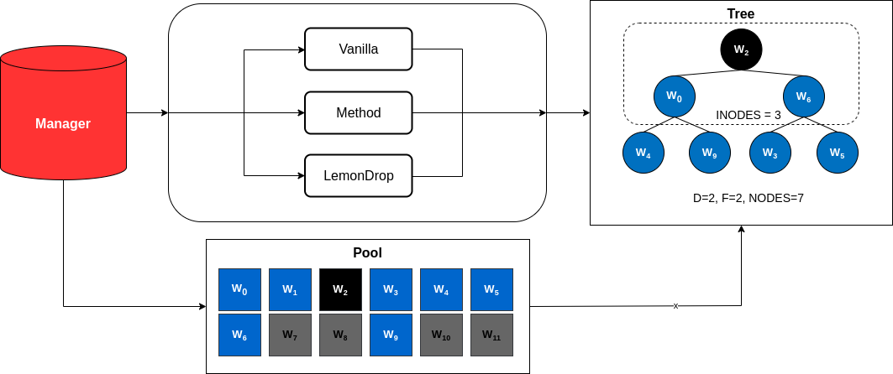
TreeBuilder: Testbench and Design
Launches cluster of N VMs ( Manager x Workers )
Apply: [ Proposed Method, LemonDrop and Vanilla ]
Evaluate Trees
Notes:
Project:
This work was named TreeBuilder
It includes not only our lightweight method of selecting VMs in the cloud
As well as a built-in testbench to compare and contrast results of different techniques
The overall concept of TreeBuilder is to:
allocate pool of VMs:
there we have a manager node and a pool of workers
these exchange messages with each other to issue commands, gather results and probe on each other’s state
apply different VM selection methods:
Our proposed methodology
a faithful implementation of LemonDrop
Vanilla scenario, no intelligent selection

Slide 19
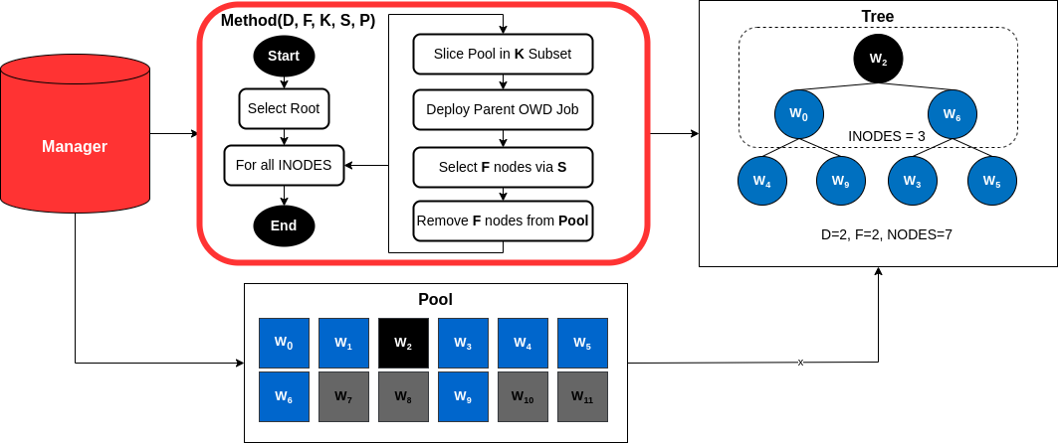
TreeBuilder: Testbench and Design
Launches cluster of N VMs ( Manager x Workers )
Apply: [ Proposed Method, LemonDrop and Vanilla ]
Evaluate Trees
Notes:
Project:
This work was named TreeBuilder
It includes not only our lightweight method of selecting VMs in the cloud
As well as a built-in testbench to compare and contrast results of different techniques
The overall concept of TreeBuilder is to:
allocate pool of VMs:
there we have a manager node and a pool of workers
these exchange messages with each other to issue commands, gather results and probe on each other’s state
apply different VM selection methods:
Our proposed methodology
a faithful implementation of LemonDrop
Vanilla scenario, no intelligent selection

Slide 20
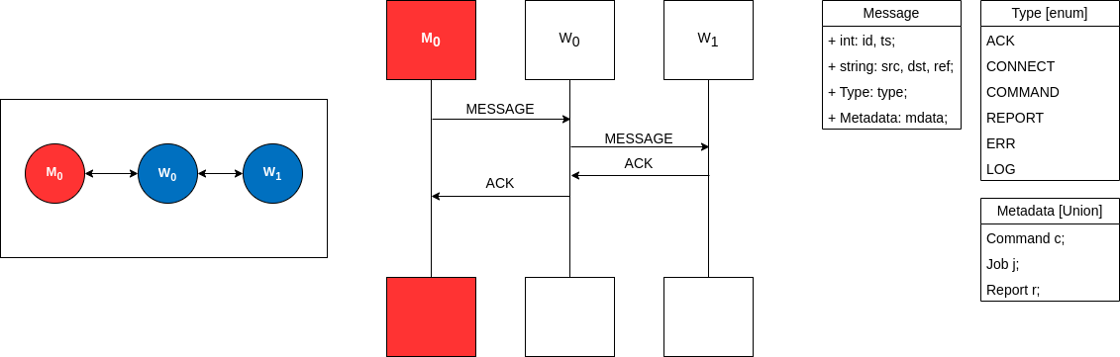
Implementation: Messages
Request and Reply
Defined and Flexible Data Structures
Notes:
The core of this testbench is the existence of two entities:
- a Manager
- and a Worker or pool of Workers
They are able to exchange messages or data between each other, and the manager has the task or ability of deploying jobs on any group of workers, evaluating the results and based on these results eventually decide how to construct a given multicast tree.

Slide 21
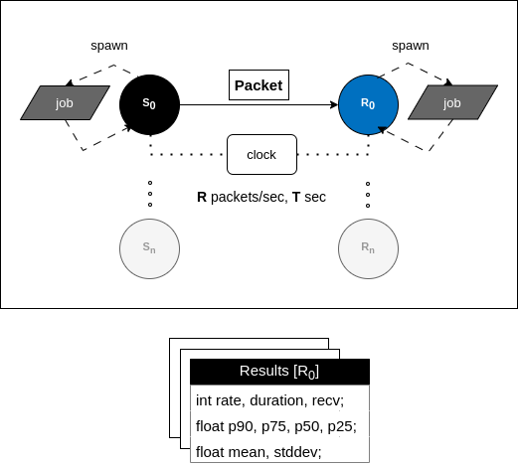
Implementation: Node(s) Examinations
Collective Tasks (Jobs)
synchronized clocks => accurate OWD latencies
Notes:
The core of this testbench is the existence of two entities:
- a Manager
- and a Worker or pool of Workers
They are able to exchange messages or data between each other, and the manager has the task or ability of deploying jobs on any group of workers, evaluating the results and based on these results eventually decide how to construct a given multicast tree.

Slide 22
Implementation: Node(s) Examinations
Collective Tasks (Jobs)
Generate Results
Notes:
The core of this testbench is the existence of two entities:
- a Manager
- and a Worker or pool of Workers
They are able to exchange messages or data between each other, and the manager has the task or ability of deploying jobs on any group of workers, evaluating the results and based on these results eventually decide how to construct a given multicast tree.

Slide 23
Implementation: Node(s) Examinations
Collective Tasks (Jobs)
Generate Results
Types:
Notes:
The core of this testbench is the existence of two entities:
- a Manager
- and a Worker or pool of Workers
They are able to exchange messages or data between each other, and the manager has the task or ability of deploying jobs on any group of workers, evaluating the results and based on these results eventually decide how to construct a given multicast tree.

Slide 24
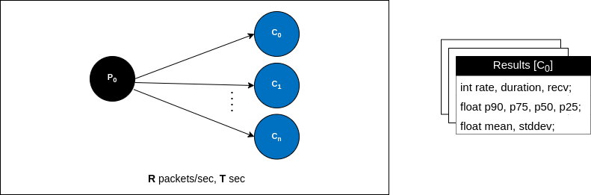
Implementation: Node(s) Examinations
Collective Tasks (Jobs)
Generate Results
Types:
Parent
Parent Job
Examines potential children nodes to a given parent!
Notes:
The core of this testbench is the existence of two entities:
- a Manager
- and a Worker or pool of Workers
They are able to exchange messages or data between each other, and the manager has the task or ability of deploying jobs on any group of workers, evaluating the results and based on these results eventually decide how to construct a given multicast tree.

Slide 25
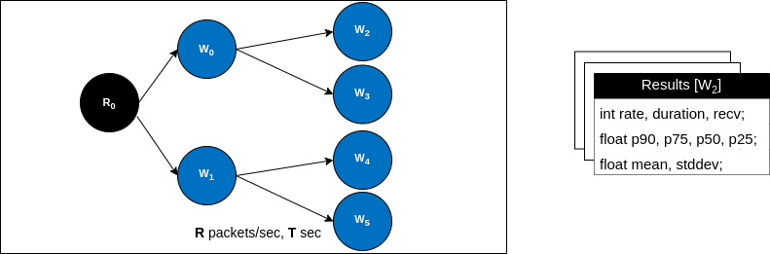
Implementation: Node(s) Examinations
Collective Tasks (Jobs)
Generate Results
Types:
Parent
Mcast
Mcast Job
Evaluates performance of a built tree!
Notes:
The core of this testbench is the existence of two entities:
- a Manager
- and a Worker or pool of Workers
They are able to exchange messages or data between each other, and the manager has the task or ability of deploying jobs on any group of workers, evaluating the results and based on these results eventually decide how to construct a given multicast tree.

Slide 26
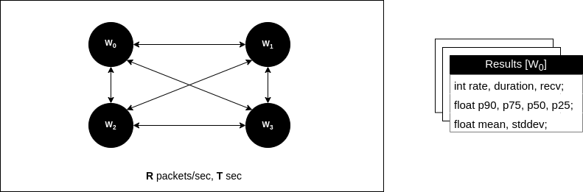
Implementation: Node(s) Examinations
Collective Tasks (Jobs)
Generate Results
Types:
Parent
Mcast
Lemon
Lemon Job
Collects pair-wise median OWDs for LemonDrop’s Heuristic!
Notes:
The core of this testbench is the existence of two entities:
- a Manager
- and a Worker or pool of Workers
They are able to exchange messages or data between each other, and the manager has the task or ability of deploying jobs on any group of workers, evaluating the results and based on these results eventually decide how to construct a given multicast tree.

Slide 27
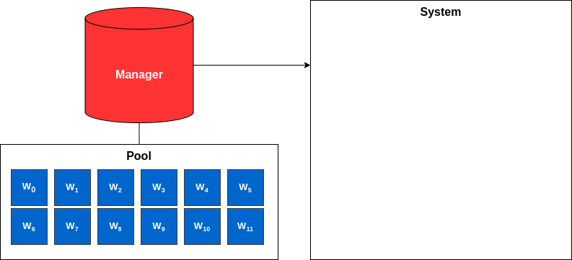
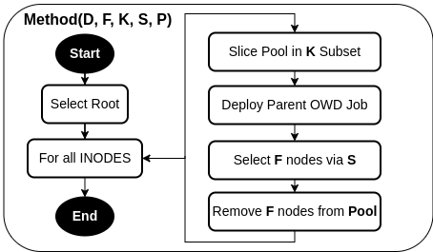
Implementation: Proposed Selection Method
Define depth and fan-out: D , F
Bounding parameter: K
Strategy: S
Pool: P
Notes:
Our Method in question depends on 4 parameters.
D and F, are the Depth and Fanout of a given Tree
K is a parameter that defines how many nodes are taken from the Pool to be evaluated.

Slide 28
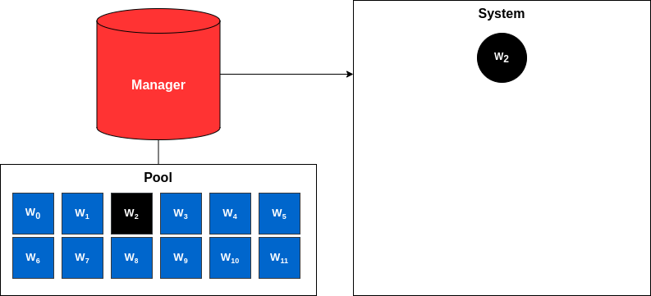
Implementation: Proposed Selection Method
Define depth and fan-out: D , F
Bounding parameter: K
Strategy: S
Pool: P
Notes:
Our Method in question depends on 4 parameters.
D and F, are the Depth and Fanout of a given Tree
K is a parameter that defines how many nodes are taken from the Pool to be evaluated.

Slide 29
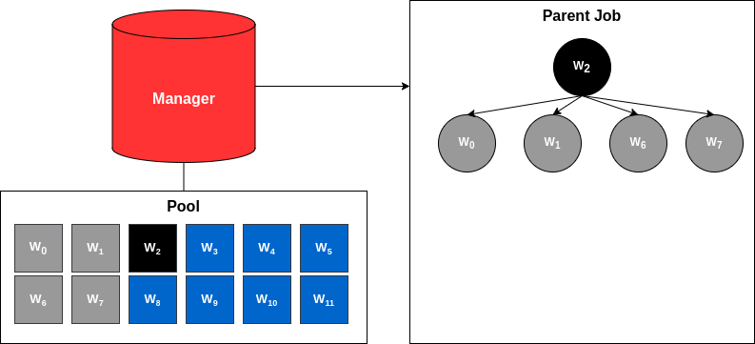
Implementation: Proposed Selection Method
Define depth and fan-out: D , F
Bounding parameter: K
Strategy: S
Pool: P
Notes:
Our Method in question depends on 4 parameters.
D and F, are the Depth and Fanout of a given Tree
K is a parameter that defines how many nodes are taken from the Pool to be evaluated.

Slide 30
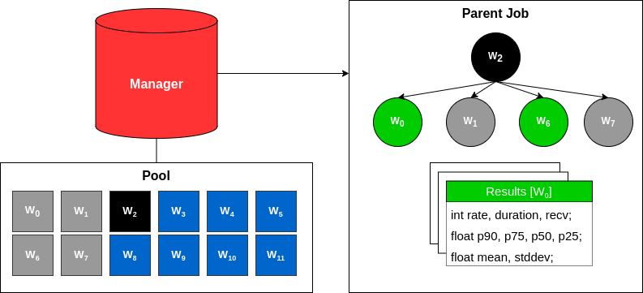
Implementation: Proposed Selection Method
Define depth and fan-out: D , F
Bounding parameter: K
Strategy: S
Pool: P
Strategies [S]:
P90: (1 x p90)
P50: (1 x p50)
Weighted: (0.7 x stddev) + (0.3 x p90)
lower => better
Notes:
Our Method in question depends on 4 parameters.
D and F, are the Depth and Fanout of a given Tree
K is a parameter that defines how many nodes are taken from the Pool to be evaluated.

Slide 31
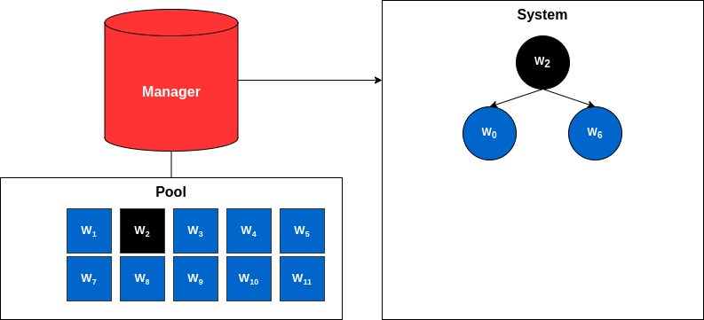
Implementation: Proposed Selection Method
Define depth and fan-out: D , F
Bounding parameter: K
Strategy: S
Pool: P
Notes:
Our Method in question depends on 4 parameters.
D and F, are the Depth and Fanout of a given Tree
K is a parameter that defines how many nodes are taken from the Pool to be evaluated.

Slide 32
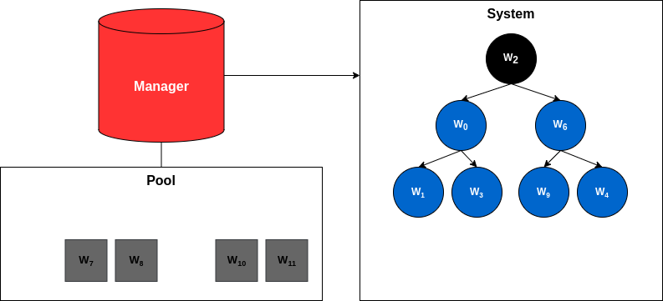
Implementation: Proposed Selection Method
Define depth and fan-out: D , F
Bounding parameter: K
Strategy: S
Pool: P
Evaluate Tree!
Mcast Job
Notes:
Our Method in question depends on 4 parameters.
D and F, are the Depth and Fanout of a given Tree
K is a parameter that defines how many nodes are taken from the Pool to be evaluated.

Slide 33
Experimental Setup
D (Depth) | 3
F (Fanout) | 2
K (Pool Subset) | 2*F = 4
P (Pool Size) | 25
Duration Parent Job | 10 sec
Duration Mcast Job | 30 sec
Rate | 10K
Number of Runs | 2
Number of Roots | 2
Build Trees:
Best: P90 x P50 x WEIGHTED
Worst: P90
Random
Lemon: ϵ = 1 x 10e-4 , n = 1000
GCP Cloud Instances: “c2d-highcpu-8”
8 virtual AMD Milan CPU’s
16GB of Memory
16Gbps of Network Bandwidth

Slide 34
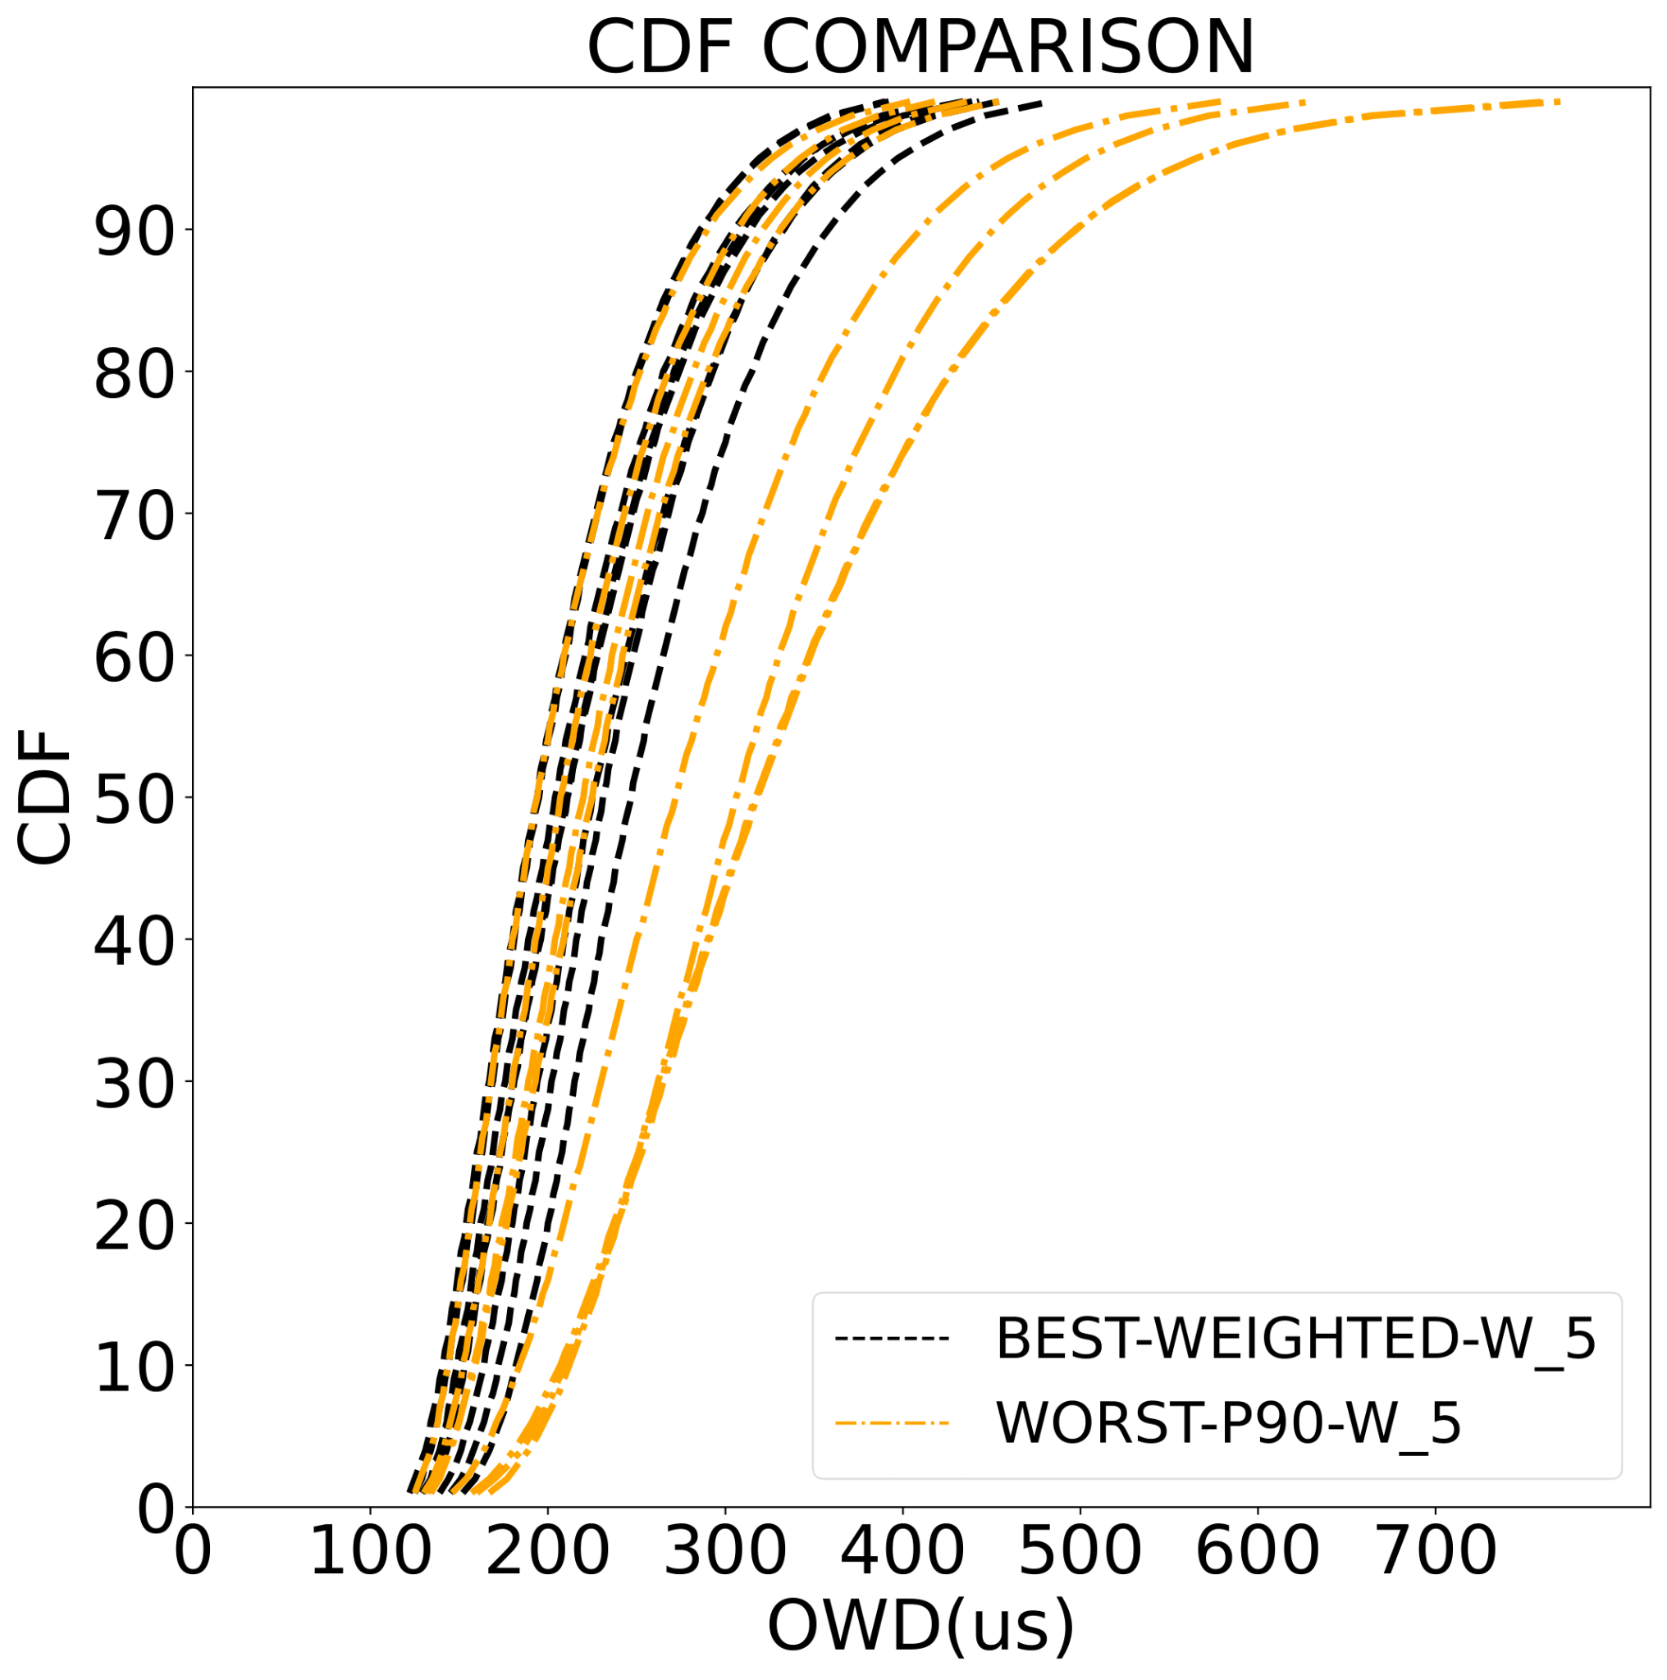
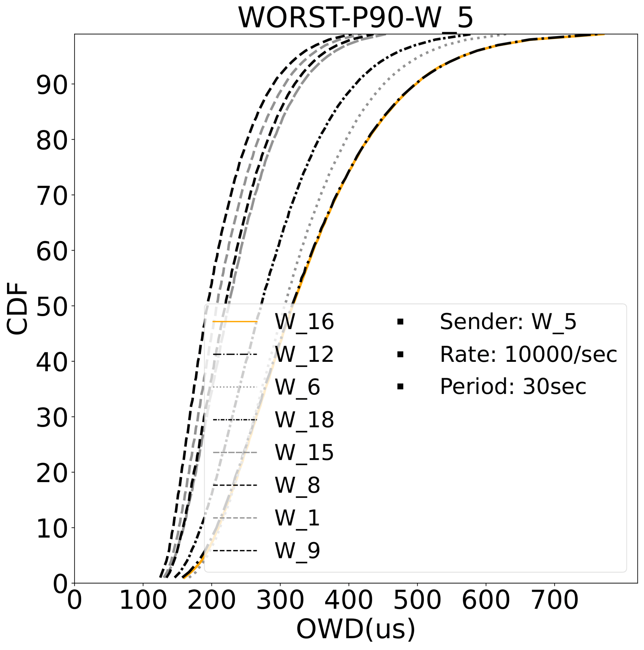
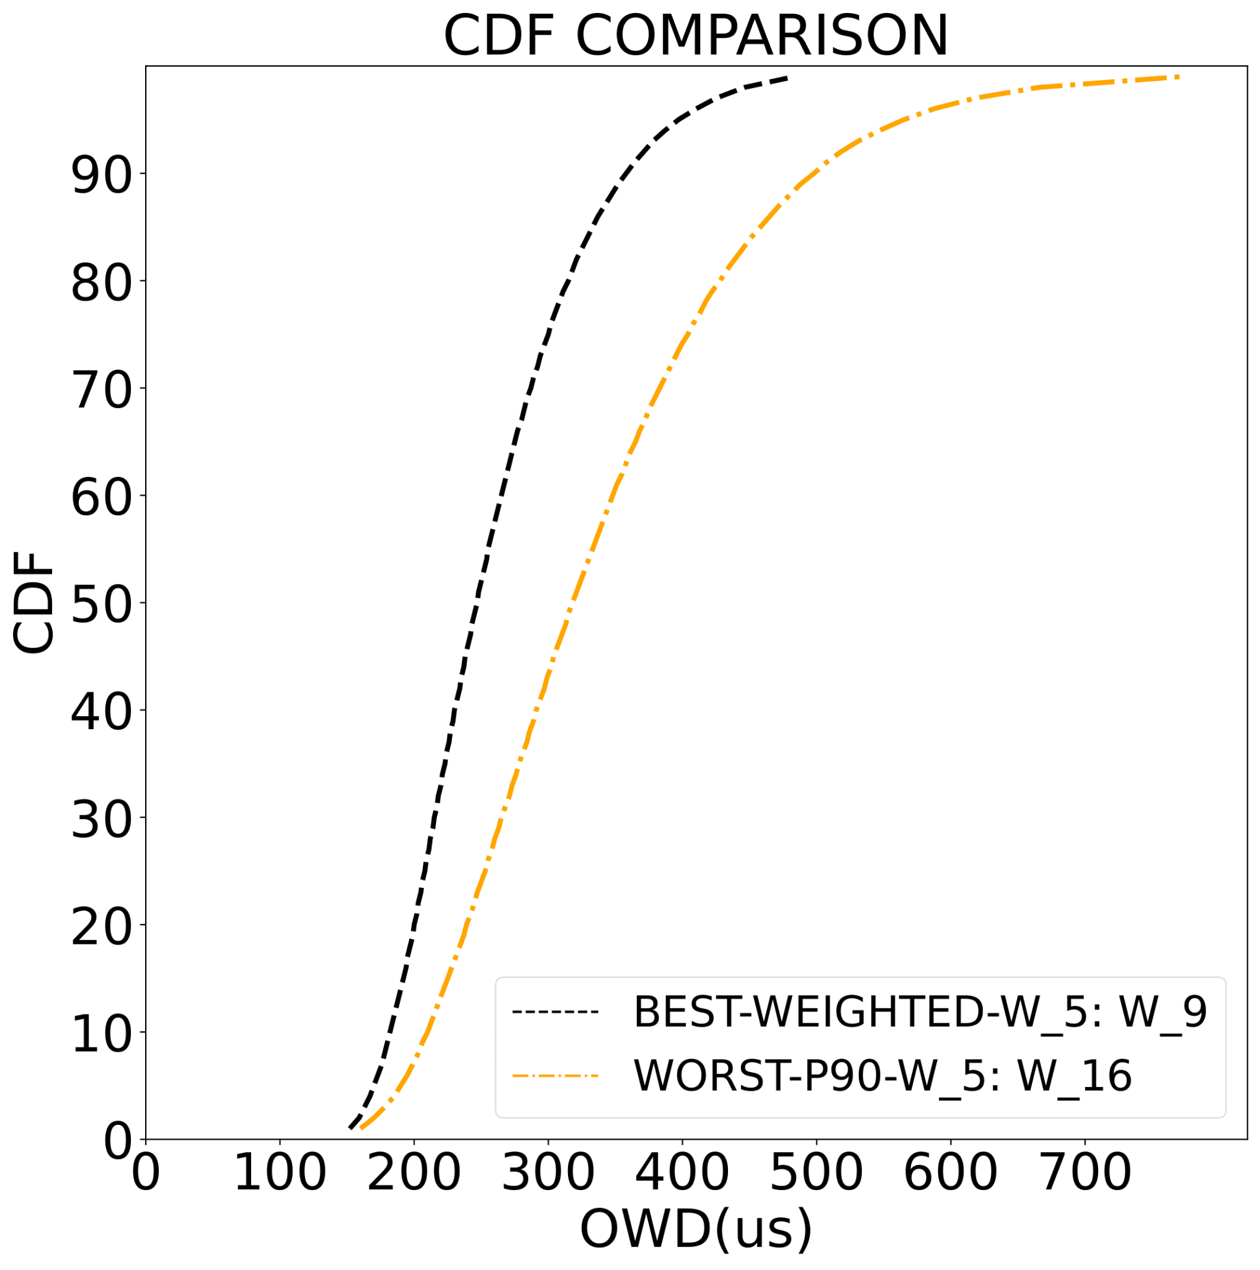
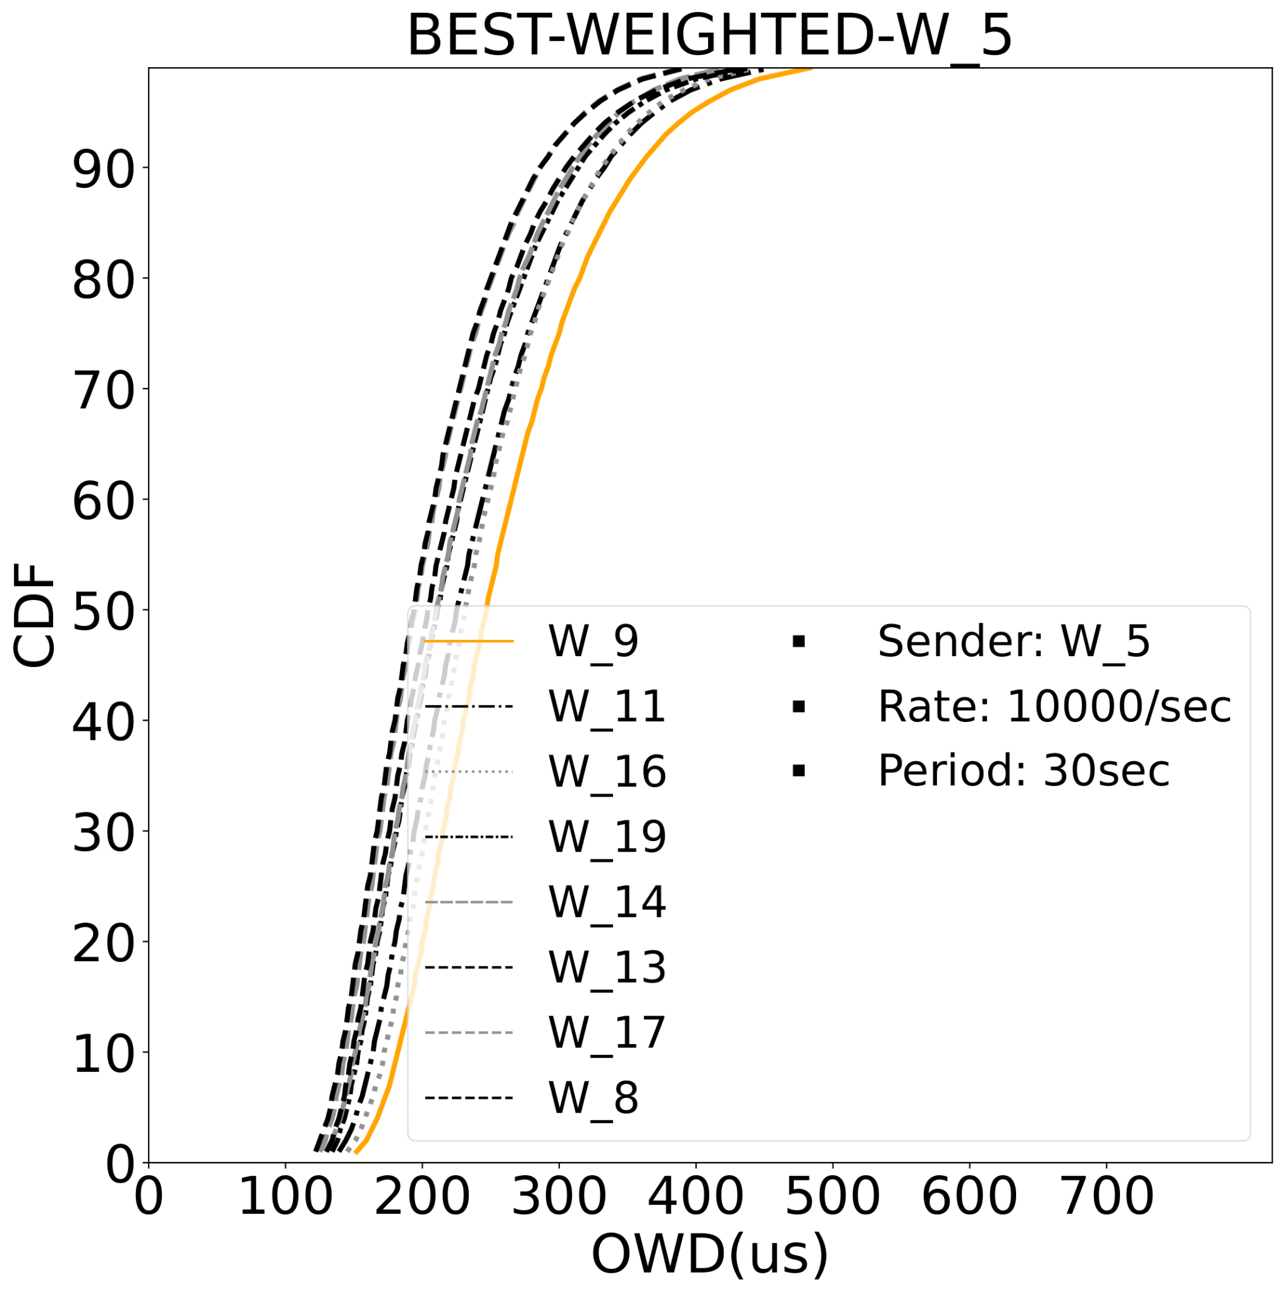
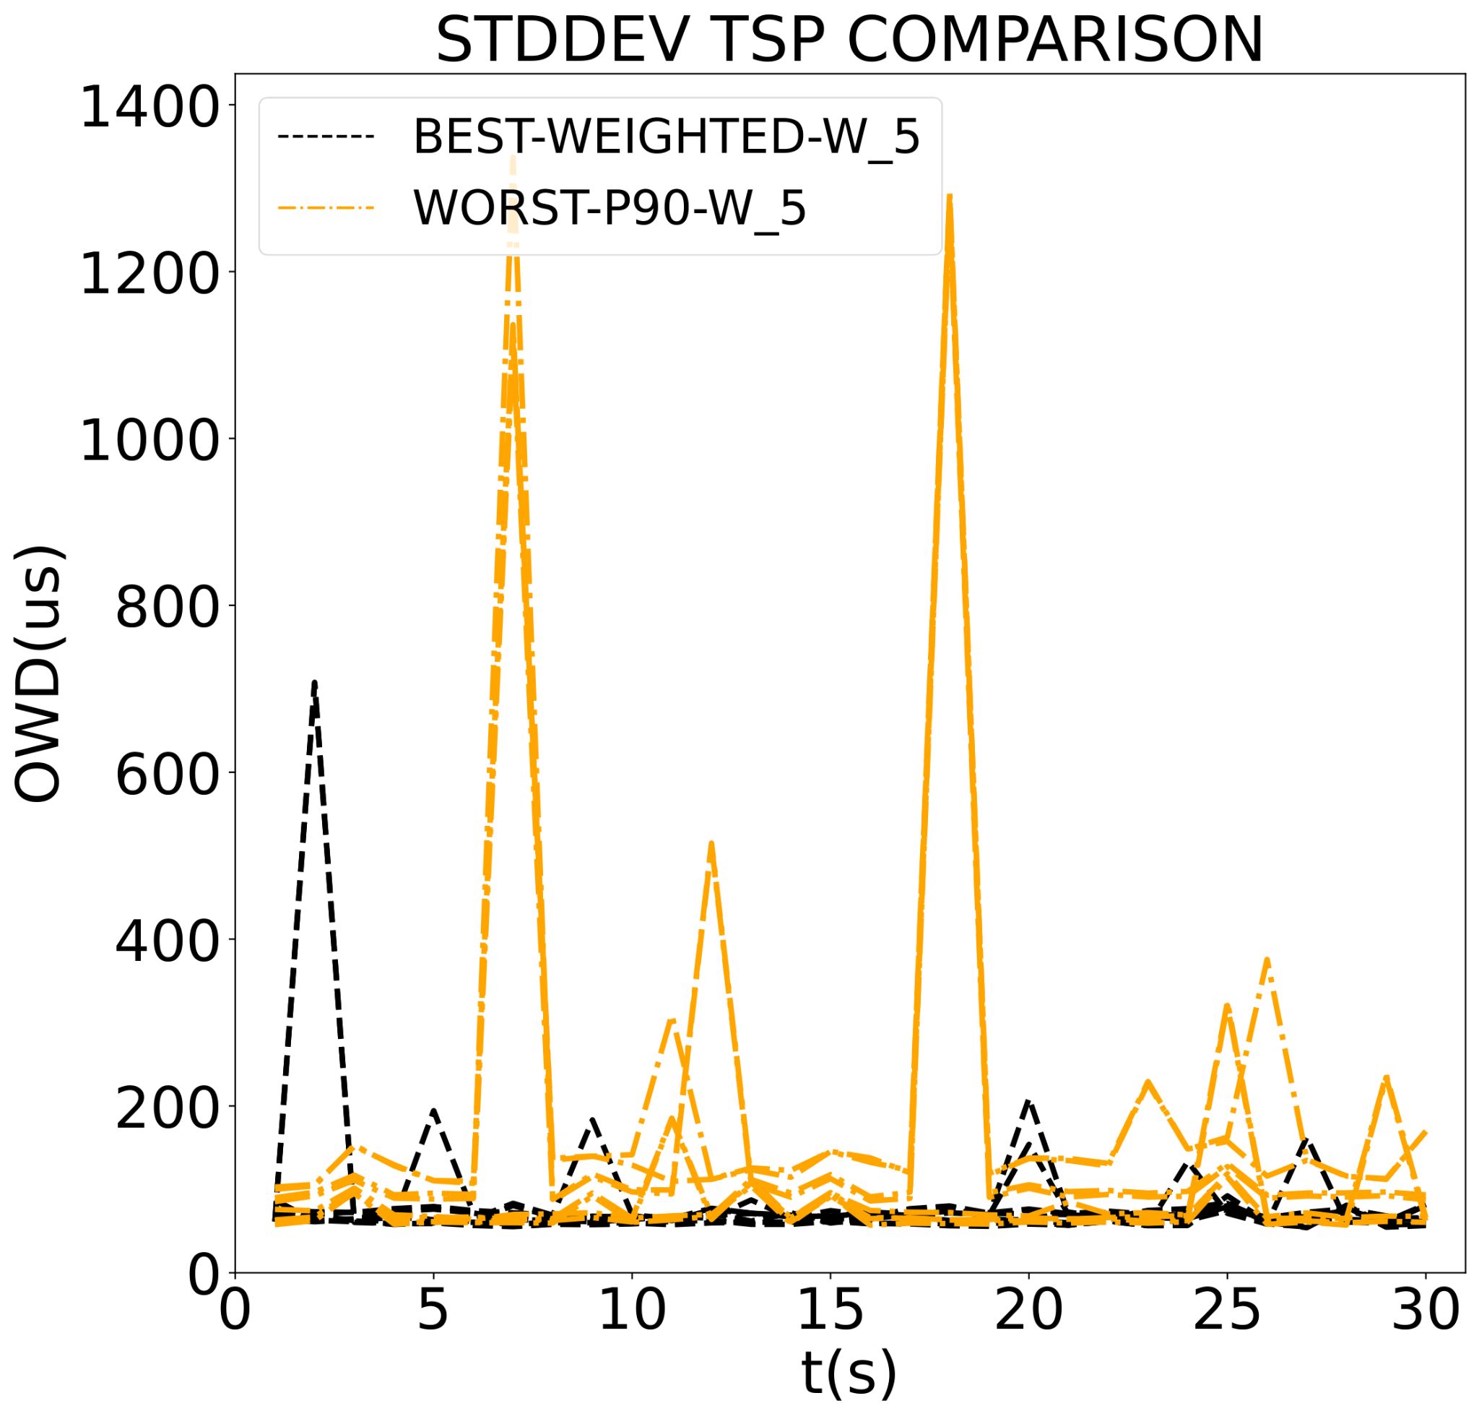
Results: Straggler Impact – BEST x WORST
WORST tree displays sparser CDF profiles and right-shifted vs BEST-WEIGHTED
WORST shows higher variancy
BEST-WEIGHTED 28.11% lower OWD latency at 90th %
 | BEST-WEIGHTED | WORST
90th % | 358 μs | 498 μs
median | 247 μs | 318 μs
mean | 261.4 μs | 353.66 μs
stddev | 78.95 μs | 352.29 μs
ID | W_9 | W_16
Best-WEIGHTED is uniformly better & more stable!

Slide 35
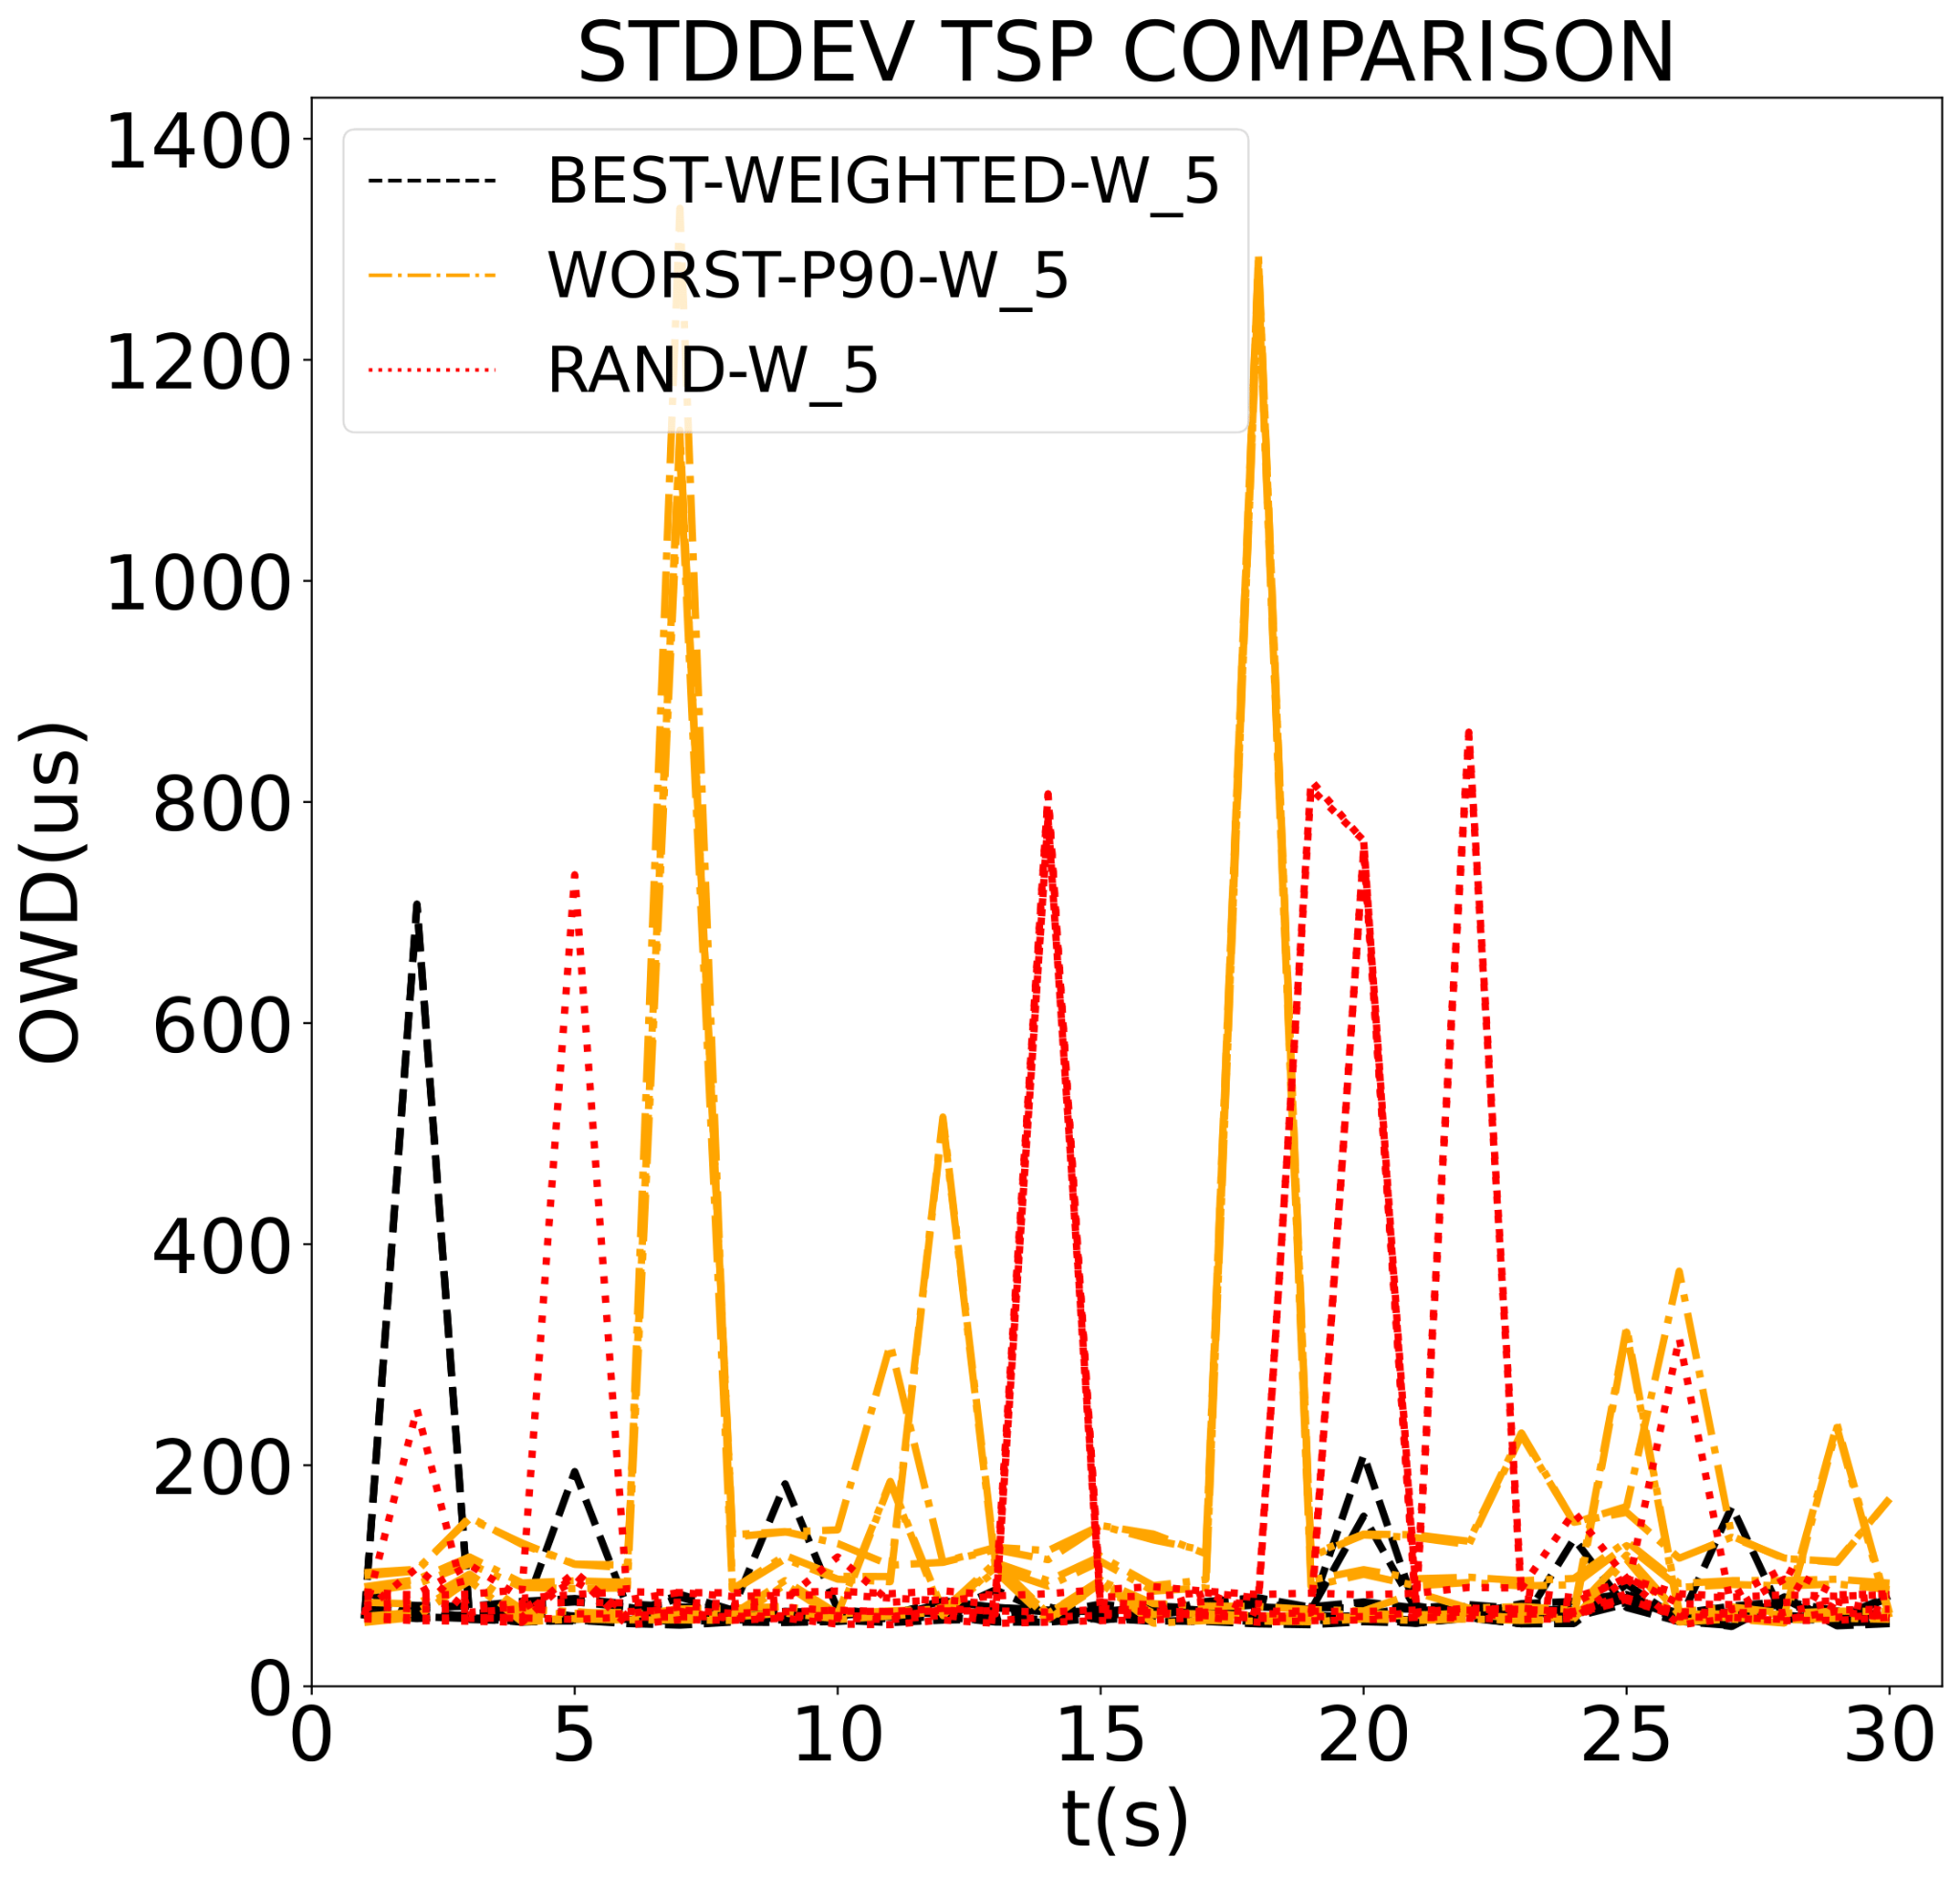
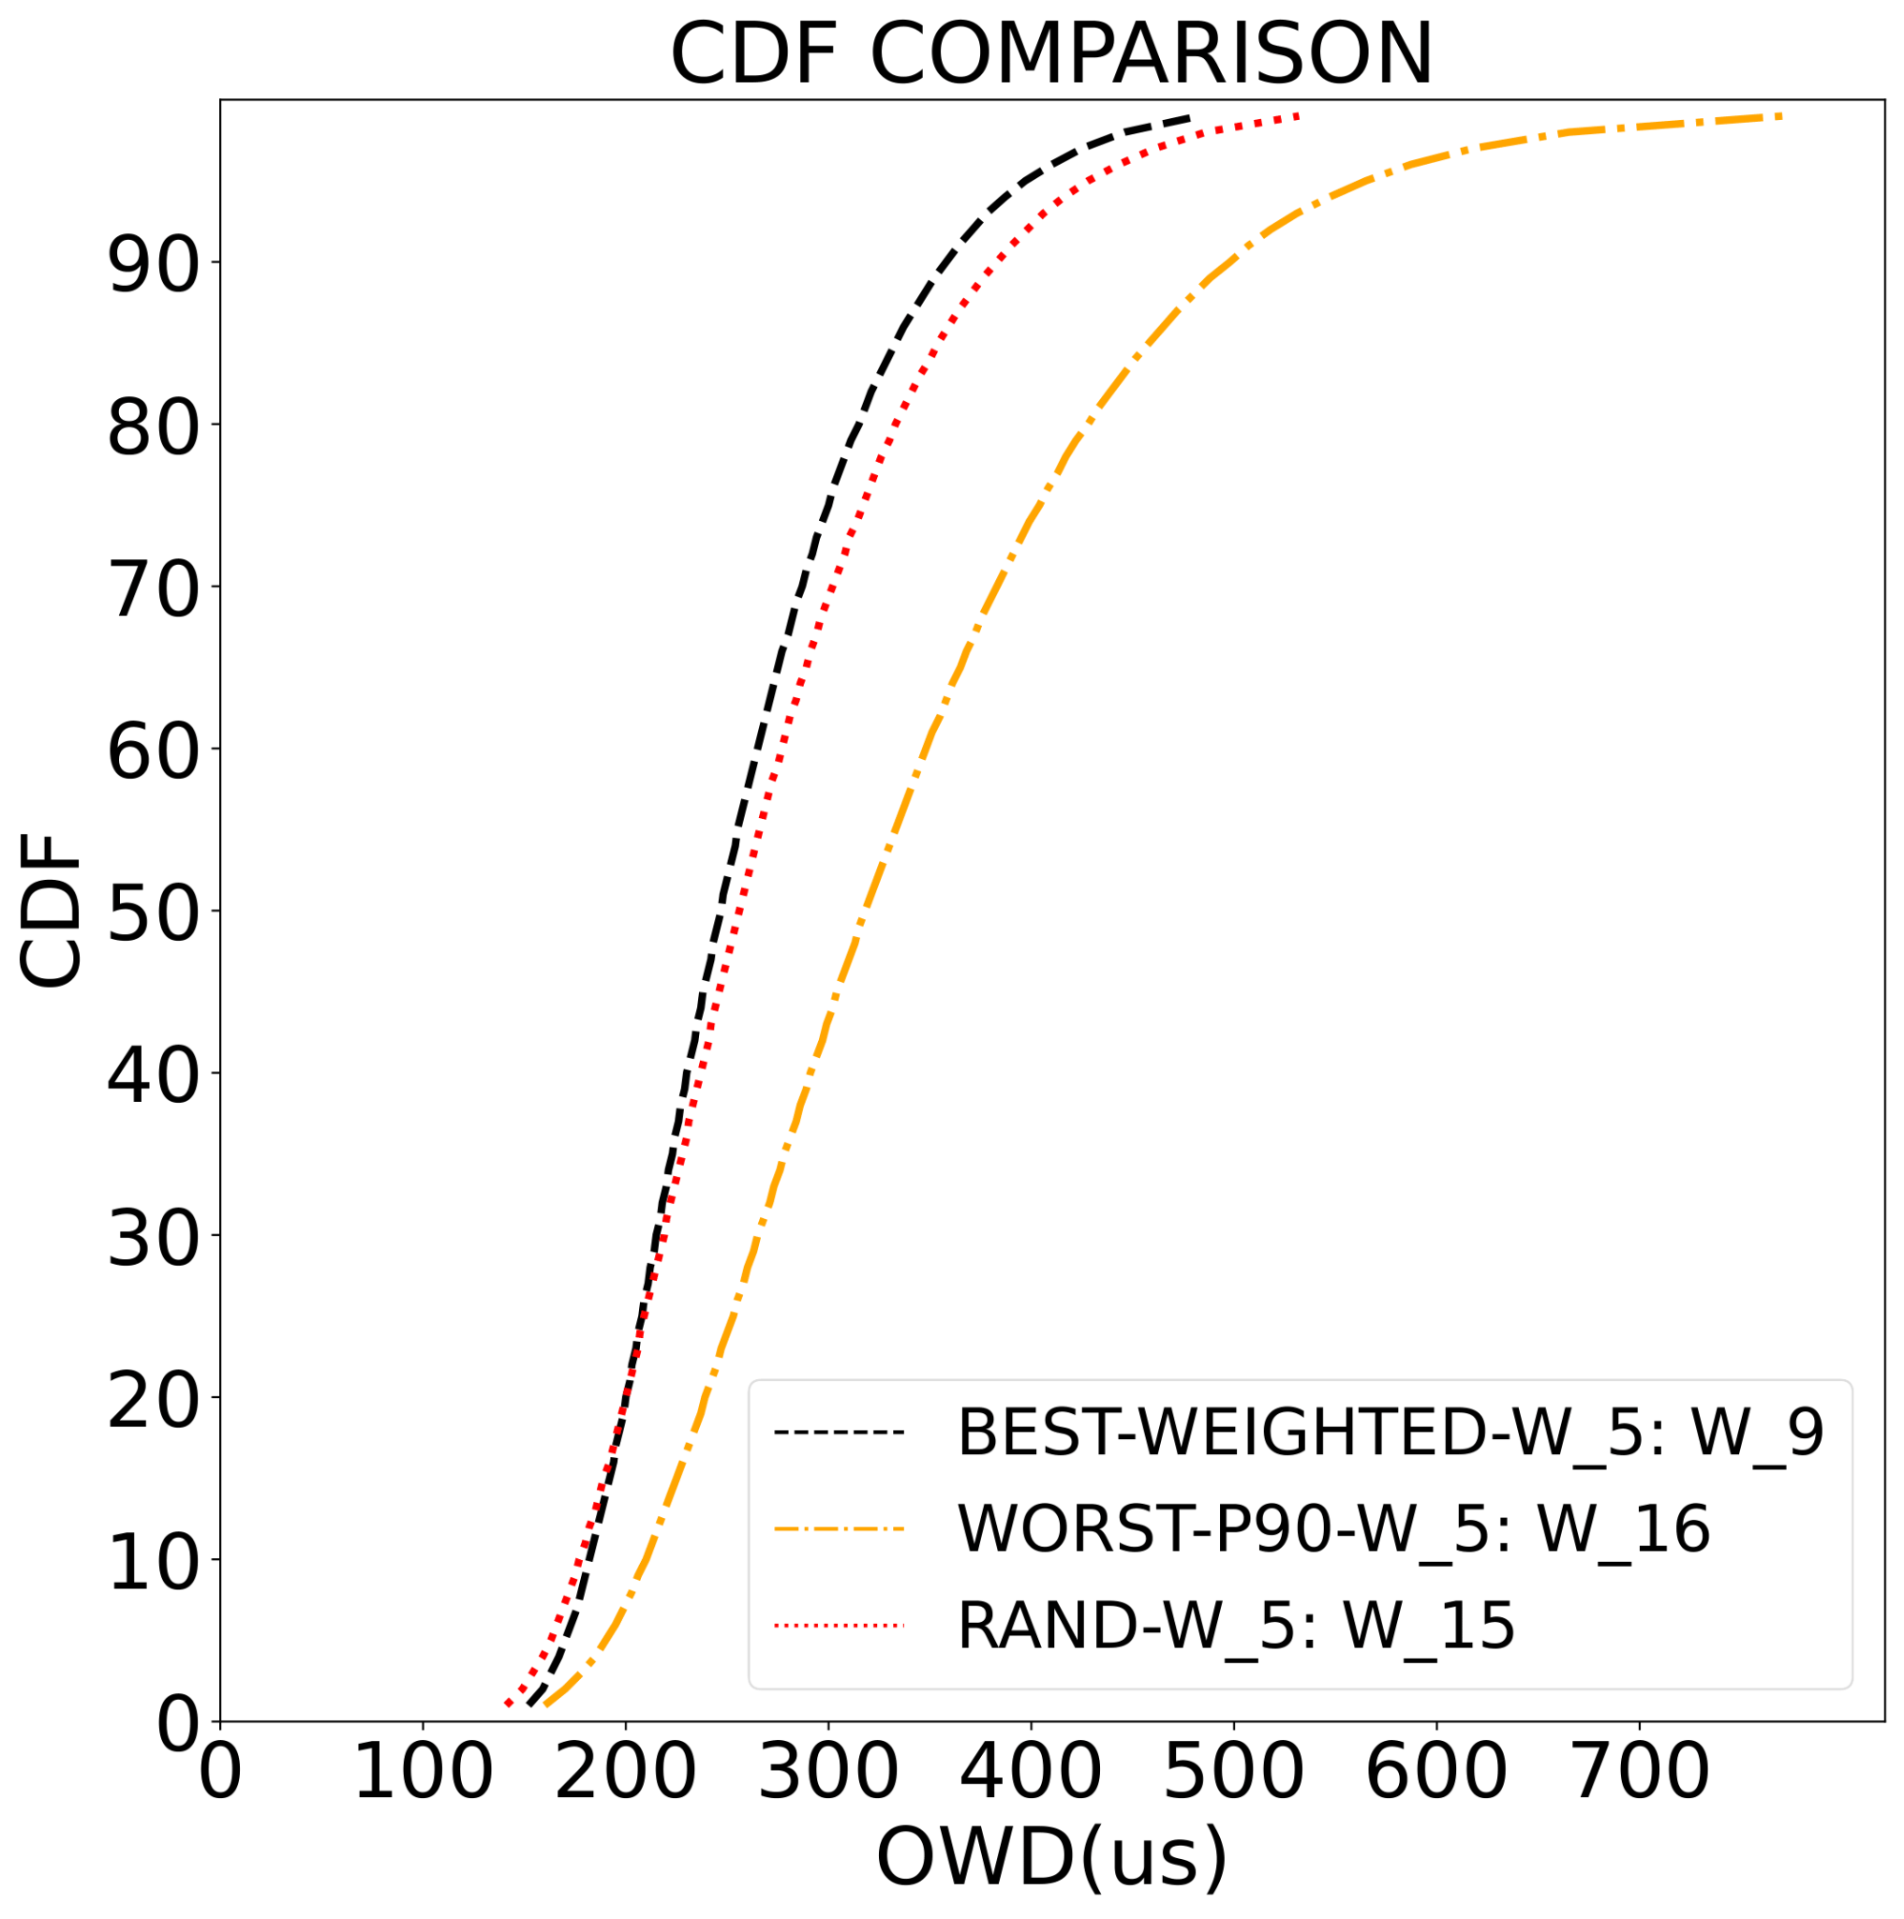
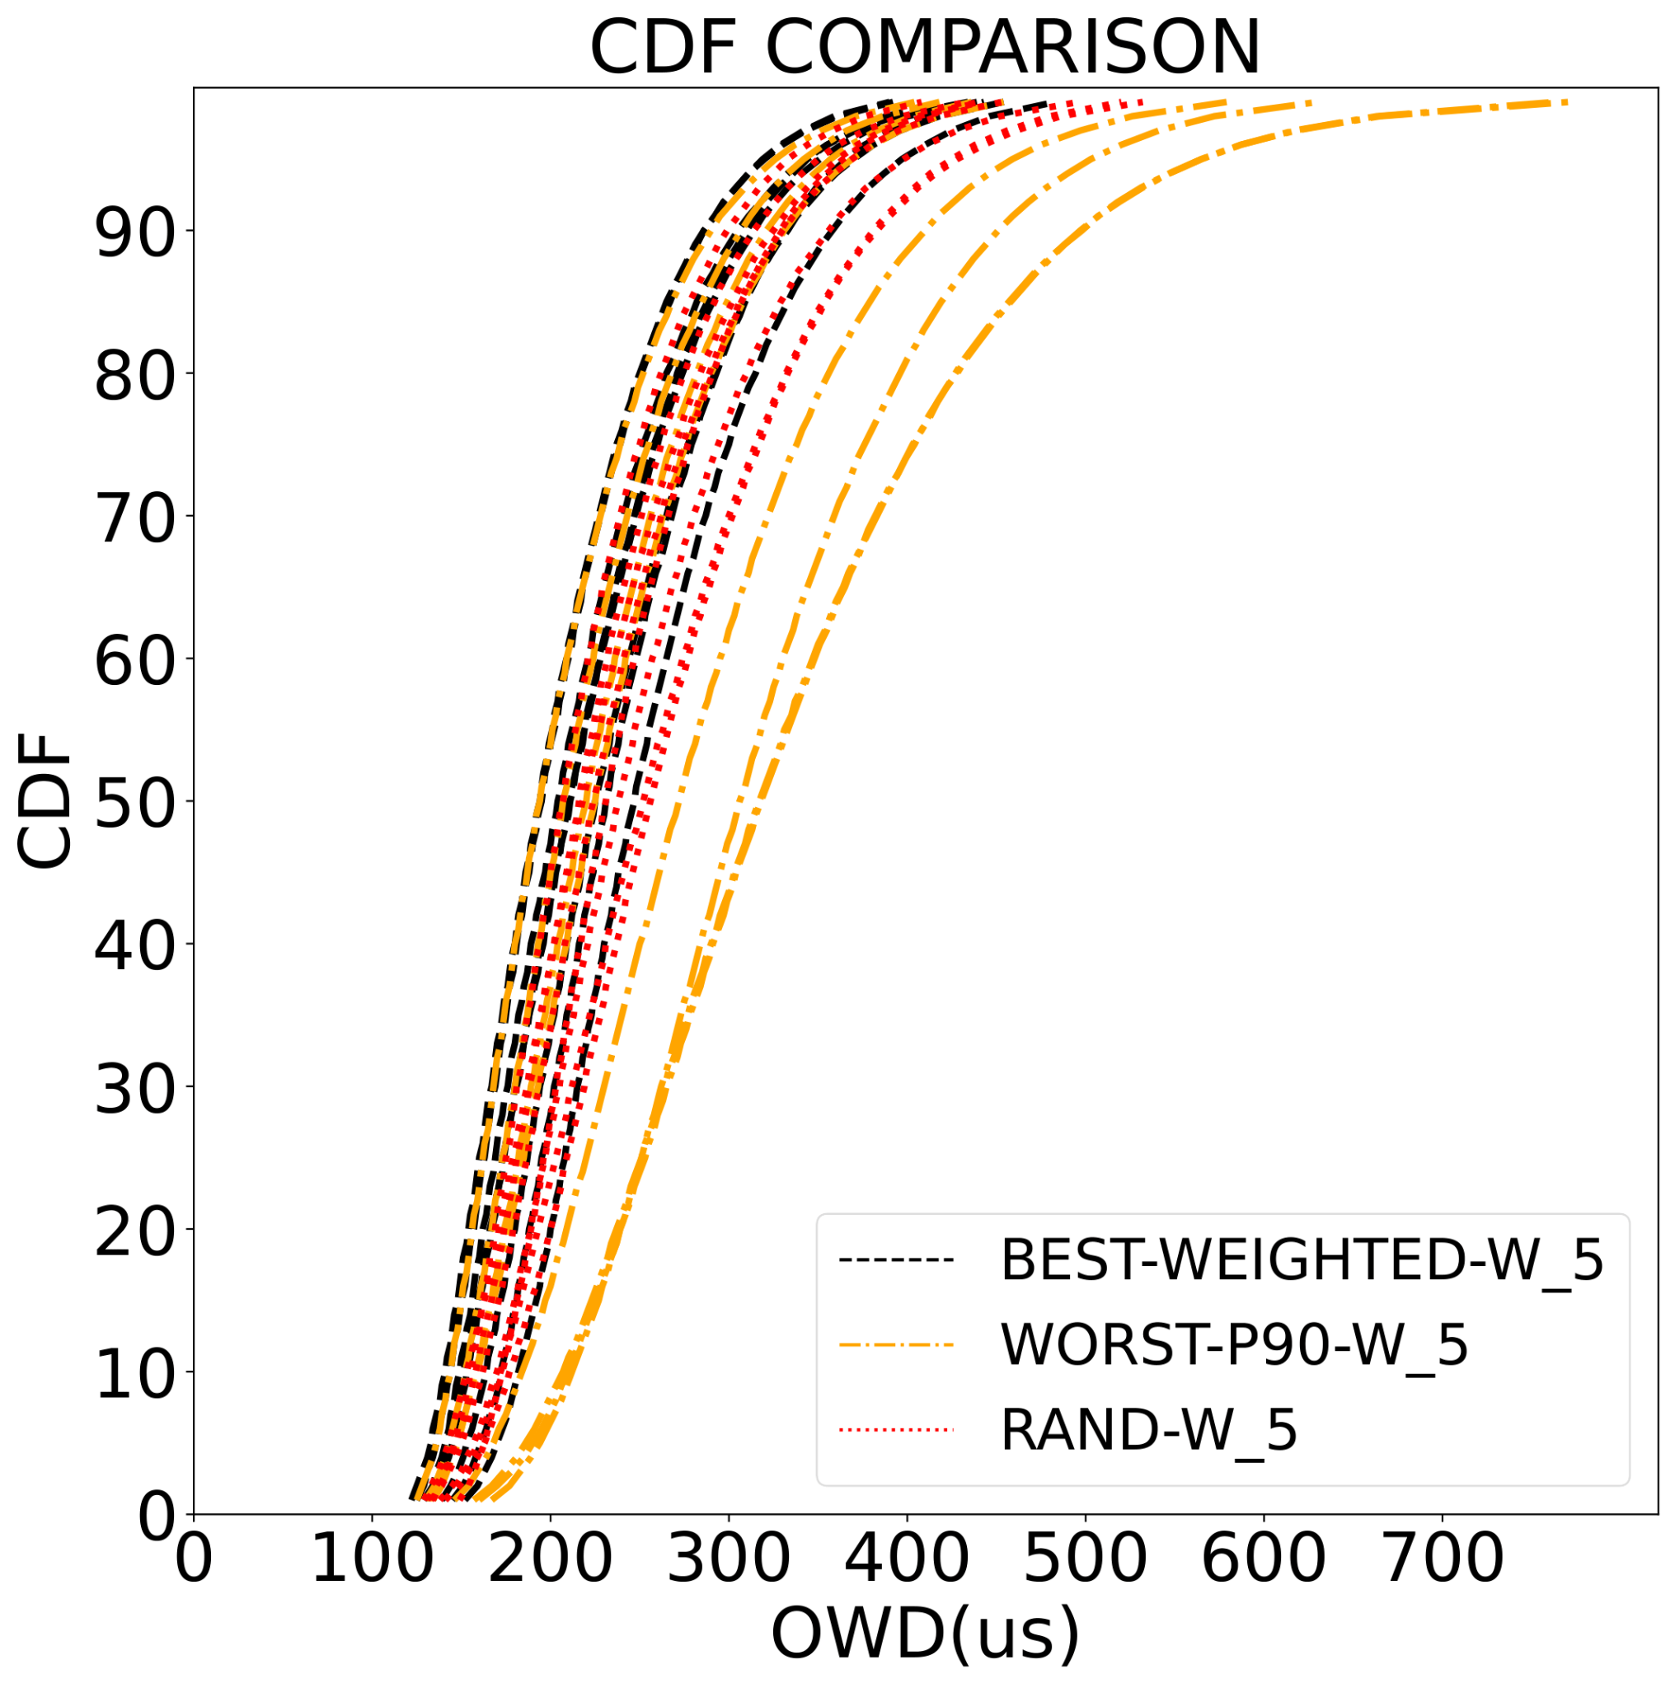
Results: Straggler Impact – BEST x WORST x RAND
BEST 6.53% lower OWD 90th % vs RAND
RAND in between BEST and WORST
RAND displays considerable variance vs BEST
 | BEST-WEIGHTED | RAND | WORST
90th % | 358 μs | 383 μs | 498 μs
median | 247 μs | 256 μs | 318 μs
mean | 261.4 μs | 281.1 μs | 353.66 μs
stddev | 78.95 μs | 308.3 μs | 352.29 μs
ID | W_9 | W_15 | W_16
There is value in optimizing against stragglers!

Slide 36
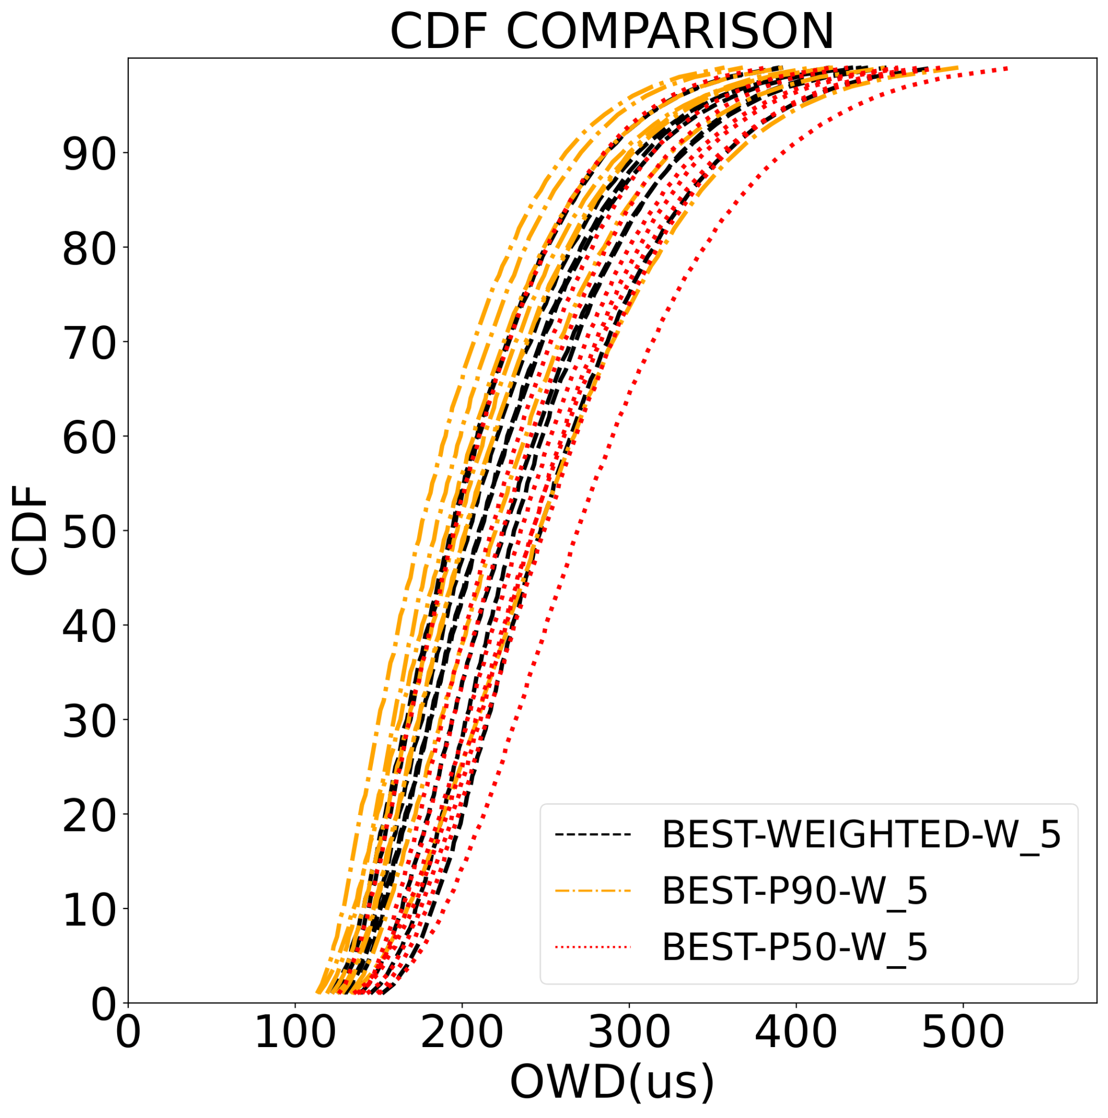
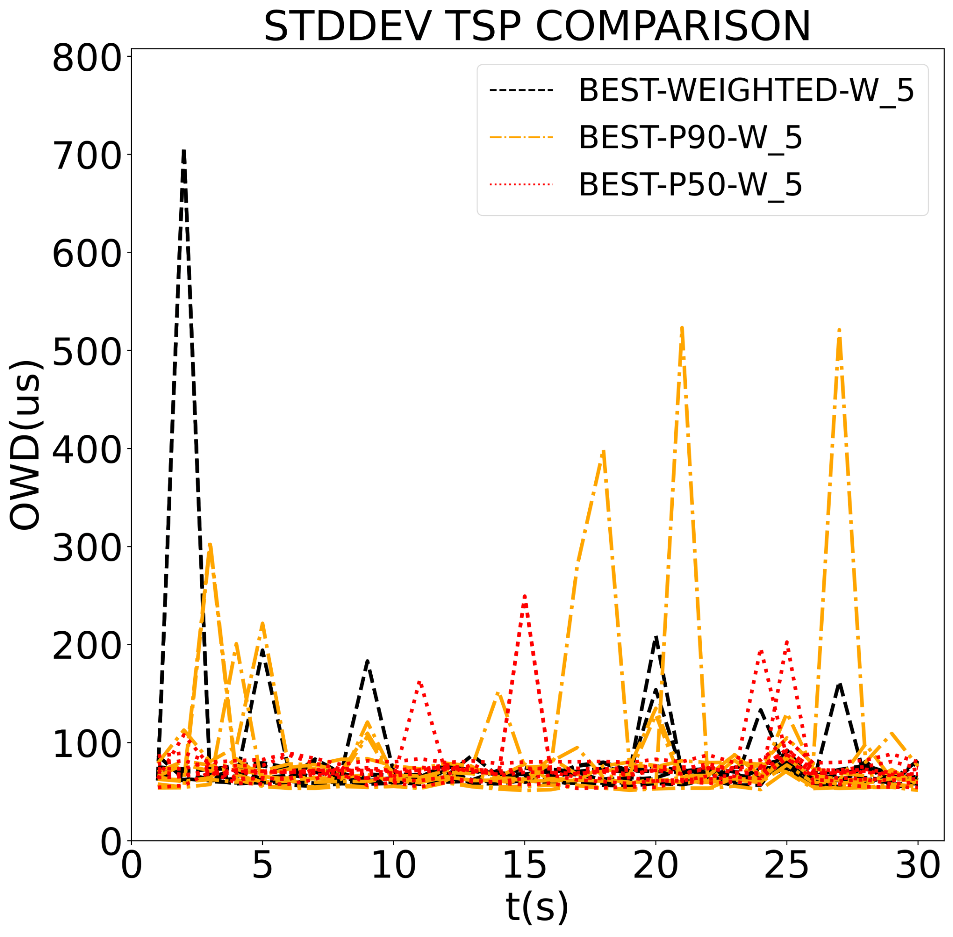
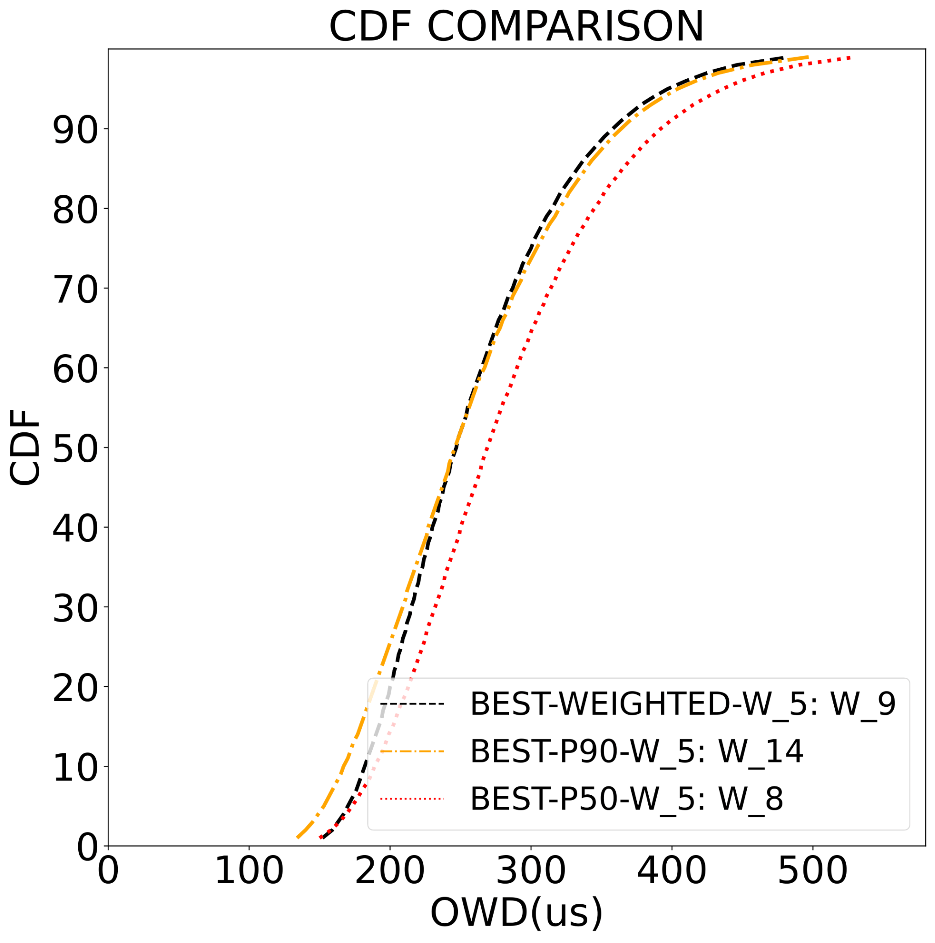
Results: Strategy Comparison – WEIGHTED x P90 x P50
WEIGHTED 6.53% lower 90th % than P50
P90 shows some of the best latency profiles
P50 shows less variance
 | BEST-WEIGHTED | BEST-P90 | BEST-P50
90th % | 358 μs | 364 μs | 392 μs
median | 247 μs | 246 μs | 269 μs
mean | 261.4 μs | 262.11 μs | 282.57 μs
stddev | 78.95 μs | 159.2 μs | 83.57 μs
ID | W_9 | W_14 | W_18
P50 prioritizes stability, P90 performance, WEIGHTED seeks balance

Slide 37
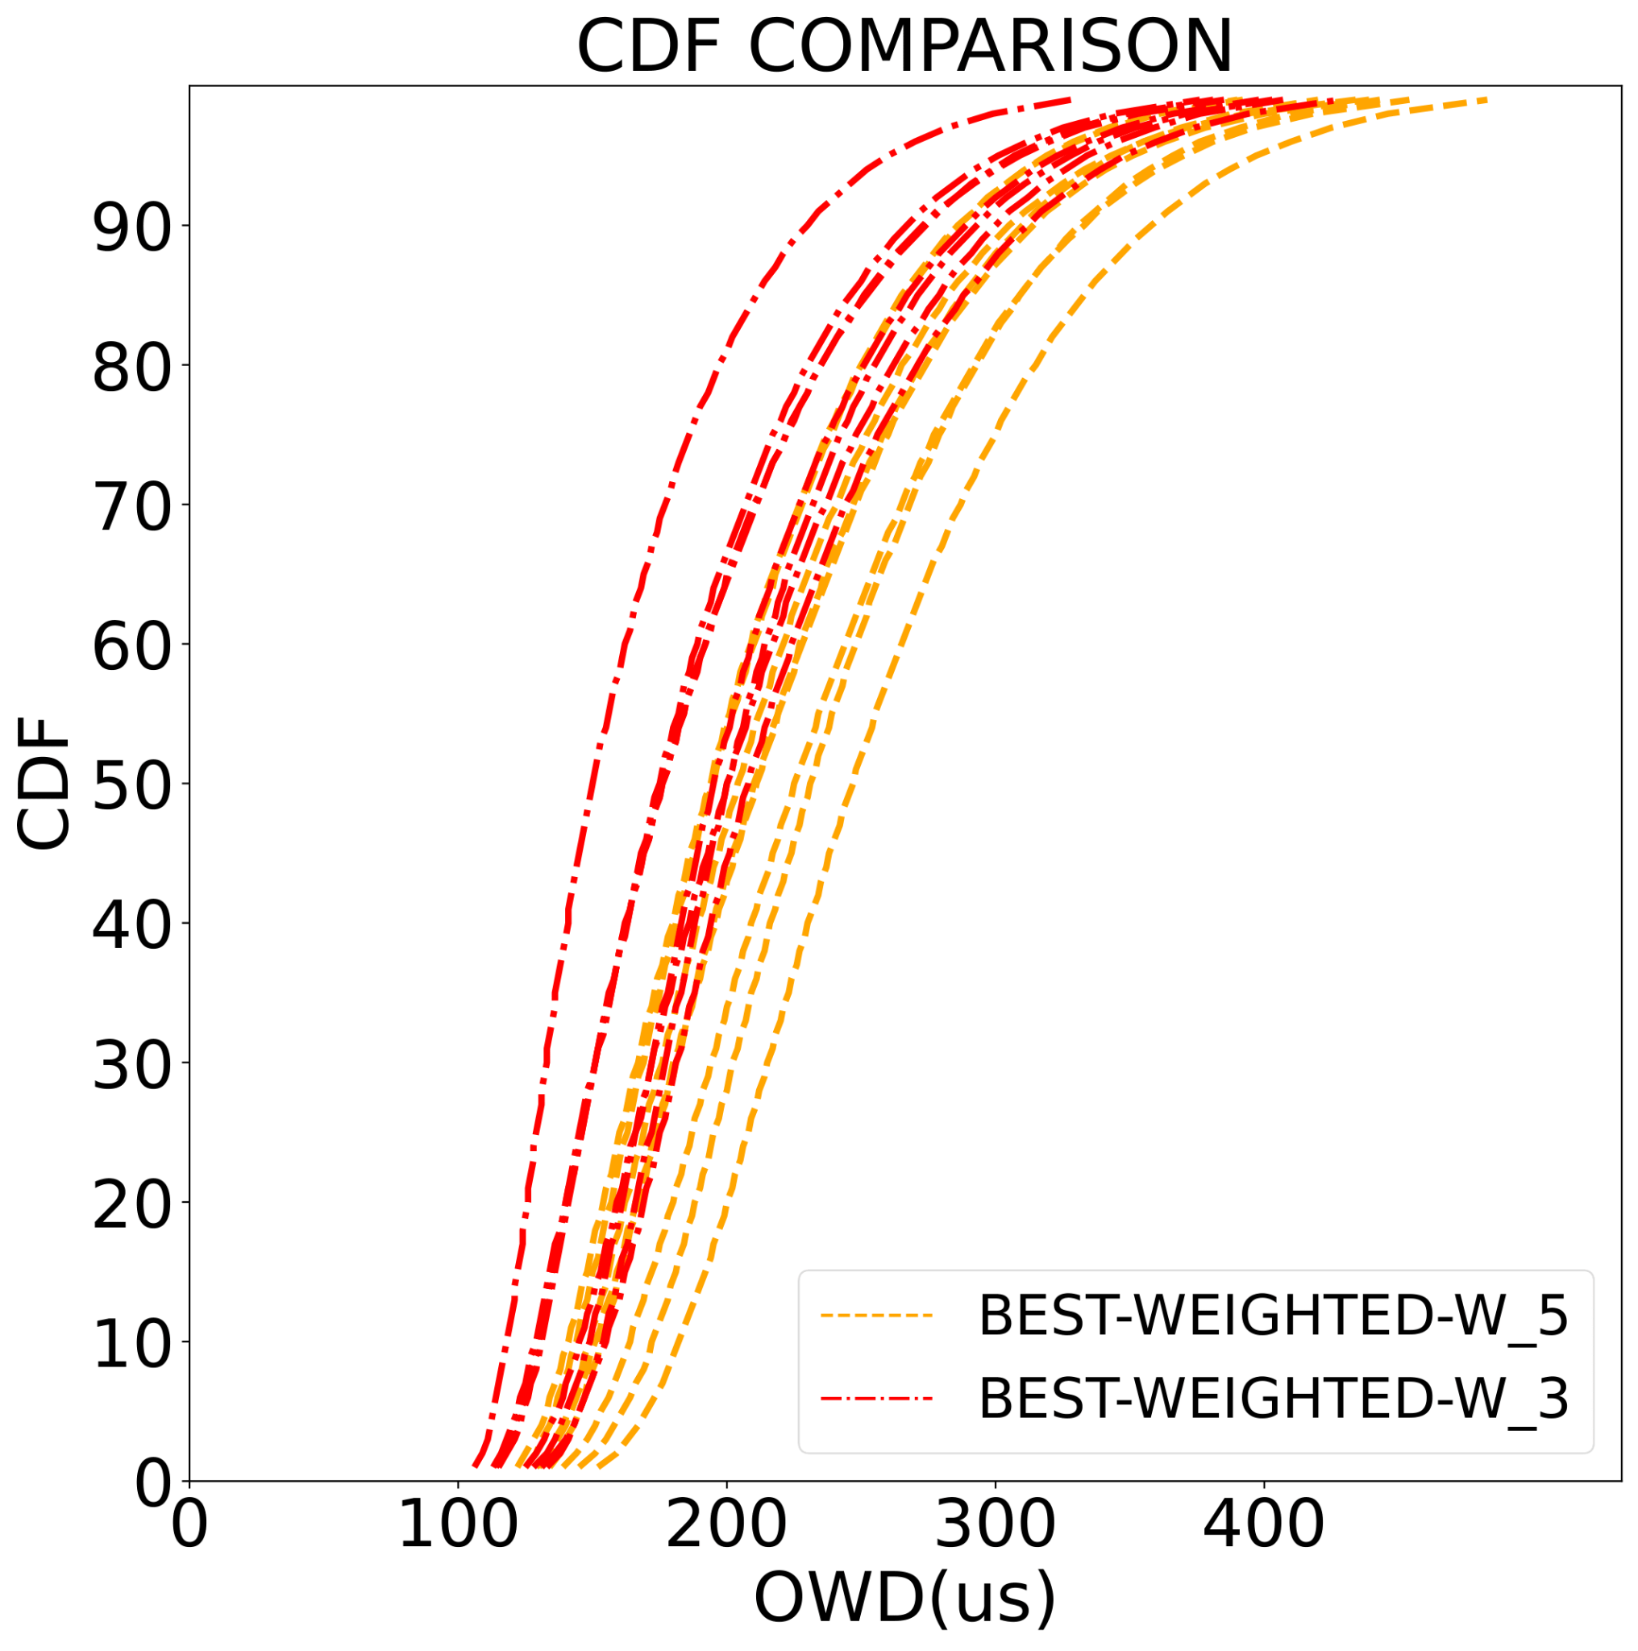
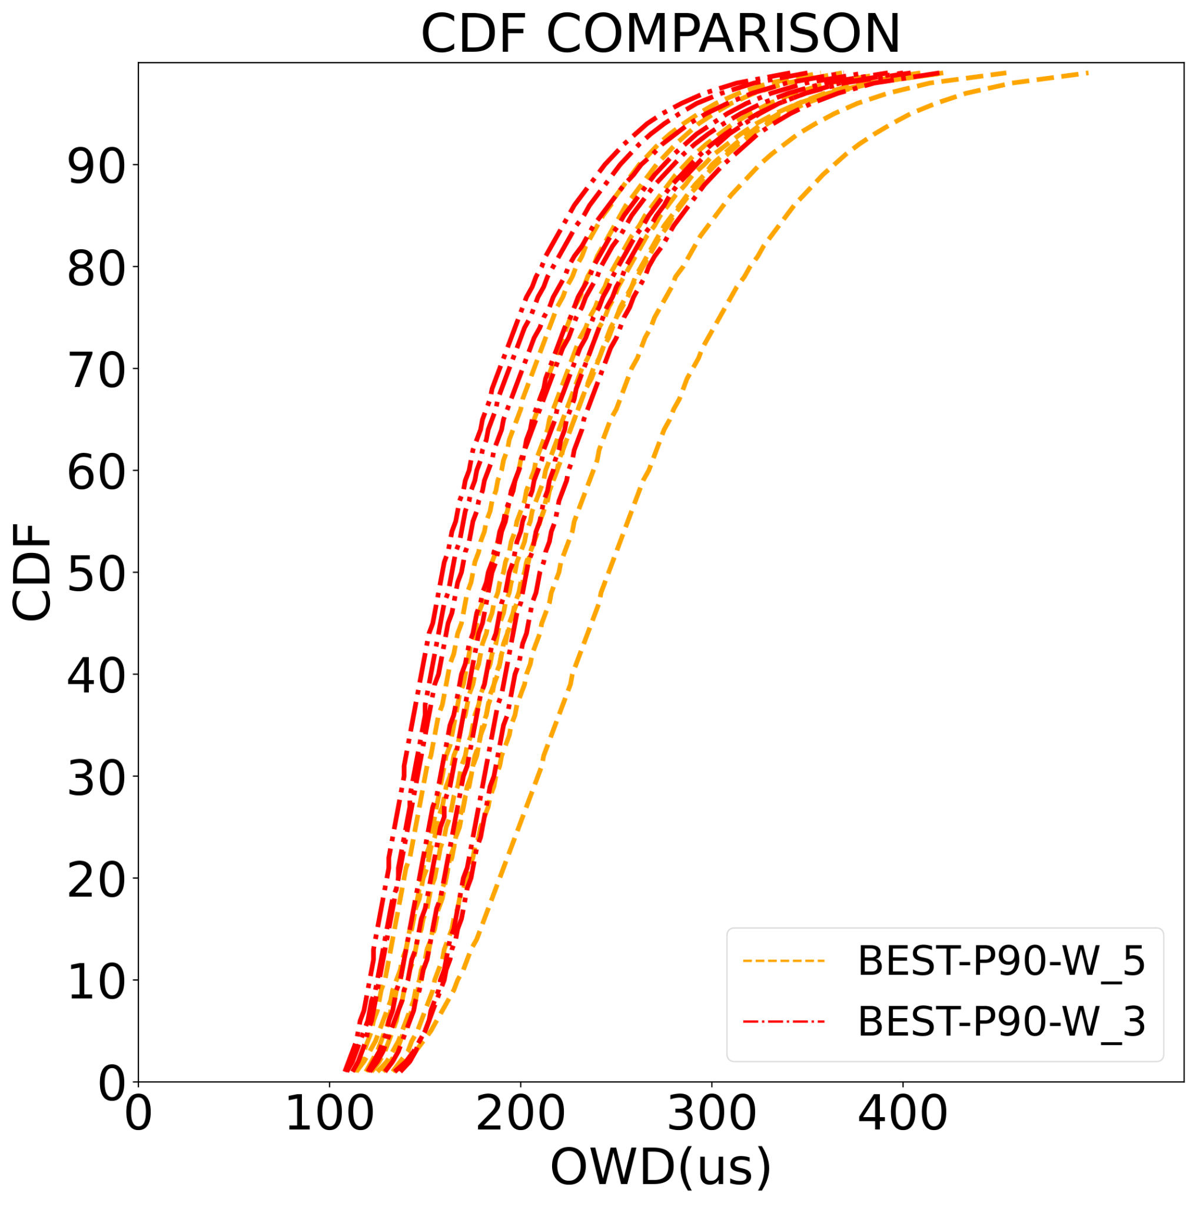
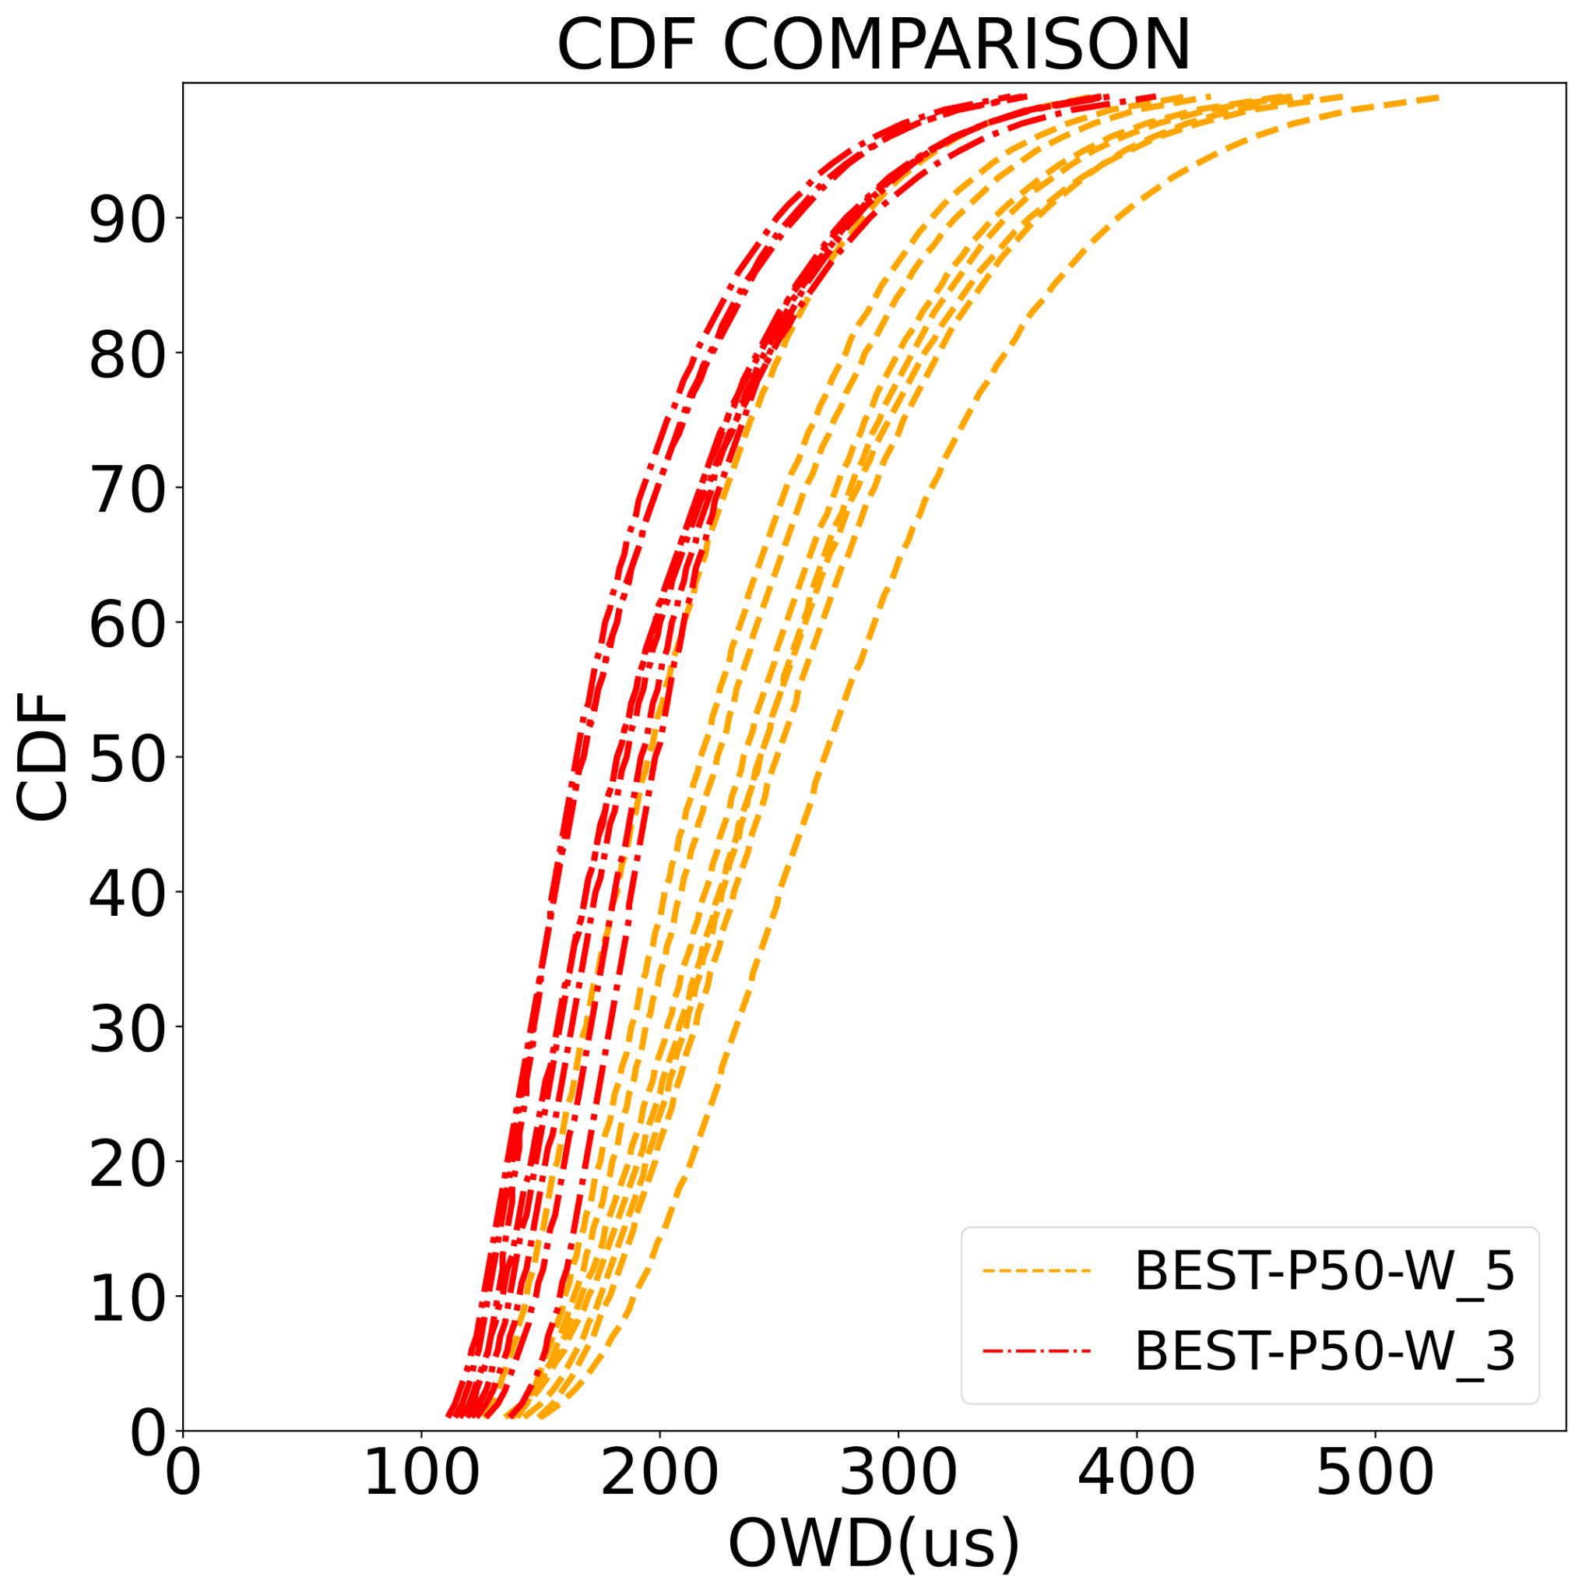
Results: Root Selection
All strategies performed worse with W_5 as root
W_3-based root shows 12.85% lower latency in 90th%
BEST-WEIGHTEDD | ROOT: W_5 | ROOT: W_3
90th % | 358 μs | 312 μs
median | 247 μs | 208 μs
mean | 261.4 μs | 223.18 μs
stddev | 78.95 μs | 68.6 μs
ID | W_9 | W_9
Root selection impact is significant!

Slide 38
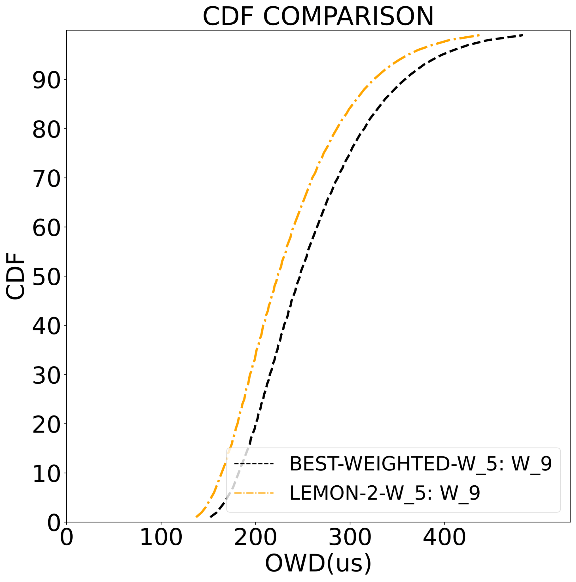
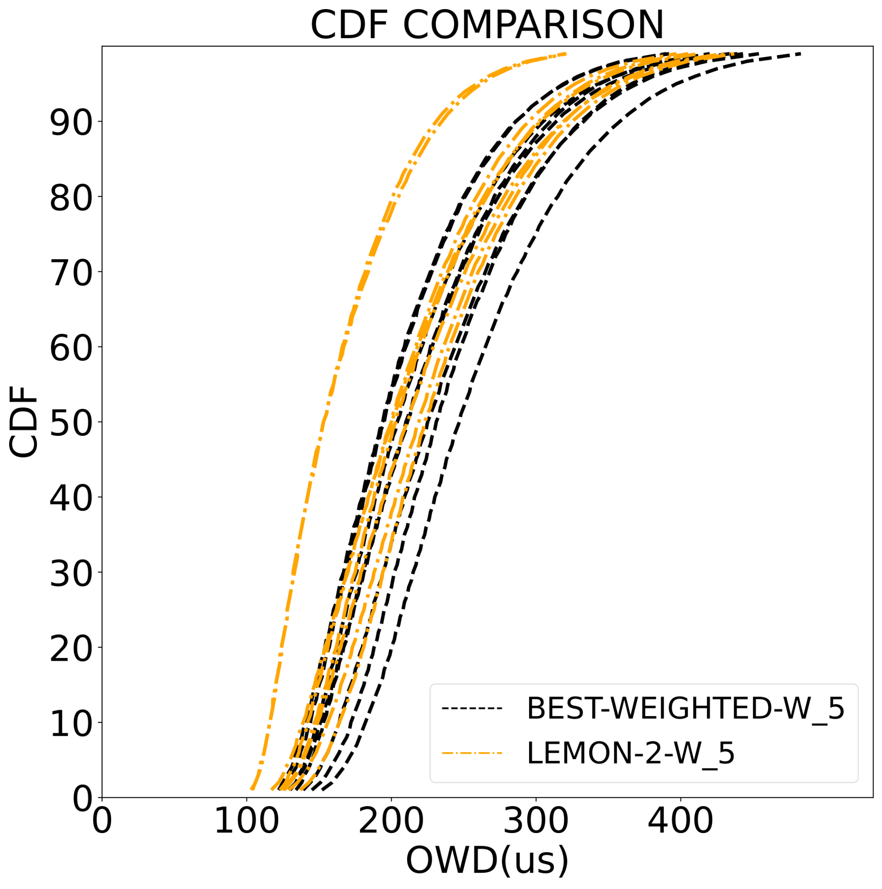
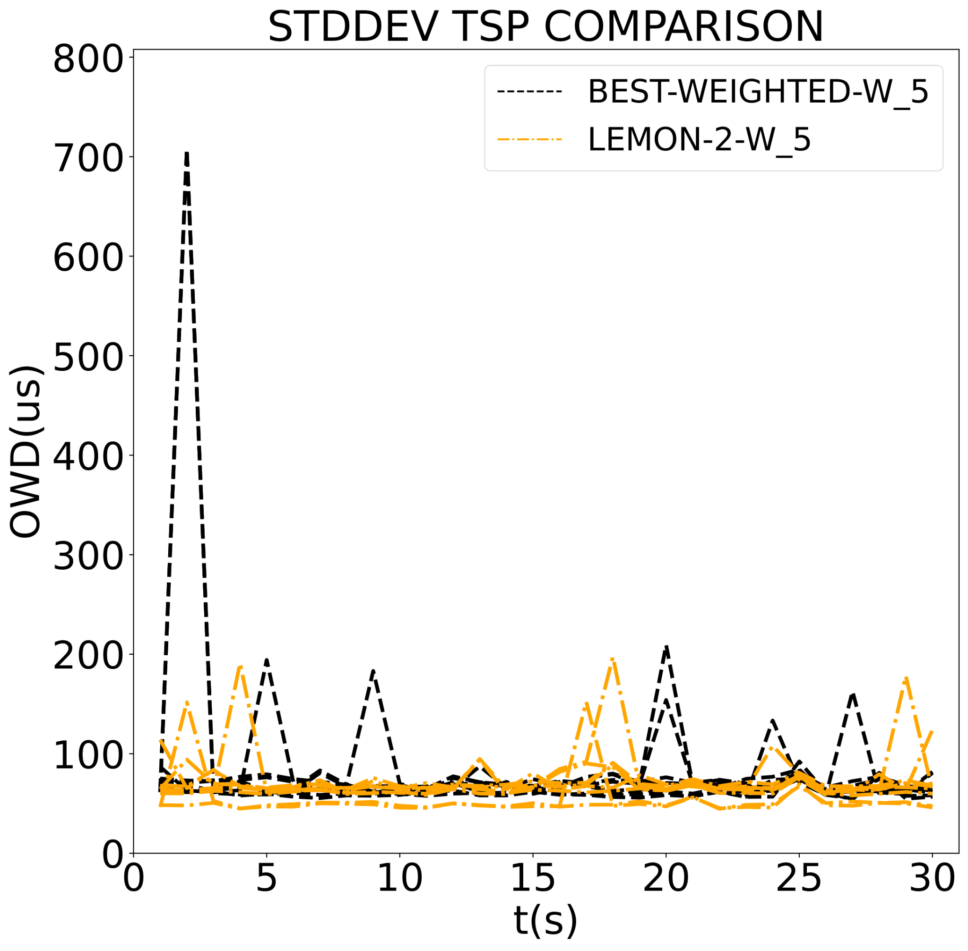
Results: LemonDrop Comparison
LEMON-2 9.22% lower 90th % than BEST-WEIGHTED
LEMON-2 left-shifted CDF profile vs BEST-WEIGHTED
LEMON-2 slightly less variant
 | BEST-WEIGHTED | LEMON-2
90th % | 358 μs | 325 μs
median | 247 μs | 223 μs
mean | 261.4 μs | 236.7 μs
stddev | 78.95 μs | 76.39 μs
ID | W_9 | W_9
LEMON-2 converged in 0.0016sec

Slide 39
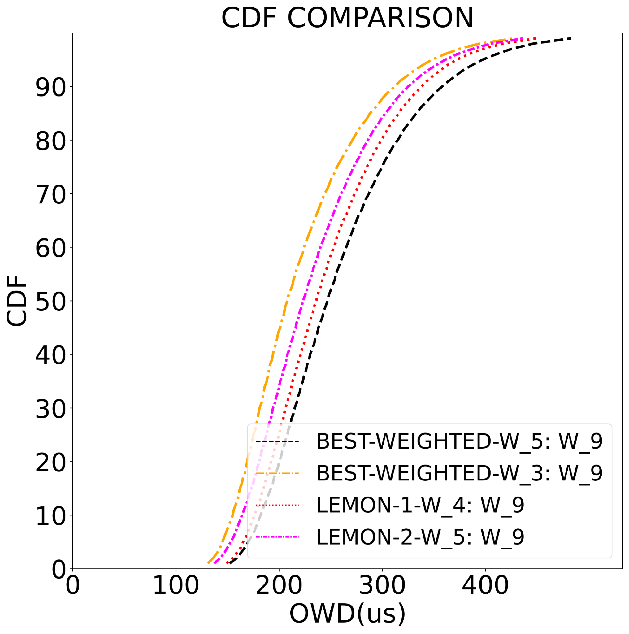
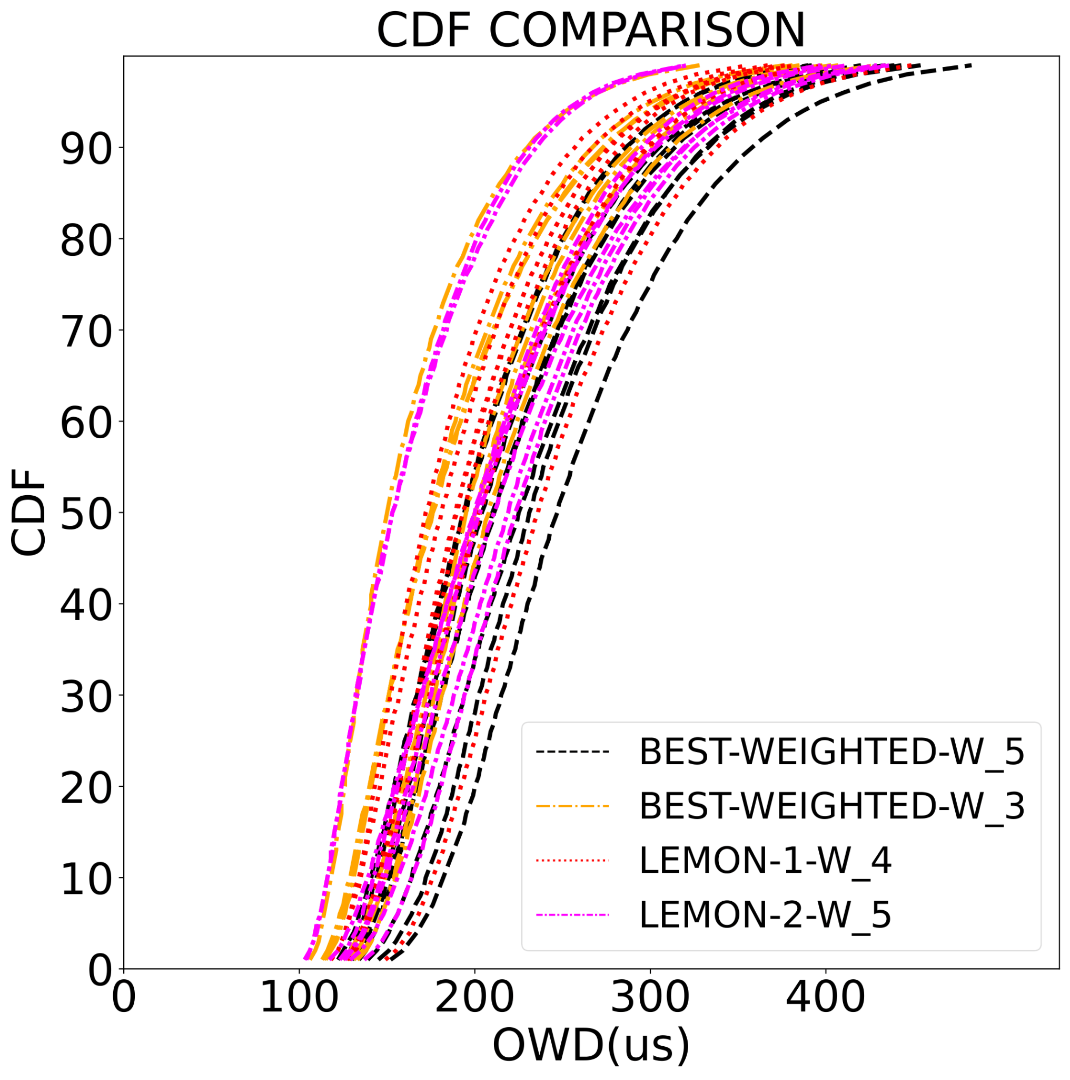
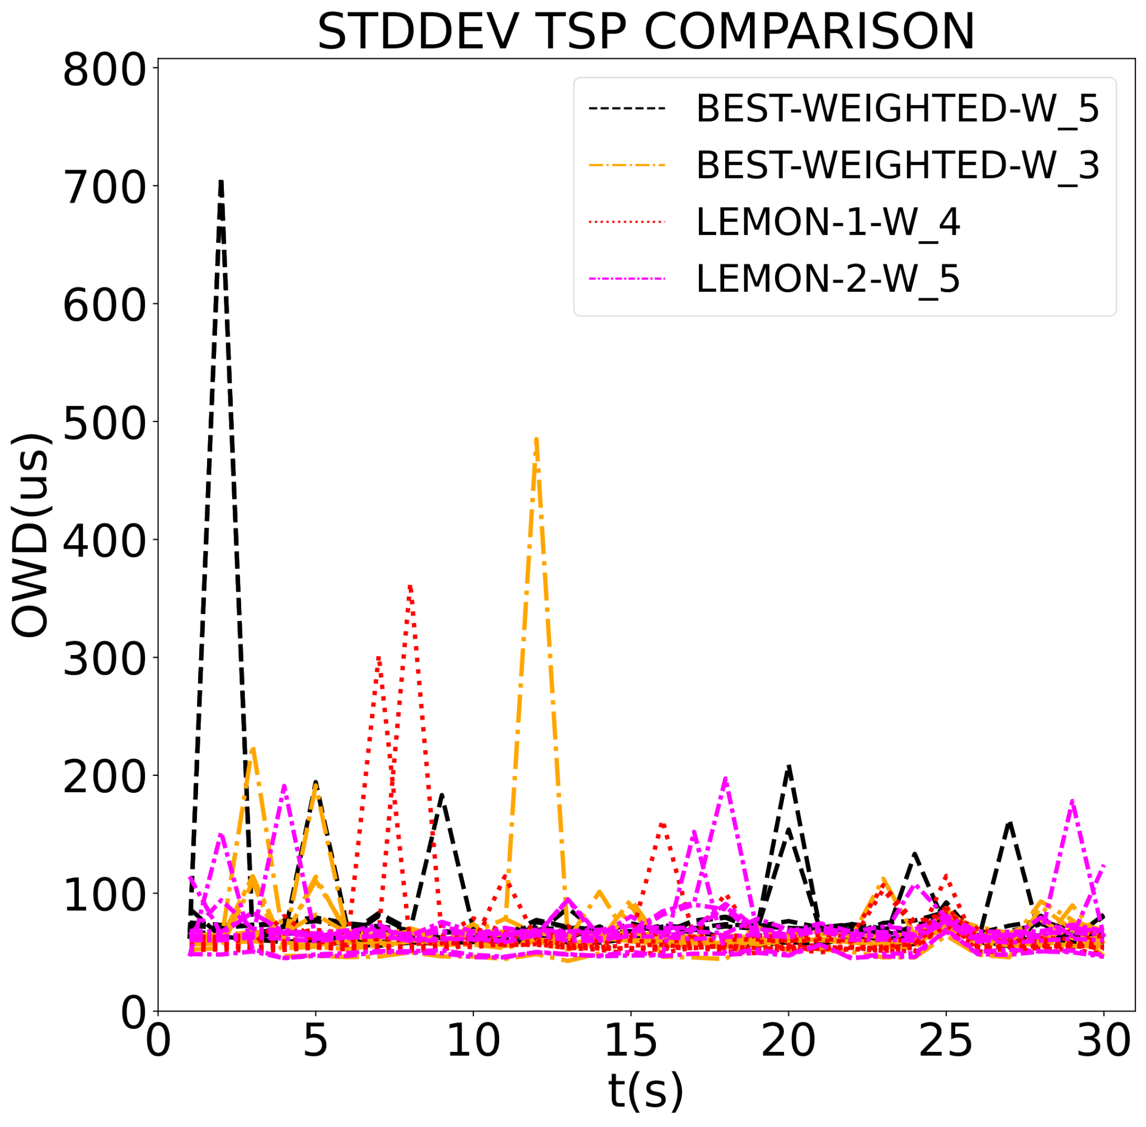
Results: LemonDrop Comparison
BEST-WEIGHTED-W_3 displays better performing worst receiver
LEMON-1 and LEMON-2 show overall healthier receiver profiles and less variance
LEMON-1 and LEMON-2 converged respectively in 0.0346 and 0.0016 seconds
Comparable performance, Lemon offers more stability

Slide 40
Conclusions
Takeaways
Future Work
Flexible Selection Framework:
Detects stragglers
Improves multicast latency (μs)
Trade-offs between variance x perf.
Straight-Forward, Lightweight
Comparable to LemonDrop
pre-defined hyperparameters (ε , n)
Incremental Updates
Latency profile per subtree
auto-scale triggers
Root selection mechanism
Refining heuristic:
high-performance
stability
Questions!

Slide 41
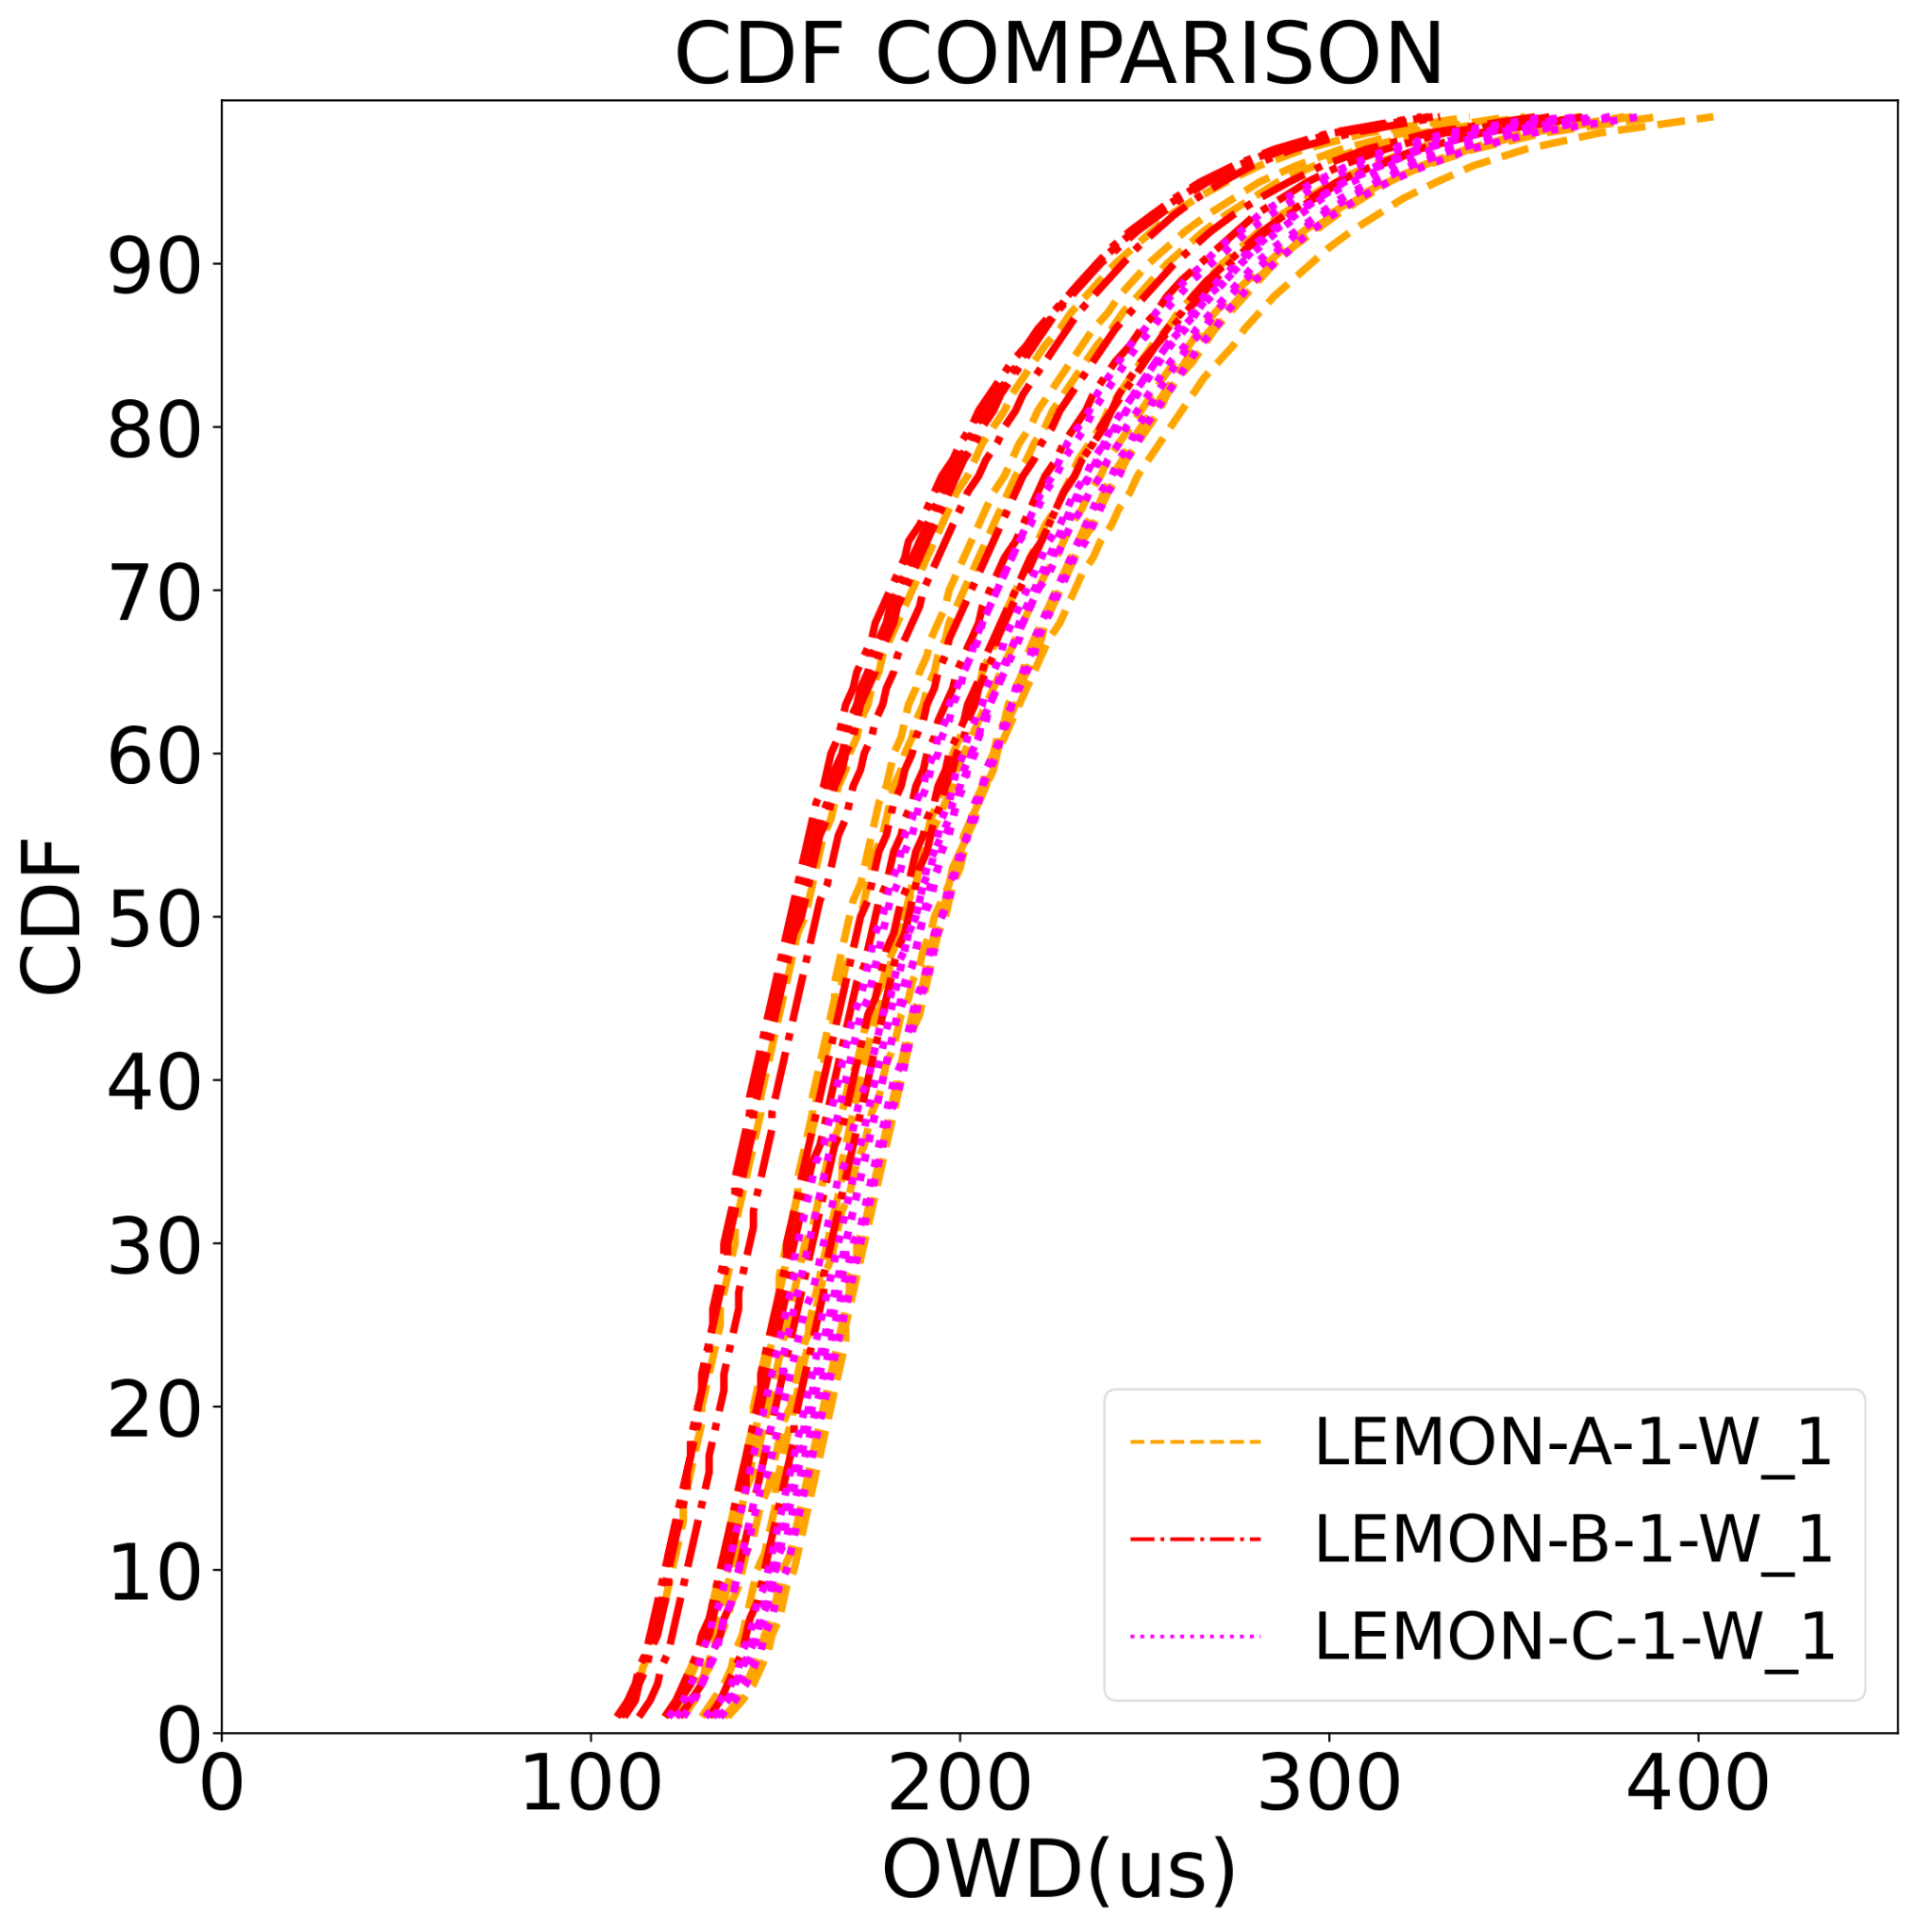
LemonDrop Parametrization
 | LEMON-A | LEMON-B | LEMON-C
90th % | 295 μs | 273 μs | 285 μs
stddev | 83.35 μs | 64.19 μs | 57.64 μs
epsilon | 1 x 10e-4 | 2.2 x 10e-5 | 1.7 x 10e-5
n | 1000 | 10 000 | 100 000
conv. | TRUE | FALSE | FALSE
time | 0.0381 sec | 11.26 sec | 111.94 sec

Slide 42
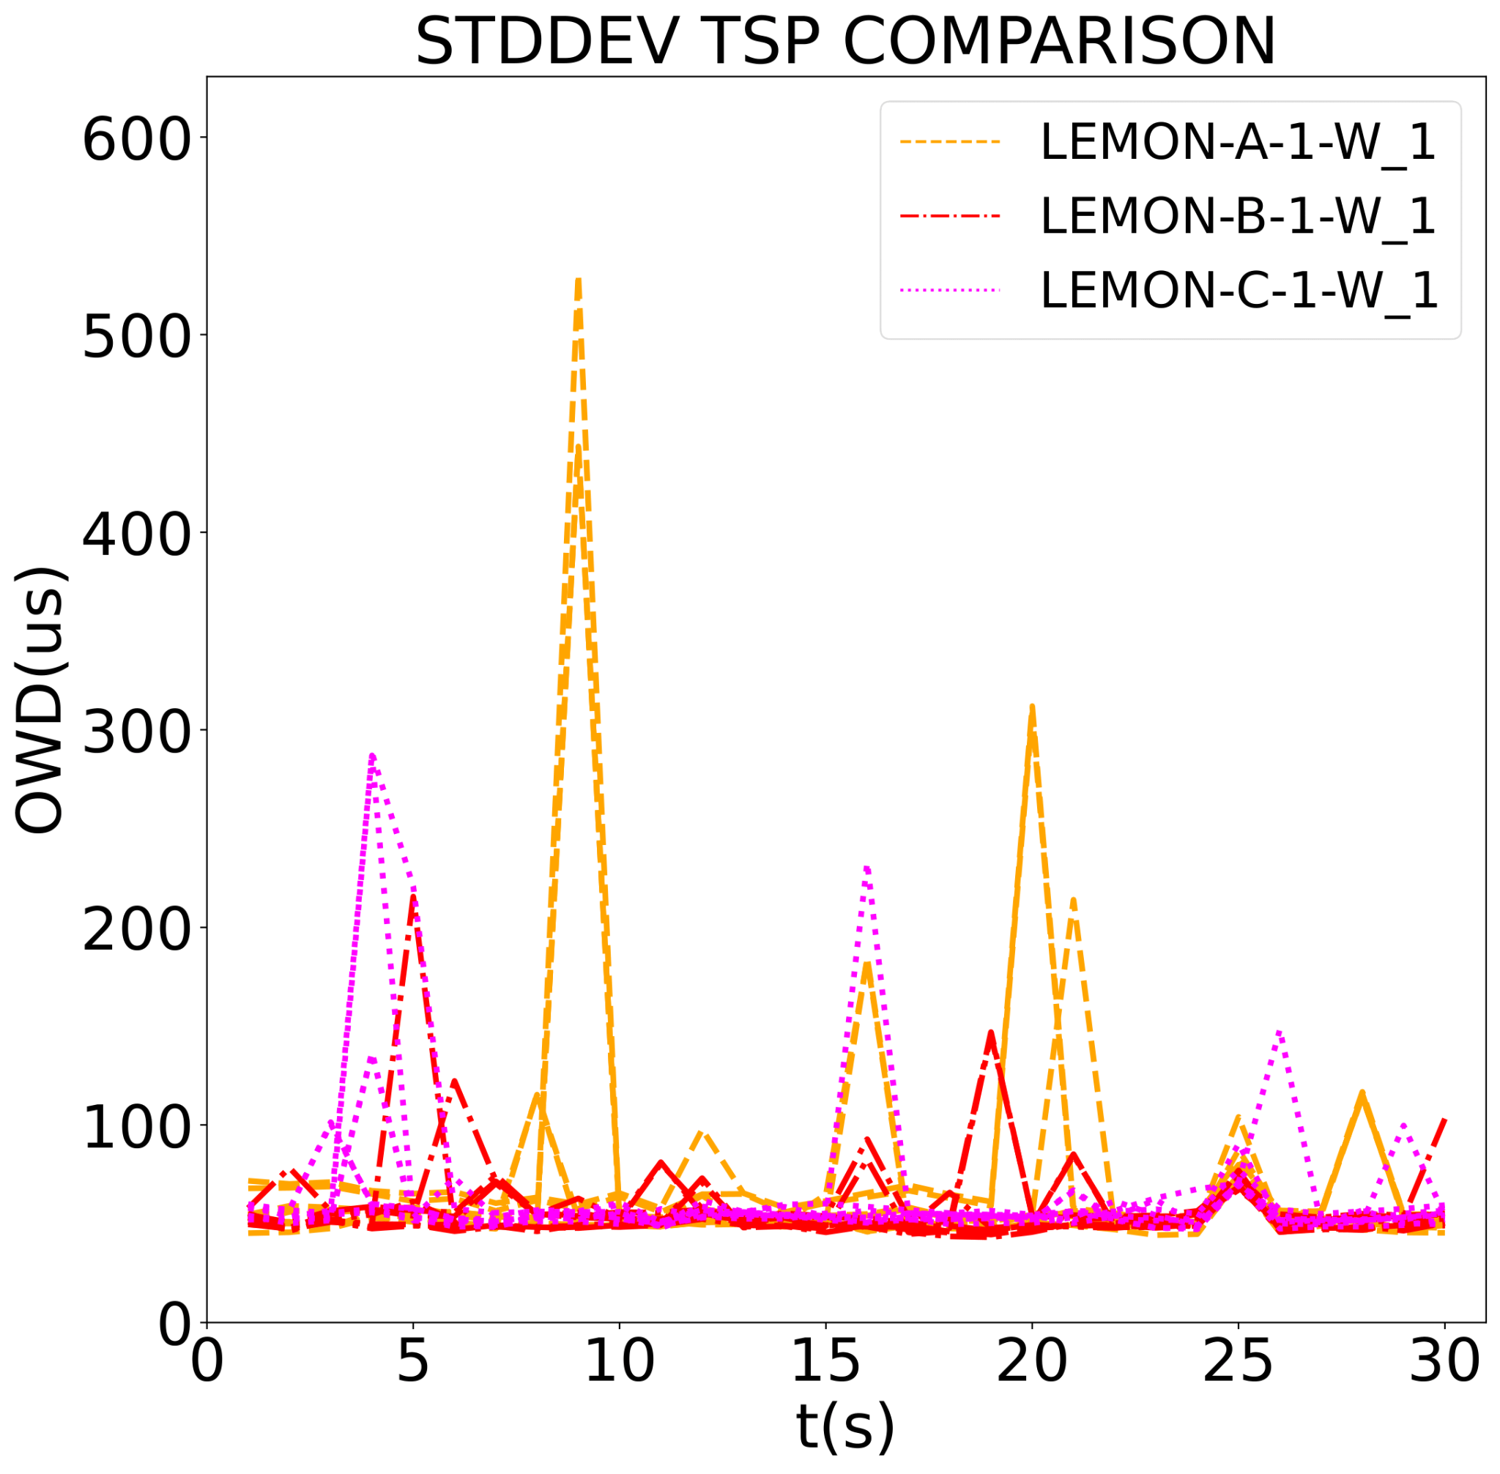
LemonDrop Parametrization
 | LEMON-A | LEMON-B | LEMON-C
90th % | 295 μs | 273 μs | 285 μs
stddev | 83.35 μs | 64.19 μs | 57.64 μs
epsilon | 1 x 10e-4 | 2.2 x 10e-5 | 1.7 x 10e-5
n | 1000 | 10 000 | 100 000
conv. | TRUE | FALSE | FALSE
time | 0.0381 sec | 11.26 sec | 111.94 sec

Slide 43
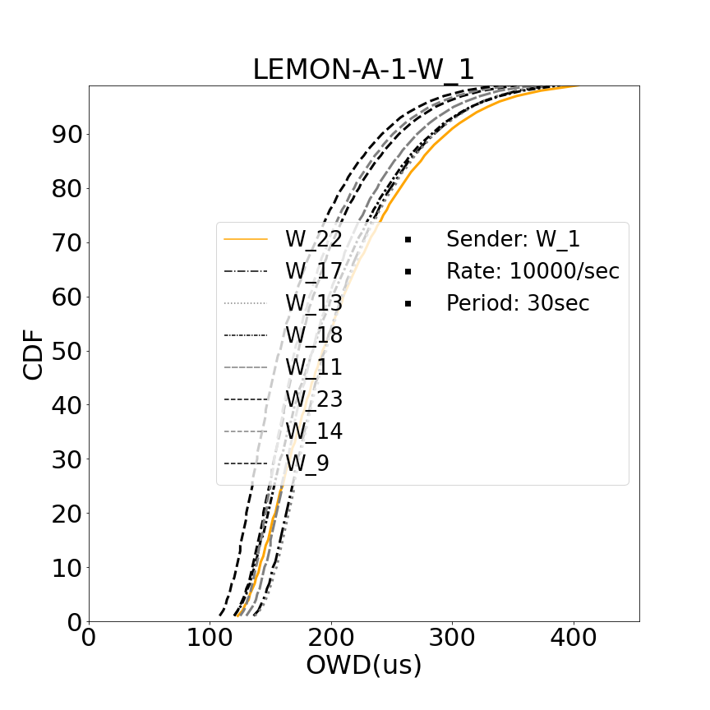
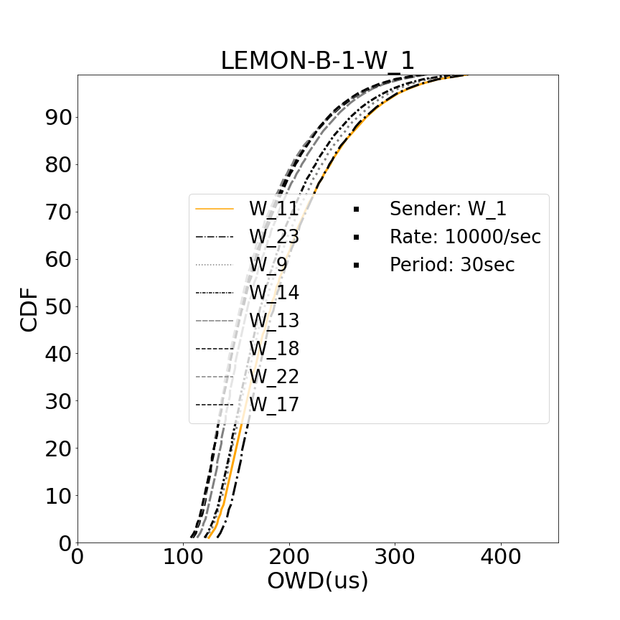
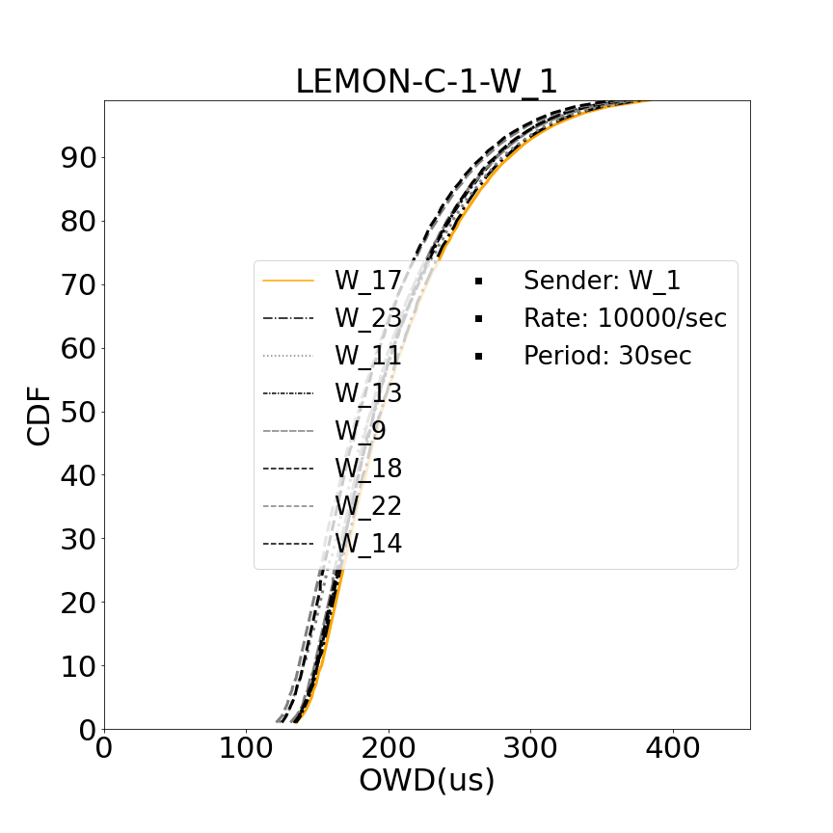
LemonDrop Parametrization

Slide 44
Root Selection impacts final system significantly – WEIGHTED
Contrast all receivers
BEST-WEIGHTEDD | ROOT: W_5 | ROOT: W_3
90th % | 358 μs | 312 μs
median | 247 μs | 208 μs
mean | 261.4 μs | 223.18 μs
stddev | 78.95 μs | 68.6 μs
ID | W_9 | W_9
Weighted = (0.7 x stddev) + (0.3 x p90)

Slide 45
Root Selection impacts final system significantly – P50
Contrast all receivers
BEST-P50 | ROOT: W_5 | ROOT: W_3
90th % | 392 μs | 288 μs
median | 269 μs | 186 μs
mean | 282.57 μs | 205.25 μs
stddev | 83.57 μs | 156.08 μs
ID | W_18 | W_9
P50: (1.0 x p50)

Slide 46
Root Selection impacts final system significantly – P90
Contrast all receivers
BEST-P90 | ROOT: W_5 | ROOT: W_3
90th % | 364 μs | 306 μs
median | 246 μs | 210 μs
mean | 262.11 μs | 226.45 μs
stddev | 159.2 μs | 153.93 μs
ID | W_14 | W_6
P90: (1.0 x p90)

Slide 47
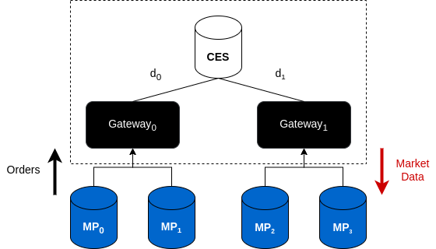
Background: Financial Exchanges
Fairness or “Fair Access” to Market Participants (MPs)
Migration to the Cloud:
i) Mechanisms for fair delivery ii) Latency Variance
Notes:
Financial Exchanges
There are two parts to this definition of fairness:
inbound fairness: one is as market players issue orders, incoming orders are processed in the same sequence they are issued.
outbound fairness: market data is disseminated across MPs simultaneously.
As mentioned, these highly-engineered infrastructures on which these financial exchanges operate are able to provide this.
switch-multicast
equal cable-lengths d₁ / d₂
1us
Market Data:
Trade Records
Snapshots of Limit Order Books
Financial Exchanges in the Cloud
Promises: Scalability, Cost-Efficiency, More Robust Infrastructure, Rapid Increase in MPs
NASDAQ plans on migrating all markets to the public cloud in the next decade
NASDAQ started offloading data processing to the cloud
Singapore Stock Exchange built cloud-native exchange infrastructure.
So what are the challenges to this shift?
Cloud Issues:
Delays between OG1, OG2 and ME/CES can vary based on congestion, VM placement.
has varying network latencies: market unfairness
network conditions that change daily
limited control over underlying infrastructure
no mechanisms for fair delivery

Slide 48
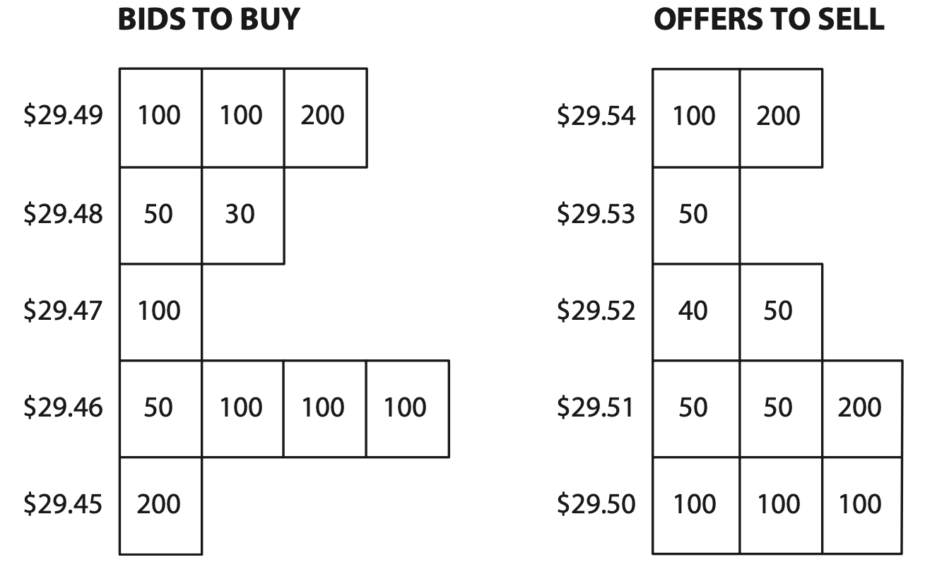
Background: Financial Exchanges to the Cloud

Slide 49
State-of-the-Art: LemonDrop¹
Core of method:
Clock Synchronization
(QAP) Optimization Method: Facilities=Nodes, VMs=Locations
𝚲: Load Matrix, Δ: OWD Matrix, P: Permutation Matrix
D = ∑^{L}_{i,j=1}λ_{ij}d_{ij} , D(P) = trace(𝚲PΔ^{T}P^{T})
¹LemonDrop: https://searchworks.stanford.edu/view/14423035
Notes:
One work that addresses this is LemonDrop.
Lemondrop develops a Method for selecting VMs within a given cloud cluster optimized for an application’s latency needs.
Via this method, Lemondrop demonstrates that:
Virtual Machines (VMs) are not equally strong: “Lemons” or “Stragglers”
Virtual Machines (VMs) are not interchangeable
Algorithm:
Clock-Synchronization: Allows for accurate OWD delay latency across pairs of VMs within the entire cluster
Quadratic Assignment Problem Solver
Assign facilities to locations such that traffic flow between facilities is minimized
Nodes are facilities
VMs themselves are locations
QAP is NP-Hard
Approximate method to obtain locally optimal solution to a relaxed version of the problem is used:
FAQ:
O(n^3)
Relaxes the constraint set P to the set of doubly stochastic matrices denoted as D
non-negative, rows and columns add to 1.
continuous optimization routine
final solution is projected to the closest point in P
Step-by-Step
scipy and scipy.optimize
Initialize Permutation matrix: P = np.ones((self.N, self.N)) / self.N
While Loop:
Gradient with respect to current solution
Q Direction that minimizes the gradient, and alpha step size to minimize gradient => steepest descent of objective
both done with `linear_sum_assignment` and `minimize_scalar`
Update Solution
If Current Solution has changed (Frobenius norm) beyond a threshold `epsilon`, stop
Frobenius norm is a way to establish the magnitude of the change between two matrices
if a change is smaller than a given threshold, we have likely found a local optimum
If max iterations ran, stop
Input:
Accurate OWD Measurements Matrix:
NxN
packets timestamped when sent
Median Delay
44Byte UDP Packets
Communication/Load Pattern/Matrix (Application Traffic Pattern)
LxL
captures the normalized number of requests made by node k to node l per unit of time.
padded with zeros to be NxN
Goal:
D = ∑^{L}_{i,j=1}λ_{ij}d_{ij}
HADAMARD PRODUCT OF OWD x LOAD
captures total distance traversed by the requests of the application per unit of time
Mathematical Representation of the total time or more precisely “in-network” time it takes for requests to flow through the distributed application.
Minimize: D(P) = trace(𝚲PΔ^{T}P^{T})
P is the set of all possible permutation matrices
trace: the sum of diagonal elements
trace of hadamard product with permutation set:
represents “in-network time” of requests for this assignment of service nodes to VMs
summing up only elements where i=j, representing the product of load and delay for requests that start and end at the same VM.
aims to find the VM assignment that minimizes the total “in-network” time for self-communicating requests?
the diagonal is important because LemonDrop is primarily concerned with optimizing delays experienced by requests that start and stay within same VM?
these are requests that are directly affected by VM performance.
𝚲xP:
multiplies the LOAD matrix by permutation matrix
rearranges the rows of the LOAD matrix according to the assignment of service nodes to VMs
resulting matrix represents the LOAD between VMs after the assignment
(𝚲xP) x Δ^{T}
Multiplies the result by the transpose of the OWD matrix
calculating the product of load and delay for each pair of VMs
( (𝚲xP) x Δ^{T} ) x P^{T}
Multiplies again by the transpose of the permutation matrix
rearranging columns of the resulting matrix
aligning the results with the original service node ordering
trace()
sums up diagonal elements, representing the in-network time for requests that start and end at the same VM
Disproportionally robust for Jasper’s use case
Scalability Issues:
All-to-All Probe Mesh (2 min): N increases => Stress placed on VMs, Data Collection, Storing, Analyzing
Expensive
Not Scalable
Optimization Method
FAQ is O(n³)

Slide 50
State-of-the-Art: LemonDrop¹
𝚲: Load Matrix, Δ: OWD Matrix, P: Permutation Matrix
Hadamard Product: D = ∑^{L}_{i,j=1}λ_{ij}d_{ij}
Goal: Minimize D(P) = trace(𝚲PΔ^{T}P^{T})
Δ: (NxN)
𝚲: (LxL)
P: (NxN)
d₀₀ d₀₁ d₀₂
d₁₀ d₁₁ d₁₂
d₂₀ d₂₁ d₂₂
λ₀₀ λ₀₁ λ₀₂
λ₁₀ λ₁₁ λ₁₂
0 1 0
1 0 0
0 0 1
trace
𝚲
Δ^{T} P^{T}
¹LemonDrop: https://searchworks.stanford.edu/view/14423035
Notes:
One work that addresses this is LemonDrop.
Lemondrop develops a Method for selecting VMs within a given cloud cluster optimized for an application’s latency needs.
Via this method, Lemondrop demonstrates that:
Virtual Machines (VMs) are not equally strong: “Lemons” or “Stragglers”
Virtual Machines (VMs) are not interchangeable
Algorithm:
Clock-Synchronization: Allows for accurate OWD delay latency across pairs of VMs within the entire cluster
Quadratic Assignment Problem Solver
Assign facilities to locations such that traffic flow between facilities is minimized
Nodes are facilities
VMs themselves are locations
QAP is NP-Hard
Approximate method to obtain locally optimal solution to a relaxed version of the problem is used:
FAQ:
O(n^3)
Relaxes the constraint set P to the set of doubly stochastic matrices denoted as D
non-negative, rows and columns add to 1.
continuous optimization routine
final solution is projected to the closest point in P
Step-by-Step
scipy and scipy.optimize
Initialize Permutation matrix: P = np.ones((self.N, self.N)) / self.N
While Loop:
Gradient with respect to current solution
Q Direction that minimizes the gradient, and alpha step size to minimize gradient => steepest descent of objective
both done with `linear_sum_assignment` and `minimize_scalar`
Update Solution
If Current Solution has changed (Frobenius norm) beyond a threshold `epsilon`, stop
Frobenius norm is a way to establish the magnitude of the change between two matrices
if a change is smaller than a given threshold, we have likely found a local optimum
If max iterations ran, stop
Input:
Accurate OWD Measurements Matrix:
NxN
packets timestamped when sent
Median Delay
44Byte UDP Packets
Communication/Load Pattern/Matrix (Application Traffic Pattern)
LxL
captures the normalized number of requests made by node k to node l per unit of time.
padded with zeros to be NxN
Goal:
D = ∑^{L}_{i,j=1}λ_{ij}d_{ij}
HADAMARD PRODUCT OF OWD x LOAD
captures total distance traversed by the requests of the application per unit of time
Mathematical Representation of the total time or more precisely “in-network” time it takes for requests to flow through the distributed application.
Minimize: D(P) = trace(𝚲PΔ^{T}P^{T})
P is the set of all possible permutation matrices
trace: the sum of diagonal elements
trace of hadamard product with permutation set:
represents “in-network time” of requests for this assignment of service nodes to VMs
summing up only elements where i=j, representing the product of load and delay for requests that start and end at the same VM.
aims to find the VM assignment that minimizes the total “in-network” time for self-communicating requests?
the diagonal is important because LemonDrop is primarily concerned with optimizing delays experienced by requests that start and stay within same VM?
these are requests that are directly affected by VM performance.
𝚲xP:
multiplies the LOAD matrix by permutation matrix
rearranges the rows of the LOAD matrix according to the assignment of service nodes to VMs
resulting matrix represents the LOAD between VMs after the assignment
(𝚲xP) x Δ^{T}
Multiplies the result by the transpose of the OWD matrix
calculating the product of load and delay for each pair of VMs
( (𝚲xP) x Δ^{T} ) x P^{T}
Multiplies again by the transpose of the permutation matrix
rearranging columns of the resulting matrix
aligning the results with the original service node ordering
trace()
sums up diagonal elements, representing the in-network time for requests that start and end at the same VM
Disproportionally robust for Jasper’s use case
Scalability Issues:
All-to-All Probe Mesh (2 min): N increases => Stress placed on VMs, Data Collection, Storing, Analyzing
Expensive
Not Scalable
Optimization Method
FAQ is O(n³)

Slide 51
State-of-the-Art: LemonDrop¹
𝚲: Load Matrix, Δ: OWD Matrix, P: Permutation Matrix
Hadamard Product: D = ∑^{L}_{i,j=1}λ_{ij}d_{ij}
Goal: Minimize D(P) = trace(𝚲PΔ^{T}P^{T})
Δ: (10x10)
𝚲: (7x7)
Application
d₀₀ d₀₁ … d₀₉
d₁₀ d₁₁ … d₁₉
…
d₉₀ d₉₁ … d₉₉
0 1 1 0 0 0 0
n₀
0 0 0 1 1 0 0
0 0 0 0 0 1 1
n₁
n₂
…
0 0 0 0 0 0 0
n₃
n₄
n₅
n₆
¹LemonDrop: https://searchworks.stanford.edu/view/14423035
Notes:
One work that addresses this is LemonDrop.
Lemondrop develops a Method for selecting VMs within a given cloud cluster optimized for an application’s latency needs.
Via this method, Lemondrop demonstrates that:
Virtual Machines (VMs) are not equally strong: “Lemons” or “Stragglers”
Virtual Machines (VMs) are not interchangeable
Algorithm:
Clock-Synchronization: Allows for accurate OWD delay latency across pairs of VMs within the entire cluster
Quadratic Assignment Problem Solver
Assign facilities to locations such that traffic flow between facilities is minimized
Nodes are facilities
VMs themselves are locations
QAP is NP-Hard
Approximate method to obtain locally optimal solution to a relaxed version of the problem is used:
FAQ:
O(n^3)
Relaxes the constraint set P to the set of doubly stochastic matrices denoted as D
non-negative, rows and columns add to 1.
continuous optimization routine
final solution is projected to the closest point in P
Step-by-Step
scipy and scipy.optimize
Initialize Permutation matrix: P = np.ones((self.N, self.N)) / self.N
While Loop:
Gradient with respect to current solution
Q Direction that minimizes the gradient, and alpha step size to minimize gradient => steepest descent of objective
both done with `linear_sum_assignment` and `minimize_scalar`
Update Solution
If Current Solution has changed (Frobenius norm) beyond a threshold `epsilon`, stop
Frobenius norm is a way to establish the magnitude of the change between two matrices
if a change is smaller than a given threshold, we have likely found a local optimum
If max iterations ran, stop
Input:
Accurate OWD Measurements Matrix:
NxN
packets timestamped when sent
Median Delay
44Byte UDP Packets
Communication/Load Pattern/Matrix (Application Traffic Pattern)
LxL
captures the normalized number of requests made by node k to node l per unit of time.
padded with zeros to be NxN
Goal:
D = ∑^{L}_{i,j=1}λ_{ij}d_{ij}
HADAMARD PRODUCT OF OWD x LOAD
captures total distance traversed by the requests of the application per unit of time
Mathematical Representation of the total time or more precisely “in-network” time it takes for requests to flow through the distributed application.
Minimize: D(P) = trace(𝚲PΔ^{T}P^{T})
P is the set of all possible permutation matrices
trace: the sum of diagonal elements
trace of hadamard product with permutation set:
represents “in-network time” of requests for this assignment of service nodes to VMs
summing up only elements where i=j, representing the product of load and delay for requests that start and end at the same VM.
aims to find the VM assignment that minimizes the total “in-network” time for self-communicating requests?
the diagonal is important because LemonDrop is primarily concerned with optimizing delays experienced by requests that start and stay within same VM?
these are requests that are directly affected by VM performance.
𝚲xP:
multiplies the LOAD matrix by permutation matrix
rearranges the rows of the LOAD matrix according to the assignment of service nodes to VMs
resulting matrix represents the LOAD between VMs after the assignment
(𝚲xP) x Δ^{T}
Multiplies the result by the transpose of the OWD matrix
calculating the product of load and delay for each pair of VMs
( (𝚲xP) x Δ^{T} ) x P^{T}
Multiplies again by the transpose of the permutation matrix
rearranging columns of the resulting matrix
aligning the results with the original service node ordering
trace()
sums up diagonal elements, representing the in-network time for requests that start and end at the same VM
Disproportionally robust for Jasper’s use case
Scalability Issues:
All-to-All Probe Mesh (2 min): N increases => Stress placed on VMs, Data Collection, Storing, Analyzing
Expensive
Not Scalable
Optimization Method
FAQ is O(n³)

Slide 52
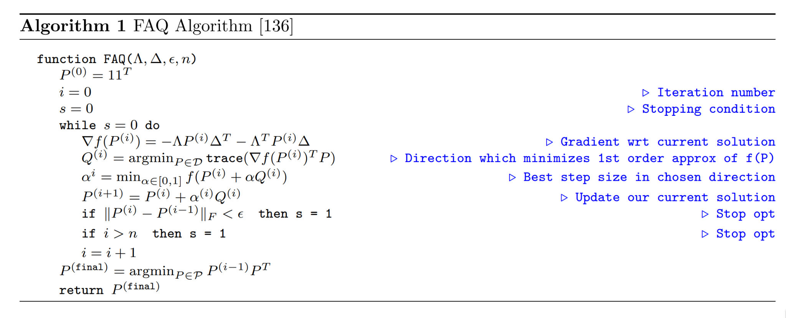
State-of-the-Art: LemonDrop¹
𝚲: Load Matrix, Δ: OWD Matrix, P: Permutation Matrix
D = ∑^{L}_{i,j=1}λ_{ij}d_{ij} , D(P) = trace(𝚲PΔ^{T}P^{T})
¹LemonDrop: https://searchworks.stanford.edu/view/14423035
Notes:
One work that addresses this is LemonDrop.
Lemondrop develops a Method for selecting VMs within a given cloud cluster optimized for an application’s latency needs.
Via this method, Lemondrop demonstrates that:
Virtual Machines (VMs) are not equally strong: “Lemons” or “Stragglers”
Virtual Machines (VMs) are not interchangeable
Algorithm:
Clock-Synchronization: Allows for accurate OWD delay latency across pairs of VMs within the entire cluster
Quadratic Assignment Problem Solver
Assign facilities to locations such that traffic flow between facilities is minimized
Nodes are facilities
VMs themselves are locations
QAP is NP-Hard
Approximate method to obtain locally optimal solution to a relaxed version of the problem is used:
FAQ:
Relaxes the constraint set P to the set of doubly stochastic matrices denoted as D
non-negative, rows and columns add to 1.
continuous optimization routine
final solution is projected to the closest point in P
Step-by-Step
scipy and scipy.optimize
Initialize Permutation matrix: P = np.ones((self.N, self.N)) / self.N
While Loop:
Gradient with respect to current solution
Q Direction that minimizes the gradient, and alpha step size to minimize gradient => steepest descent of objective
both done with `linear_sum_assignment` and `minimize_scalar`
Update Solution
If Current Solution has changed (Frobenius norm) beyond a threshold `epsilon`, stop
Frobenius norm is a way to establish the magnitude of the change between two matrices
if a change is smaller than a given threshold, we have likely found a local optimum
If max iterations ran, stop
Input:
Accurate OWD Measurements Matrix:
NxN
packets timestamped when sent
Median Delay
44Byte UDP Packets
Communication/Load Pattern/Matrix (Application Traffic Pattern)
LxL
captures the normalized number of requests made by node k to node l per unit of time.
padded with zeros to be NxN
Goal:
D = ∑^{L}_{i,j=1}λ_{ij}d_{ij}
HADAMARD PRODUCT OF OWD x LOAD
Mathematical Representation of the total time or more precisely “in-network” time it takes for requests to flow through the distributed application.
Minimize: D(P) = trace(𝚲PΔ^{T}P^{T})
P is the set of all possible permutation matrices
trace: the sum of diagonal elements
trace of hadamard product with permutation set:
summing up only elements where i=j, representing the product of load and delay for requests that start and end at the same VM.
aims to find the VM assignment that minimizes the total “in-network” time for self-communicating requests?
the diagonal is important because LemonDrop is primarily concerned with optimizing delays experienced by requests that start and stay within same VM?
these are requests that are directly affected by VM performance.
𝚲xP:
multiplies the LOAD matrix by permutation matrix
rearranges the rows of the LOAD matrix according to the assignment of service nodes to VMs
resulting matrix represents the LOAD between VMs after the assignment
(𝚲xP) x Δ^{T}
Multiplies the result by the transpose of the OWD matrix
calculating the product of load and delay for each pair of VMs
( (𝚲xP) x Δ^{T} ) x P^{T}
Multiplies again by the transpose of the permutation matrix
rearranging columns of the resulting matrix
aligning the results with the original service node ordering
trace()
sums up diagonal elements, representing the in-network time for requests that start and end at the same VM
Disproportionally robust for Jasper’s use case
Scalability Issues:
All-to-All Probe Mesh (2 min): N increases => Stress placed on VMs, Data Collection, Storing, Analyzing
Expensive
Not Scalable
Optimization Method
FAQ is O(n³)

Slide 53
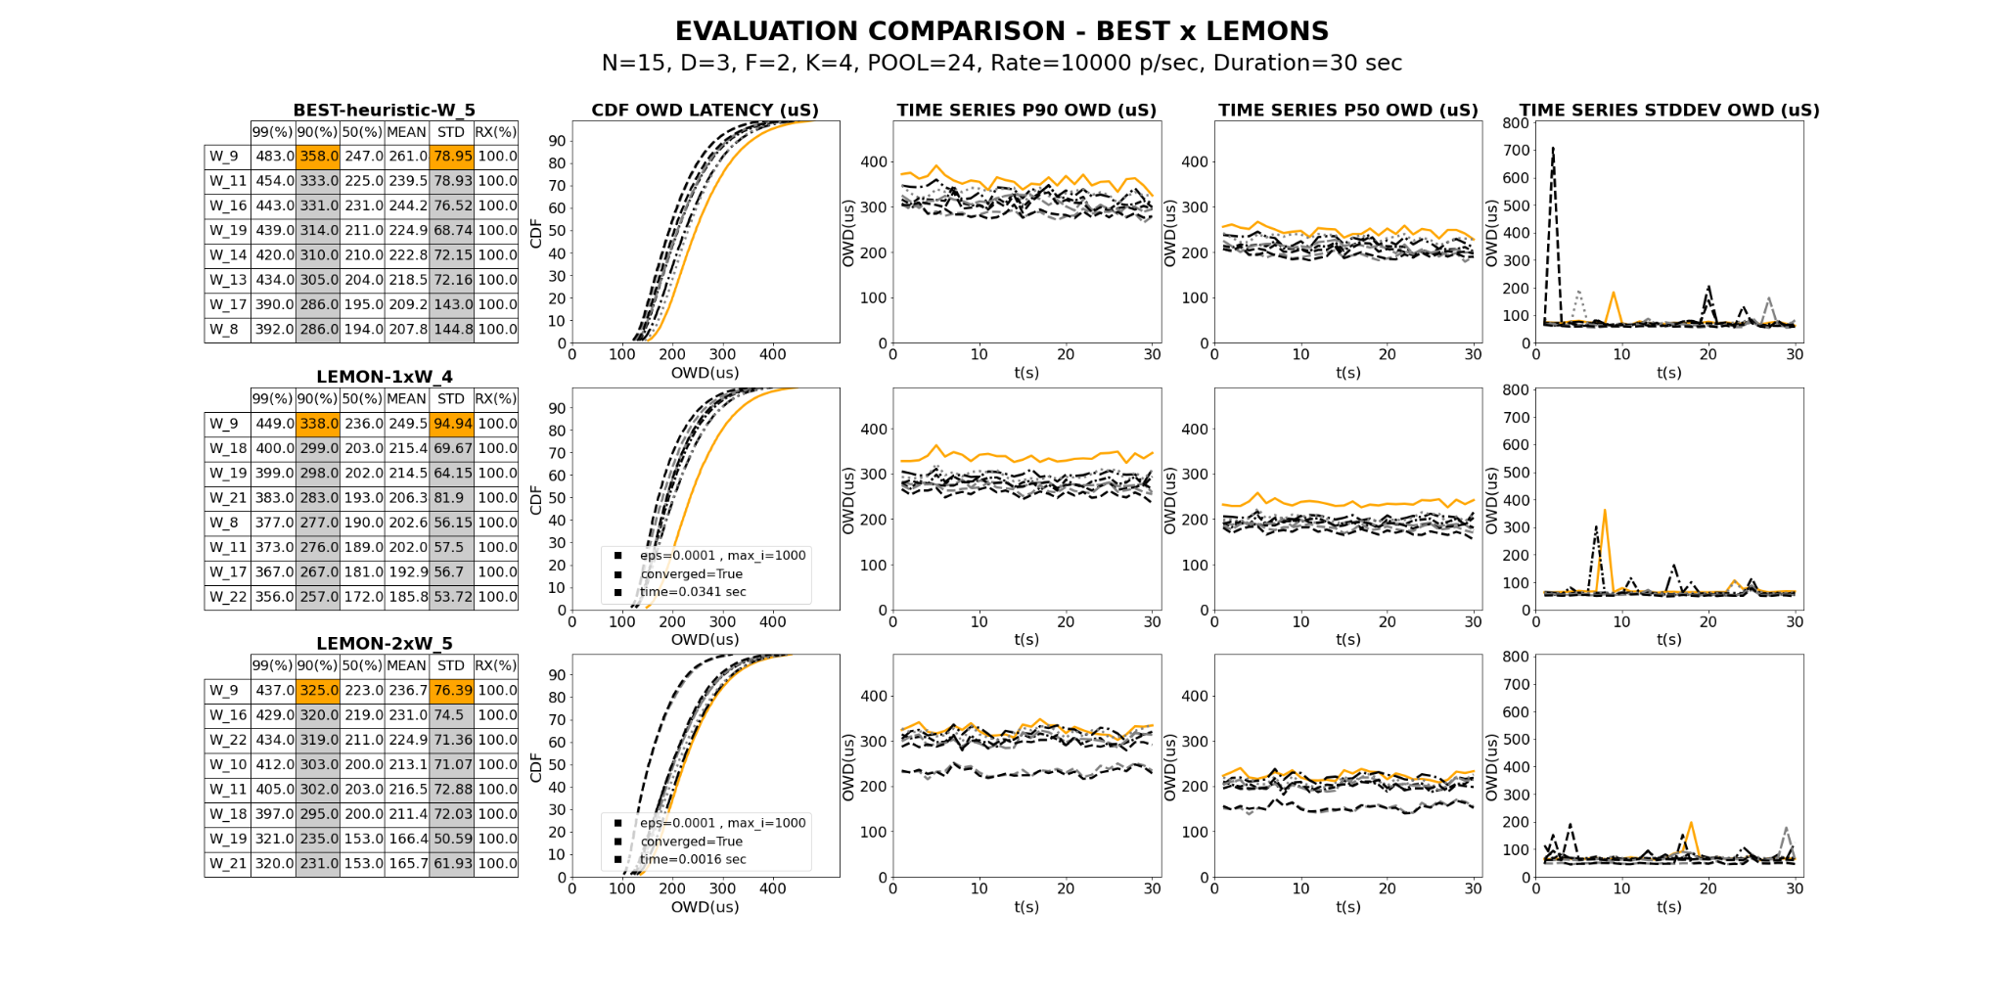
Results
- LemonDrop(Epsilon, MAX_I): Smaller Epsilon => Pickier Solution
- HEURISTIC shows comparable performance to LemonDrop => 358us vs 338us vs 325us
Notes:
Mention Hyperparameters (K, N): F as the final set of VMS chosen. (Be prepared for this!) Parameter K:
Time efficiency
Smaller computation
Make algorithm robust to different tree sizes!
Incremental Updates
Parallelism

Slide 54
Background: Jasper
10 Receivers
D | F | OML (μs)
1 | 10 | 66
2 | 4 | 88
100 Receivers
D | F | OML (μs)
1 | 100 | 351
2 | 10 | 139
3 | 5 | 141
1000 Receivers
D | F | OML (μs)
2 | 32 | 282
3 | 10 | 217
4 | 6 | 226
D = Log₁₀(N)
N = 100, D=2, F=10
N = 1000, D=3, F=10
Notes:
Larger D, more hops
Larger F, larger data replication delay
N at small scale, D does not bring many benefits.
N = 100, increasing D, while reducing F, reduced message replication delay/transmission delay outweigh new hops!
N = 1000, if D is larger than 3, Latency does not improve and may worsen
Empirically fixed F=10 and deduced D from the log equation

Slide 55

Results
Notes:
Mention Hyperparameters (K, N): F as the final set of VMS chosen. (Be prepared for this!) Parameter K:
Time efficiency
Smaller computation
Make algorithm robust to different tree sizes!
Incremental Updates
Parallelism

Slide 56

Results
- Simple quick selection seems to at least prune bad VMs
Notes:
Mention Hyperparameters (K, N): F as the final set of VMS chosen. (Be prepared for this!) Parameter K:
Time efficiency
Smaller computation
Make algorithm robust to different tree sizes!
Incremental Updates
Parallelism

Slide 57

Results
- Simple quick selection seems to at least prune bad VMs
Notes:
Mention Hyperparameters (K, N): F as the final set of VMS chosen. (Be prepared for this!) Parameter K:
Time efficiency
Smaller computation
Make algorithm robust to different tree sizes!
Incremental Updates
Parallelism

Slide 58

Results
- Simple quick selection seems to at least prune bad VMs
Notes:
Mention Hyperparameters (K, N): F as the final set of VMS chosen. (Be prepared for this!) Parameter K:
Time efficiency
Smaller computation
Make algorithm robust to different tree sizes!
Incremental Updates
Parallelism

Slide 59

Results
- Simple quick selection seems to at least prune bad VMs
Notes:
Mention Hyperparameters (K, N): F as the final set of VMS chosen. (Be prepared for this!) Parameter K:
Time efficiency
Smaller computation
Make algorithm robust to different tree sizes!
Incremental Updates
Parallelism

Slide 60

Results
- Simple quick selection seems to at least prune bad VMs
Notes:
Mention Hyperparameters (K, N): F as the final set of VMS chosen. (Be prepared for this!) Parameter K:
Time efficiency
Smaller computation
Make algorithm robust to different tree sizes!
Incremental Updates
Parallelism

Slide 61

Results
- Simple quick selection seems to at least prune bad VMs
Notes:
Mention Hyperparameters (K, N): F as the final set of VMS chosen. (Be prepared for this!) Parameter K:
Time efficiency
Smaller computation
Make algorithm robust to different tree sizes!
Incremental Updates
Parallelism

Slide 62

Results
- Smaller epsilon: negligible performance enhancement & too long to converge
Notes:
Mention Hyperparameters (K, N): F as the final set of VMS chosen. (Be prepared for this!) Parameter K:
Time efficiency
Smaller computation
Make algorithm robust to different tree sizes!
Incremental Updates
Parallelism

Slide 63

Results
Notes:
Mention Hyperparameters (K, N): F as the final set of VMS chosen. (Be prepared for this!) Parameter K:
Time efficiency
Smaller computation
Make algorithm robust to different tree sizes!
Incremental Updates
Parallelism

Slide 64

Results
Notes:
Mention Hyperparameters (K, N): F as the final set of VMS chosen. (Be prepared for this!) Parameter K:
Time efficiency
Smaller computation
Make algorithm robust to different tree sizes!
Incremental Updates
Parallelism

Slide 65

Results
Notes:
Mention Hyperparameters (K, N): F as the final set of VMS chosen. (Be prepared for this!) Parameter K:
Time efficiency
Smaller computation
Make algorithm robust to different tree sizes!
Incremental Updates
Parallelism

Slide 66

Results
Notes:
Mention Hyperparameters (K, N): F as the final set of VMS chosen. (Be prepared for this!) Parameter K:
Time efficiency
Smaller computation
Make algorithm robust to different tree sizes!
Incremental Updates
Parallelism

Slide 67

Results
Notes:
Mention Hyperparameters (K, N): F as the final set of VMS chosen. (Be prepared for this!) Parameter K:
Time efficiency
Smaller computation
Make algorithm robust to different tree sizes!
Incremental Updates
Parallelism

Slide 68

Results
Notes:
Mention Hyperparameters (K, N): F as the final set of VMS chosen. (Be prepared for this!) Parameter K:
Time efficiency
Smaller computation
Make algorithm robust to different tree sizes!
Incremental Updates
Parallelism

Slide 69

Results
- Multiple runs perform similarly
Notes:
Mention Hyperparameters (K, N): F as the final set of VMS chosen. (Be prepared for this!) Parameter K:
Time efficiency
Smaller computation
Make algorithm robust to different tree sizes!
Incremental Updates
Parallelism

Slide 70

Results
- REBUILD on leaf layers provide inconsistent performance gains
Notes:
Mention Hyperparameters (K, N): F as the final set of VMS chosen. (Be prepared for this!) Parameter K:
Time efficiency
Smaller computation
Make algorithm robust to different tree sizes!
Incremental Updates
Parallelism

Slide 71

Results
- REBUILD on leaf layers provide inconsistent performance gains
Notes:
Mention Hyperparameters (K, N): F as the final set of VMS chosen. (Be prepared for this!) Parameter K:
Time efficiency
Smaller computation
Make algorithm robust to different tree sizes!
Incremental Updates
Parallelism

Slide 72
Figures 1

Slide 73
Figures 1

